Slide 1
Exploring the Foundations of Artificial Intelligence in Secondary Education
A Workshop-Based Study
Keller, Kandlhofer, and Steinbauer-Wagner
Notes:
Duration: 1 minute
- Introduce yourself and your affiliation
- Mention that this presentation covers a study on AI literacy for secondary school teachers
- Acknowledge the authors of the original paper

Slide 2

Research Context & Motivation
AI's growing impact on society
Critical need for AI literacy among young students
Challenges
  technical knowledge
  contextual understanding
  ethical considerations
Gap between rapid AI advancement and teacher preparedness
Teachers are essential for a strong AI understanding of students
Notes:
Duration: 2 minutes
- Emphasize how AI is transforming education and daily life
Only recently EU has published the AI Literacy framework (following several others, like Unesco, ai4k12, etc)
- Highlight that teachers need both technical and ethical understanding
- Stress the gap between AI advancement and teacher preparation
- Emphasize teachers' role in shaping students' understanding of AI

Slide 3

ENARIS teaching materials & workshops
Goal: increase interest and understanding of artificial intelligence through playful, interactive approaches.
Target group: lower secondary school students (10-14yo)
free accessible ready-to-use materials
  Topic based modules
  Clear learning objectives
  Agenda, slides, (un)plugged exercises
Offer interactive workshops to classes and teachers
https://enaris.org/
Notes:
What is Enaris?
- European Union Interreg Project with Austria and Hungary
- 10 Modules for different AI topics, like computer vision, reinforcement learning, neural networks,
- We conduct these workshops over the last few years

Slide 4
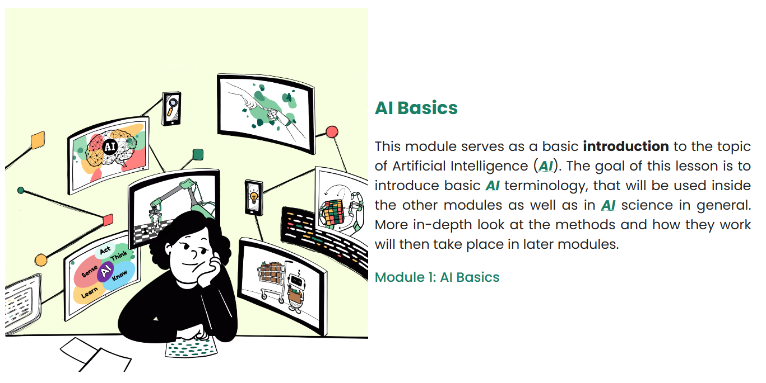
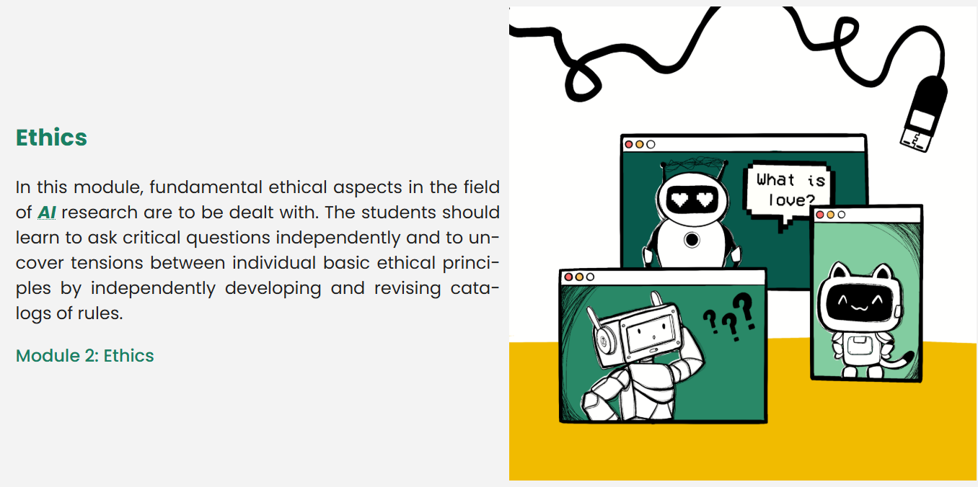
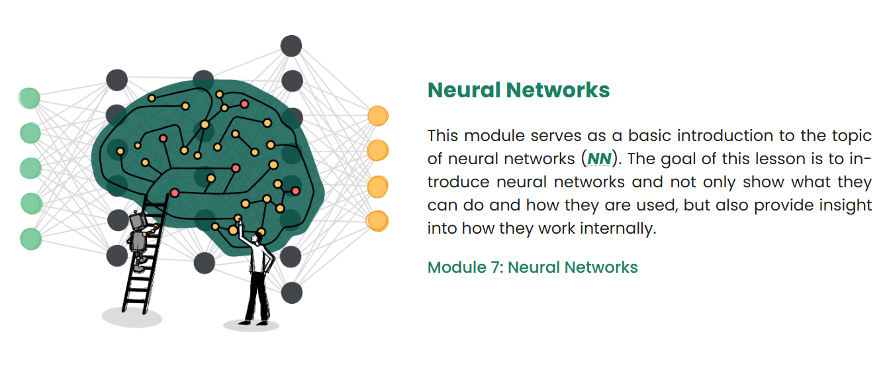
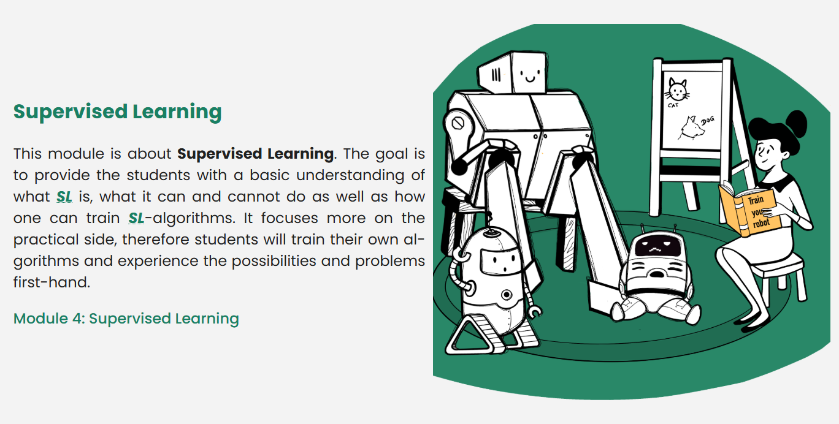
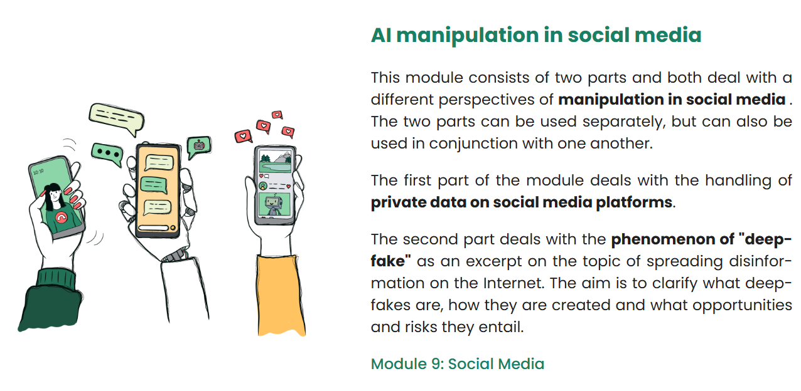
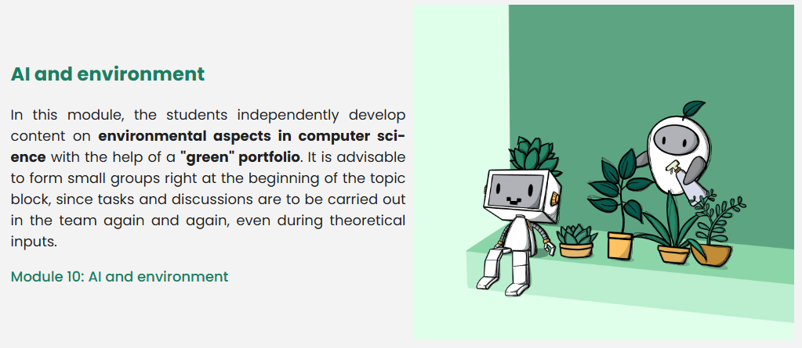
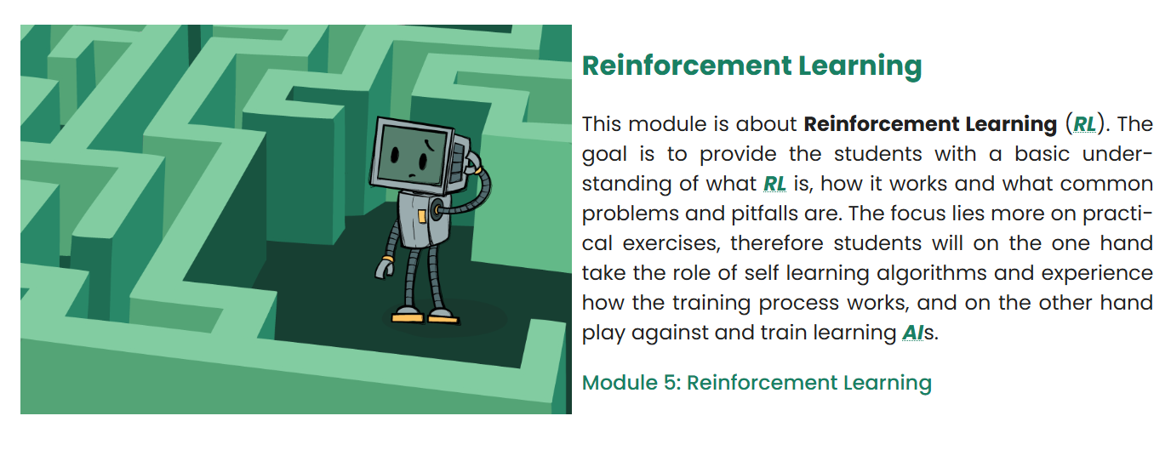
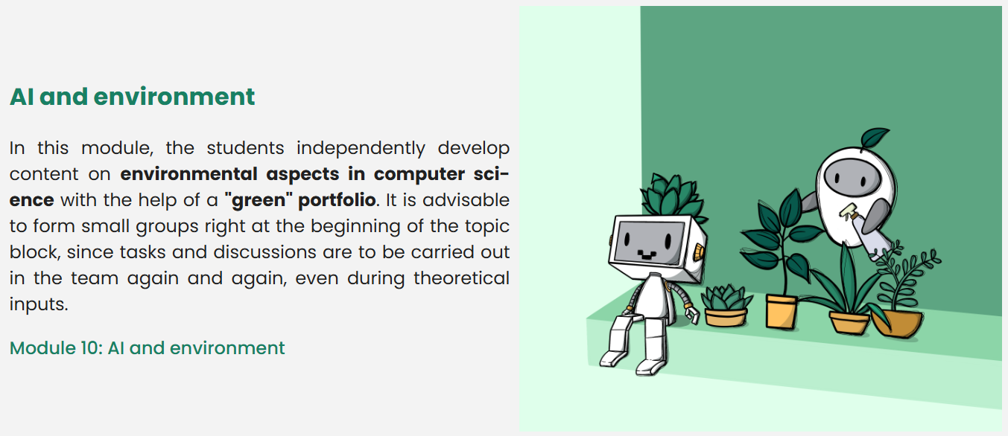
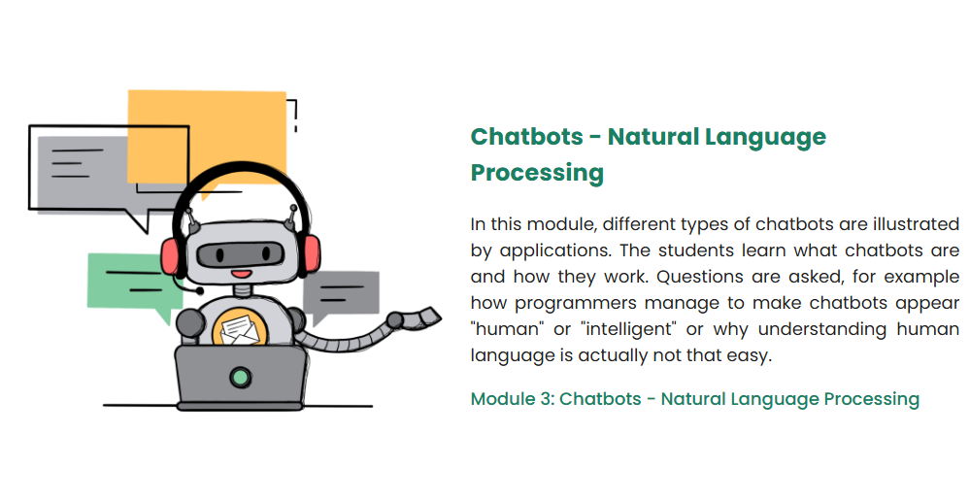
ENARIS Modules
Notes:
Ethics – critical
These Modules are freely available on enaris.org and ready-to-use
(Bridge) - In this study we want to get more insights on the perception on the teacher side during a workshop.
Further what is the impact of such a workshop.

Slide 5
Research Questions
How effectively can secondary school teachers acquire foundational AI knowledge in a 3-hour workshop?
How do teachers link technical AI knowledge to broader ethical considerations?
What challenges and opportunities do teachers identify when introducing AI topics?
What are teachers' perspectives on fostering critical thinking about AI among students?
Notes:
Duration: 1 minute
- Read each research question clearly
- Emphasize that the study addresses both technical knowledge acquisition and ethical understanding
- Note that the study examines both challenges and opportunities

Slide 6
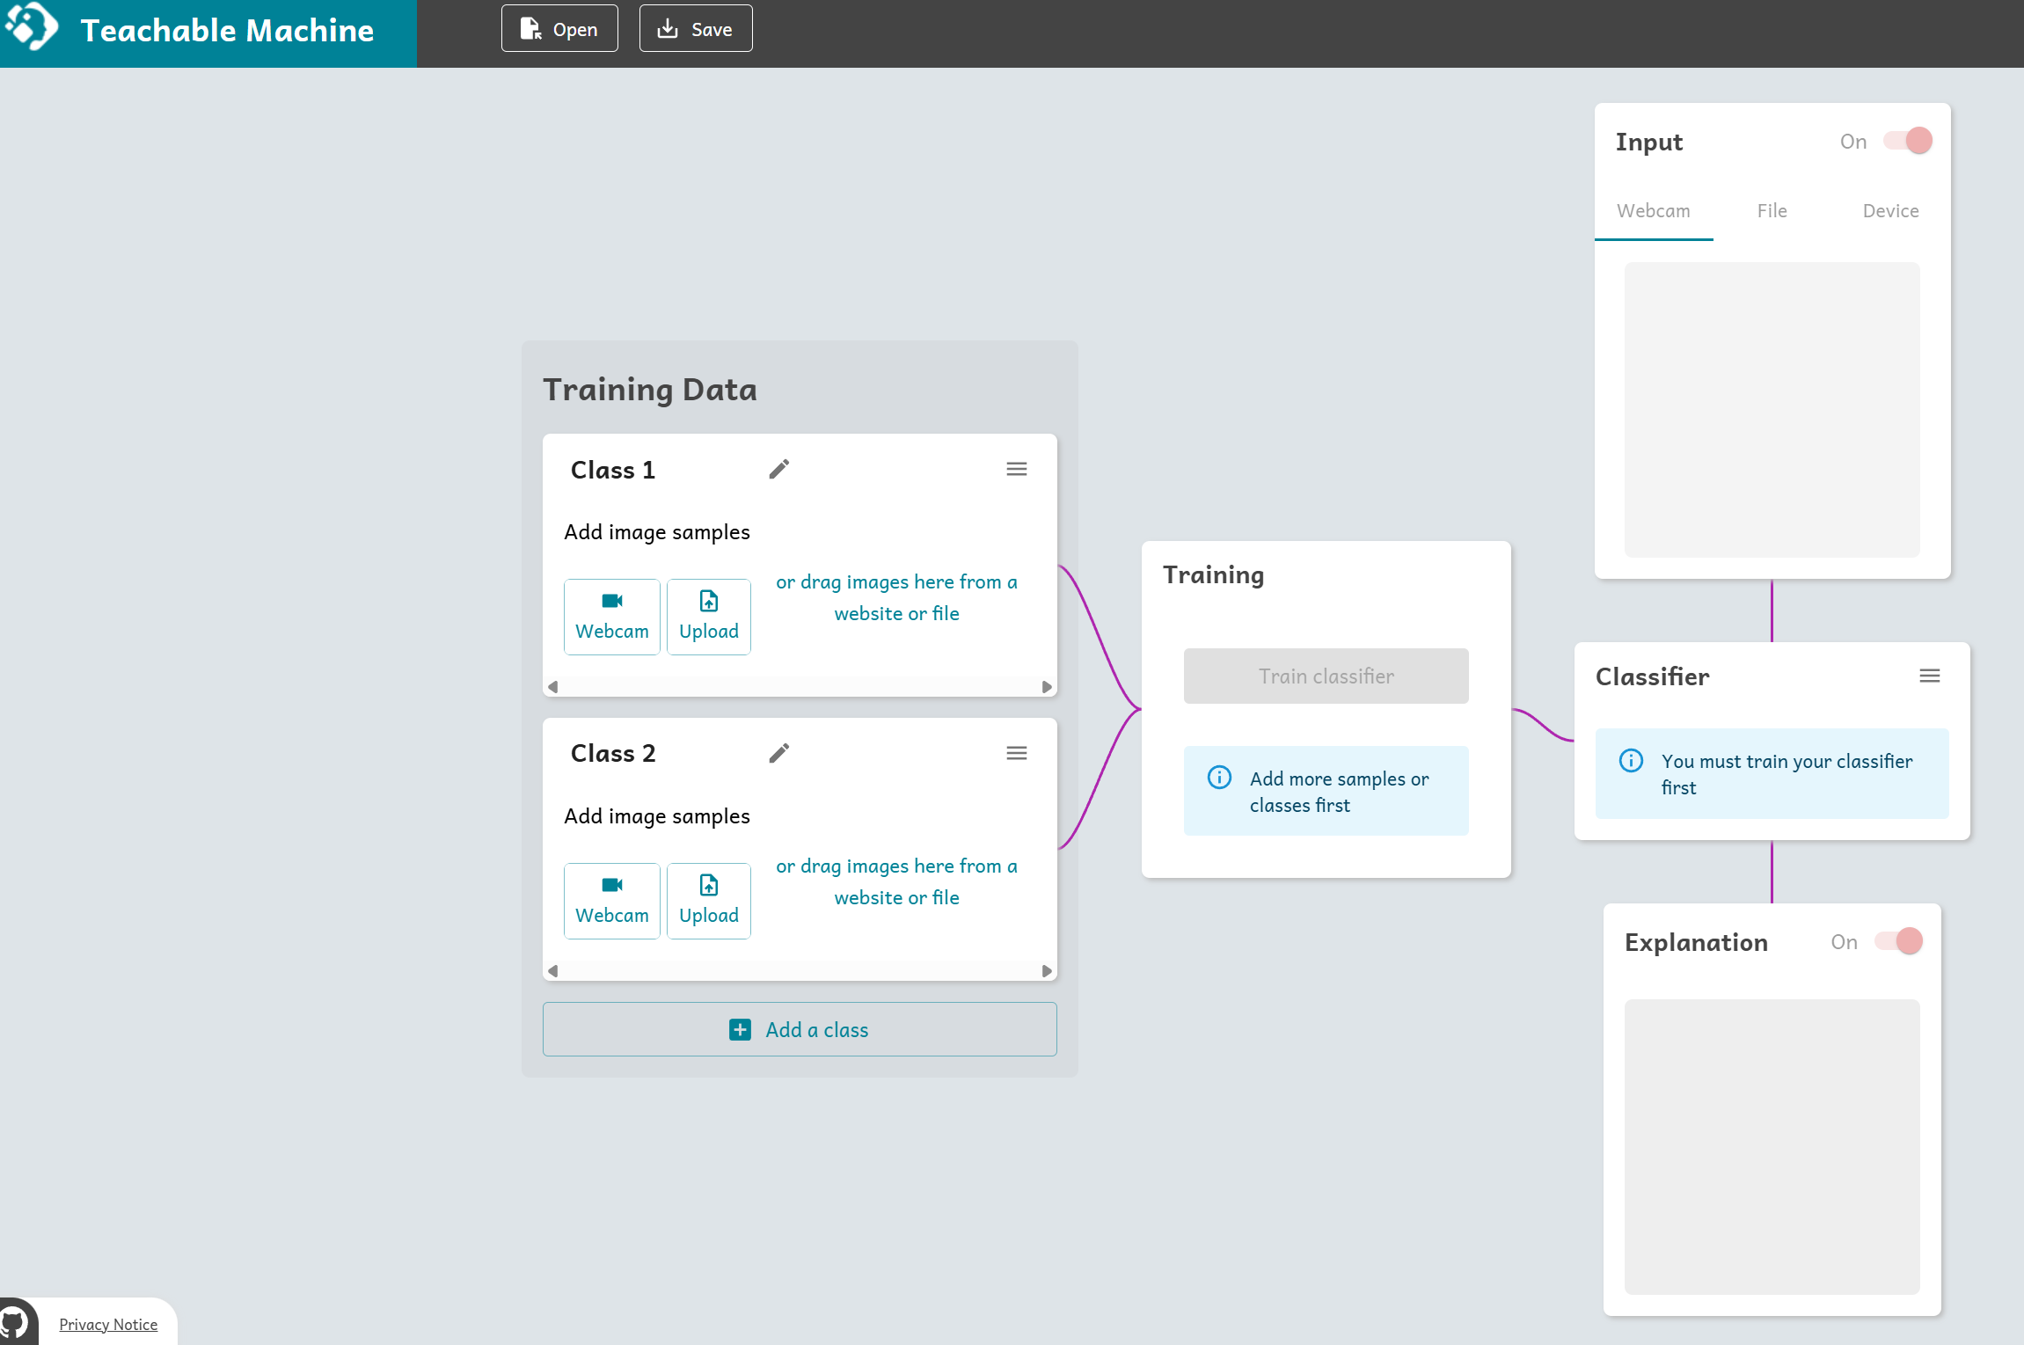
Workshop Design & Methodology
Participants:
  18 secondary school teachers (mainly CS teachers)
Duration:
  3-hour workshop based on ENARIS project modules
Four Module Structure:
  AI Basics
  Supervised Learning
  Computer Vision
  AI Ethics & discussion
Assessment:
  Pre/post questionnaires (Likert scales + free-text)
Screenshot of https://tm.gen-ai.fi/
Notes:
Duration: 2.5 minutes
- Describe the participant demographics (18 teachers, mainly CS)
- Explain the ENARIS workshop structure and its four modules in detail
AI Basics (definition of intelligence, interactive 'Map of AI,' Tic-Tac-Toe exercise)
Supervised Learning ('Teachable Machine' hands-on demo)
Computer Vision (feature detection)
AI Ethics (real-world bias discussion)
- Highlight the hands-on, interactive nature of the activities
- Explain the mixed-methods assessment approach

Slide 7
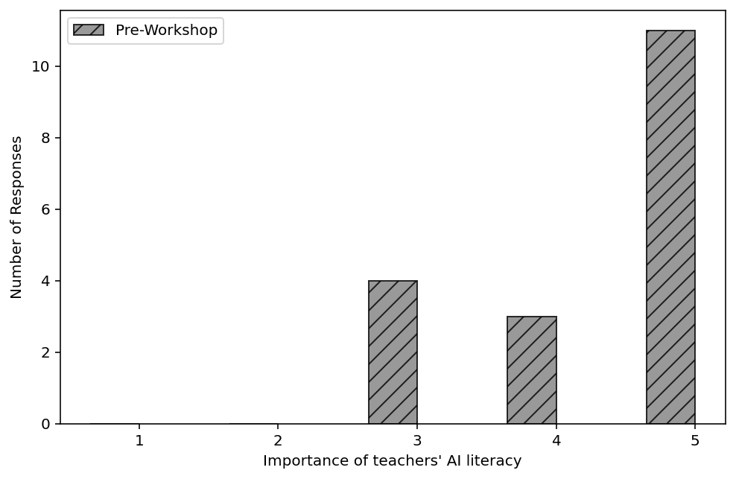
Baseline Findings (Pre-Workshop)
Before Workshop:
  AI knowledge: moderate (2-3 out of 5)
  Ethics familiarity: low (around 2 out of 5)
  Importance of AI literacy: very high consensus
Identified Opportunities:
  Critical thinking, problem-solving, learning efficiency
Identified Challenges:
  Rapid tech change
  student understanding gaps
  ethical concerns
Notes:
Duration: 1.5 minutes
- Present the initial self-assessment results
- Highlight that teachers recognized AI literacy importance despite limited knowledge
- Discuss the opportunities teachers identified before the workshop
- Explain the challenges they anticipated

Slide 8
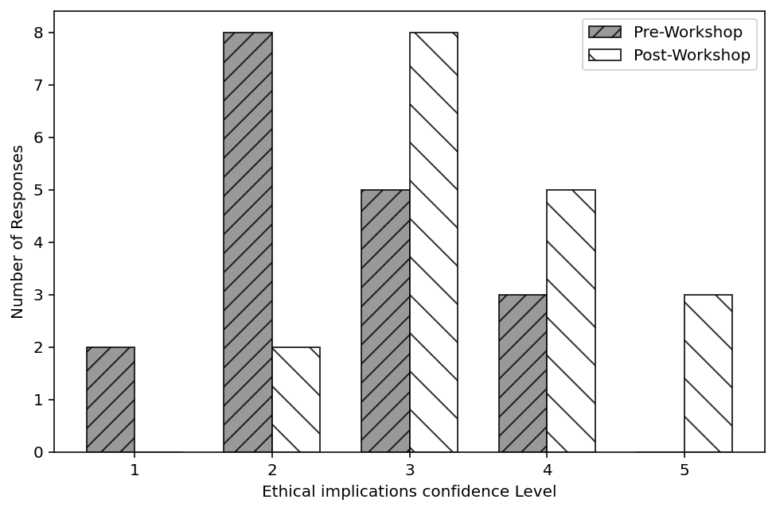
Key Results: Knowledge & Confidence Gains
Knowledge Improvement:
  Self-assessed AI understanding increased to 3-4 out of 5
Ethics Confidence:
  Improved ability to discuss AI ethics in classroom
Practical Integration Plans:
  Hands-on activities and supervised learning tools
  'Teachable Machine' implementation
  AI-generated content for critical analysis
Preparedness:
  All participants felt better equipped post-workshop
Notes:
Duration: 2.5 minutes
- Present the improvement in self-assessed AI knowledge
- Highlight increased confidence in discussing ethical implications
- Describe specific integration plans teachers developed
- Emphasize that all participants felt better prepared after the workshop

Slide 9
Study Limitations
Sample Size:
  18 participants
Self-Selection Bias:
  Voluntary participation (likely AI-interested teachers)
Time Constraints:
  Limited depth of assessment (3-hour workshop)
Demographics:
  No age/background data collected
Generalizability:
  Results may not represent broader teacher population
Notes:
Duration: 1.5 minutes
- Acknowledge the small sample size as a limitation
- Explain the potential self-selection bias
- Discuss time constraints of the workshop format
- Note the lack of demographic data
- Address generalizability concerns

Slide 10
Conclusions & Implications
Key Finding:
  Short, hands-on workshops can significantly boost teacher AI confidence
Dual Focus Success:
  Technical + ethical AI literacy approach works
Teacher Recognition:
  Strong awareness of AI literacy importance
Need for Ongoing Support:
  Continuous professional development essential
Future Directions:
  Larger studies, long-term impact assessment, specialized programs
Notes:
Duration: 2 minutes
- Emphasize that even short workshops can be effective
- Highlight the success of combining technical and ethical focus
- Stress that teachers recognize the importance of AI literacy
- Discuss the need for ongoing professional development
- Suggest directions for future research

Slide 11
Practical Takeaways & Questions
For Educators:
  Hands-on interactive workshops are effective
For Policymakers:
  Invest in teacher AI professional development
For Researchers:
  Scale up studies, track long-term impact
Questions & Discussion
Notes:
Duration: 1 minute
- Summarize key takeaways for different stakeholders
- Invite questions from the audience
- Be prepared to discuss implementation strategies
- Have additional details ready if asked about specific workshop activities

