Slide 1
A new chemoenzymatic route from carboxylic acids to nitriles

Slide 2
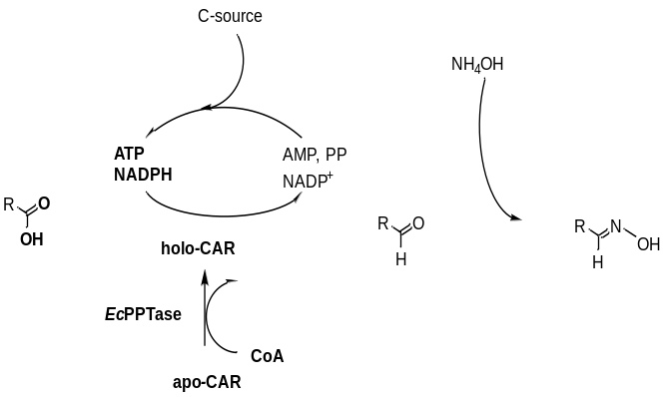
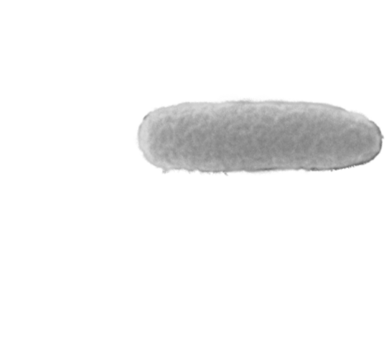
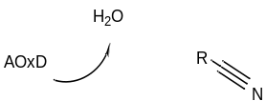
Overview
Introduction (Nitrile-Project)- Victoria
  Overview
  Substrate scope + analytics
Aim 1: Carboxylic acid to oxime- Victoria
  CAR screening C4, C5, C6, 3-PPA
  Summary
  In situ oxime formation
Aim 2: Oxime to nitrile- Melissa
  Expression of all Oxds
  Substrate scope: direct comparison with literature-known
  Time course of C6, PAOx, VanOx
  Expression additives
  OxdNh variants
Aim 3: Acid to nitrile- Melissa
  PAA to nitrile
  Cascades
  Summary
Outlook- Melissa
E. coli RARE
E. coli BL21
June 1st 2021

Slide 3
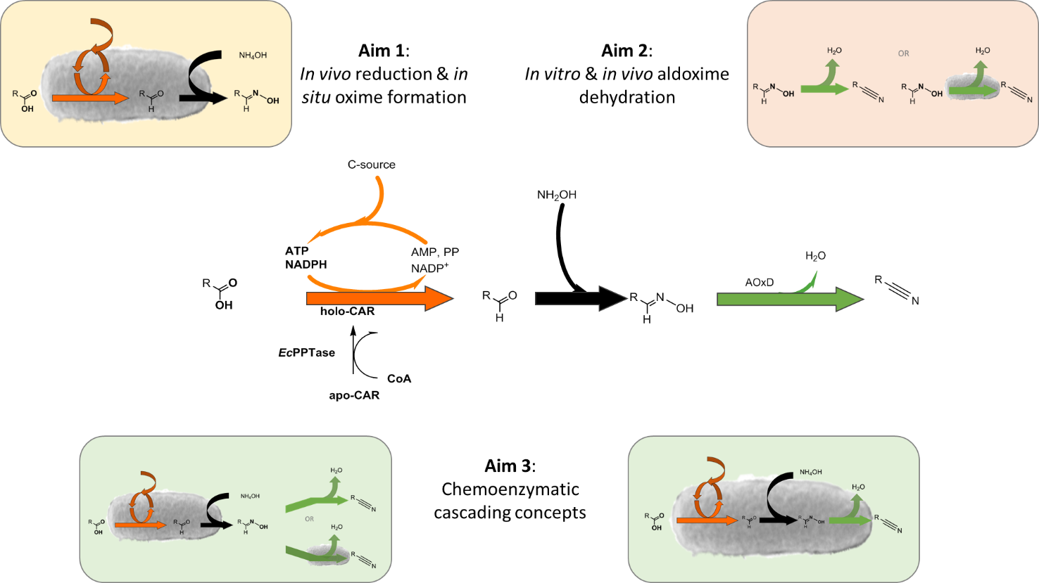
1. Overview

Slide 4
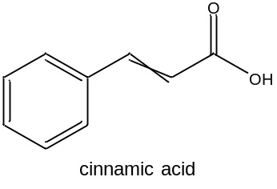
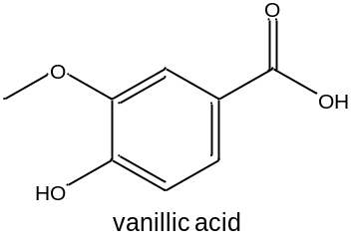
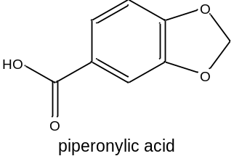

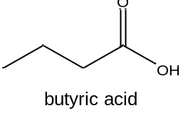
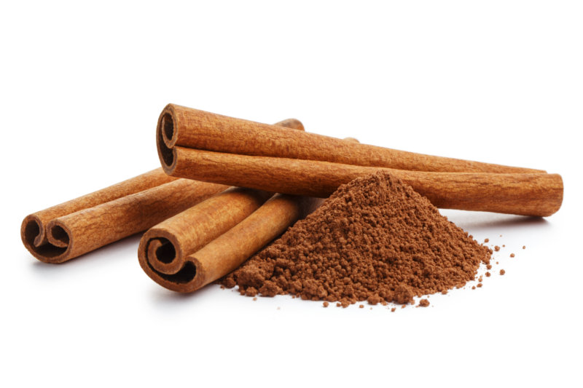
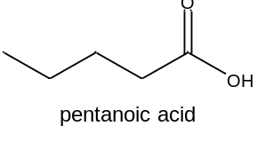
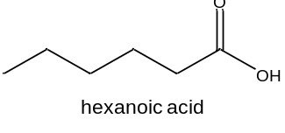

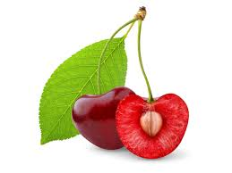

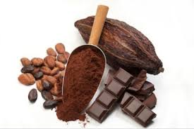

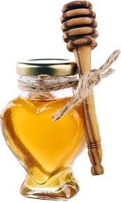

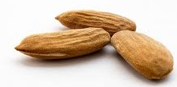
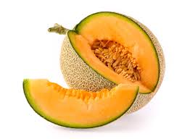
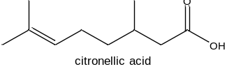

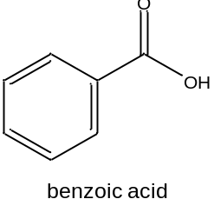
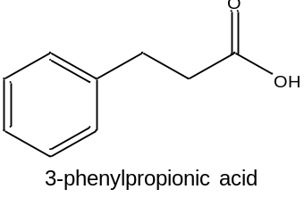
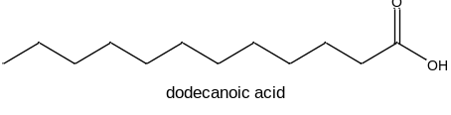
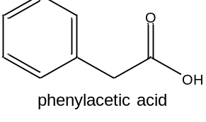
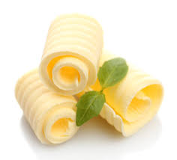
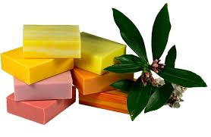
1. Substrate scope to be explored

Slide 5
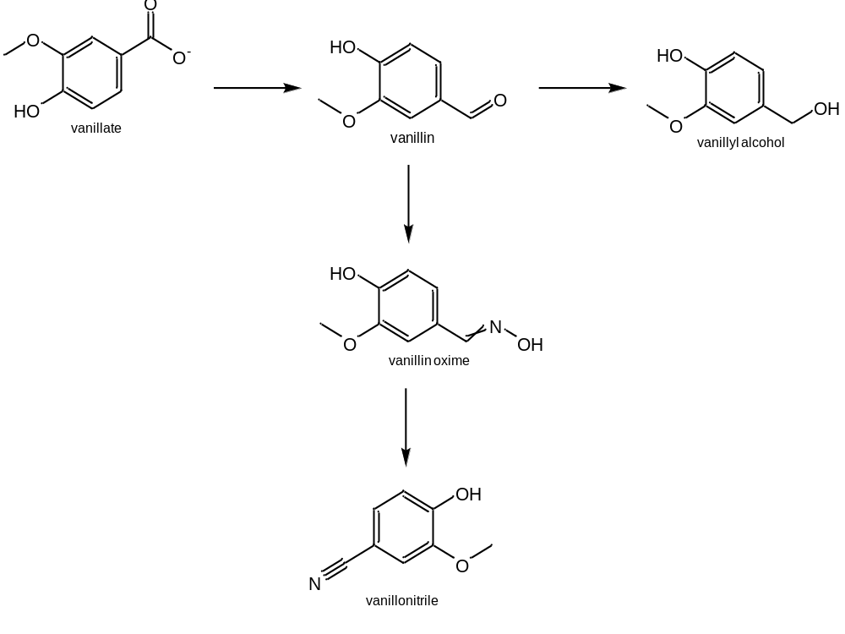
1. Introduction
CAR
ADHs/ADRs
(CooH)
(COH)
(OH)
NH₂OH
(NOH)
Oxd
E. coli RARE
E. coli BL21
(CN)
1 cascade, 5 compounds for analysis
Oximes: E/Z → 6 peaks expected

Slide 6
1. Analytics
No. | compound | HPLC-UV analysis | GC-FID method | cascade | Derivatization (TMS-diazomethane) | Seperate CAR and Oxd rxn | IS
1 | Citronellyl | No oxime and no nitrile commercially availble
2 | C4 |  | Butyric acid_hydroxylamine | no | no | Yes (OH/CN peaks) | n-tetradecane
3 | C5 |  | Valeric acid_hydroxylamine | yes | no |  | n-heptane in n-hexadecane
4 | C6 |  | Hexanoic acid_hydroxylamine1 | yes | recommended |  | n-tetradecane
5 | C12 |  | C12_hydroxylamine | yes | recommended |  | n-tetradecane
6 | Benzoic |  | Benzoic acid_hydroxylamine | yes | no |  | n-tetradecane
7 | PAA | DSC_cinnamic acid | Benzoic acid_hydroxylamine | yes | recommended |  | n-tetradecane
8 | 3-PPA |  | 3-PPO_hydroxylamine2 | no | no | Yes (OH/CN peaks) | n-tetradecane
9 | Cinnamic | DSC_cinnamic acid | Benzoic acid_hydroxylamine | possible | yes | OH/CN peak quite close | n-tetradecane
10 | Piperonylic | DSC_cinnamic acid | Piperonylic acid_hydroxylamine2 | no | no | yes (OH/CN peaks) | n-heptane
11 | Vanillic | MHO_van210223 | Piperonylic acid_hydroxylamine2 | no | no | yes (OH/CN peaks) | n-heptane

Slide 7
Overview
Introduction (Nitrile-Project)- Victoria
  Overview
  Substrate scope + analytics
Aim 1: Carboxylic acid to oxime- Victoria
  CAR screening C4, C5, C6, 3-PPA
  Summary
  In situ oxime formation
Aim 2: Oxime to nitrile- Melissa
  Expression of all Oxds
  Substrate scope: direct comparison with literature-known
  Time course of C6, PAOx, VanOx
  Expression additives
  OxdNh variants
Aim 3: Acid to nitrile- Melissa
  PAA to nitrile
  Cascades
  Summary
Outlook- Melissa
E. coli RARE
E. coli BL21
June 1st 2021

Slide 8
2. CAR screening of carboxylic acids
  Screening of 24 CARs towards substrates to find best variants for oxime formation - bioconversions:
    400µl scale (DWP), OD 15,
    100 mM glucose, 71 mM MgSO₄, 0.3 M HEPES buffer, pH 7.5
    20 mM substrate (acid) and 30 mM NH₂OH (1:1.5) used
    4.5 h incubation 28°C, 320 rpm
    NH₂OH added at beginning and reaction stopped after 4.5 h
    Extraction with EE+0.01% IS
    Detection of oximes with GC-FID
E. coli RARE
June 1st 2021

Slide 9
2. CAR Screening of C4 in n-heptane
15 OD units
300 mM HEPES, pH 7.5
20mM substrate in n-heptane phase
3.5 h, 28°C
30 mM NH2OH
4.5 h at 28°C
E. coli RARE
June 1st 2021

Slide 10
2. CAR Screening of C5 in n-hexadecane
15 OD units
300 mM HEPES, pH 7.5
20mM substrate in n-heptane phase
3.5 h, 28°C
30 mM NH2OH
4.5 h at 28°C
E. coli RARE
June 1st 2021

Slide 11
2. CAR Screening of C6 in n-heptane
15 OD units
300 mM HEPES, pH 7.5
20mM substrate in n-heptane phase
3.5 h, 28°C
30 mM NH2OH
4.5 h at 28°C
E. coli RARE
June 1st 2021

Slide 12
2. CAR Screening of 3-PPA in n-heptane
15 OD units
300 mM HEPES, pH 7.5
20mM substrate in n-heptane phase
3.5 h, 28°C
30 mM NH2OH
4.5 h at 28°C
E. coli RARE
June 1st 2021

Slide 13
2. Aim 1- Carboxylic acid to oxime:
Summary
No. | Substrate | 1st CAR* | 2nd CAR* | 3rd CAR*
2 | C4 | Ni Q283P | Mm V1 | Mm M985L
3 | C5 | Nc | Ni Q283P | Tt
4 | C6 | Nc M22 | Mm M985L | Mm I303W
5 | C12 | Not possible in cascade
6 | Benzoic | Mm V2 | Nc M29 | Nc M6
7 | PAA | Mm M150 | Mm F1 | Tv
8 | 3-PPA | Mm M985L | Mm F1 | Nc M18
9 | cinnamic | Mm F1 | Mm M150 | Nc M33
10 | Piperonylic acid | In progress
11 | Vanillic | Mm I303W | Mm V1 | Mm V3
* Screenings were ordered via substrate decrease.
E. coli RARE
June 1st 2021

Slide 14
2. In situ oxime formation
15 OD units
300 mM HEPES, pH 7.5
20mM substrate in n-heptane phase
3.5 h, 28°C
10-60 mM NH2OH for 4.5 h at 28°C
Most oxime formed with 1:3 excess NH₂OH.
E. coli RARE
June 1st 2021

Slide 15
Overview
Introduction (Nitrile-Project)- Victoria
  Overview
  Substrate scope + analytics
Aim 1: Carboxylic acid to oxime- Victoria
  CAR screening C4, C5, C6, 3-PPA
  Summary
  In situ oxime formation
Aim 2: Oxime to nitrile- Melissa
  Expression of all Oxds
  Substrate scope: direct comparison with literature-known
  Time course of C6, PAOx, VanOx
  Expression additives
  OxdNh variants
Aim 3: Acid to nitrile- Melissa
  PAA to nitrile
  Cascades
  Summary
Outlook- Melissa
E. coli RARE
E. coli BL21
June 1st 2021

Slide 16

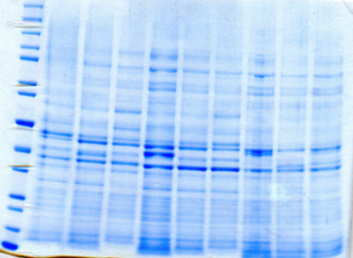
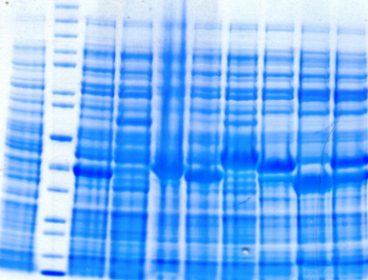
3. Expression in E.coli BL21
E. coli BL21
E. coli BL21* (DE3) pET28a:Oxds (soluble)
E. coli BL21* (DE3) pET28a:Oxds (insoluble)
200
150
120
100
85
70
60
50
40
30
25
20
15
10
200
150
120
100
85
70
60
50
40
30
25
20
15
10
Std EVC Br1 Br2 Cp Nh Tv RG RE FG
EVC Std Br1 Br2 Cp Nh Tv RG RE FG
Expression: 200mL
2xYT
1m M IPTG
30°C/16°C for 24 h
Oxds
 | OxdBr1 | OxdBr2 | OxdCp | OxdNh | OxdTv | OxdRG | OxdRE | OxdFG
Organism | Bradyrhizobium sp. LTSPM299 | Bradyrhizobium sp. WSM1253 | Corynebacterium sp. Marseille-P2417 | Nectria haematococca mpVI 77-13-4 (Fusarium vanettenii 77-13-4) | Trichoderma virens Gv29-8 | Rhodococcus globerulus A-4 | Rhodo-coccus sp. N-771 | Fusarium graminearum MAFF305135
Accession Nr. | WP_044589203 | WP_007594278.1 | WP_080796375.1 | XP_003042958.1 | XP_013960347.1 | BAC99076.1 | AB094201 | AACM01000259
size [kDa] | 38.5 | 40 | 40 | 38.9 | 44.4 | 42 | 44.7/80 | 31/44
June 1st 2021
Meeting IMIC & TUG & TU Wien

Slide 17
3. Direct comparison: Oxds
E. coli BL21
No conversion with dodecanal oxime (C12)
Poor conversion: vanillin oxime, cinnamaldehyde oxime
Good conversion: 3-PPO
Well accepted substrates: PAOx, benzaldehyde oxime, C4, C5, C6
10 OD units
300 mM HEPES, pH 7.5
10mM substrate in DMSO with n-heptane
1 h, 28°C
June 1st 2021
Meeting IMIC & TUG & TU Wien

Slide 18
3. Time curves of OxdBr1
E. coli BL21
Within 30 mins conversion complete with good substrates.
Vanillin oxime: 15% conversion after ON incubation.
10 OD of E.coli BL21star (DE3) pET28a:OxdBr1
300 mM HEPES, pH 7.5
28°C, 0-16.5 h
C6 +PAOx in n-heptane (biphasic)
Van (single phase, Eppendorf tubes, 900 rpm)
June 1st 2021
Meeting IMIC & TUG & TU Wien

Slide 19
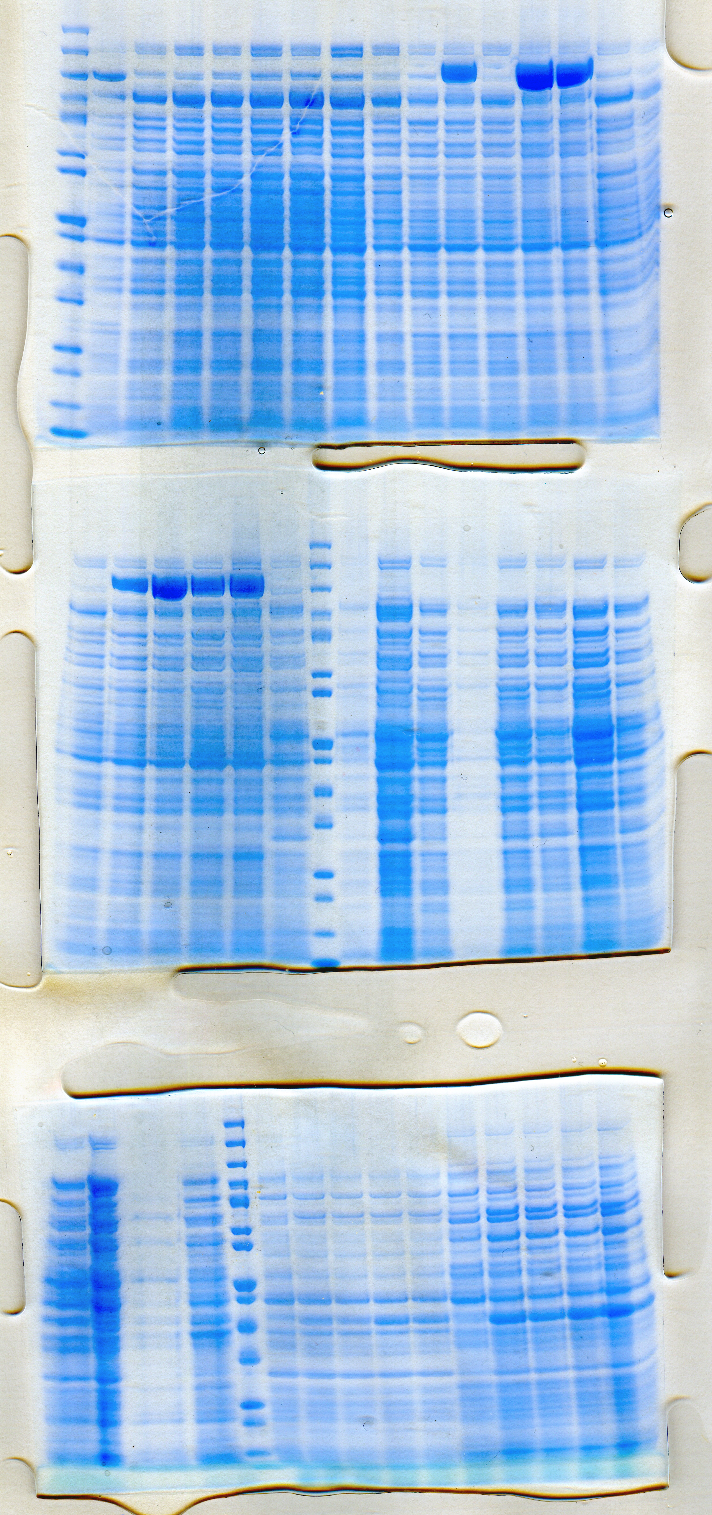
3. Oxd Expression additives
E. coli BL21
2xYT media, 1 mM IPTG, 37/20°C, 50 mL cultivation
- additional either trace salts, 0.5 mM aminolevulinic acid (ALA) or both
2.0-fold increase in activity with addition of AL.
Slight increase in soluble expression.
5 OD of E.coli BL21star (DE3) pET28a:OxdBr1
300 mM HEPES, pH 7.5, 900 rpm
28°C, 24 h
20 mM vanillic acid
June 1st 2021

Slide 20

3. OxdNh variants
E. coli BL21
Multiple sequence alignment to identify potentially conserved amino acid patterns of Oxds with Clustal Omega
3D structural alignment with Phyre² model and structure of OxdA
Variants of active site, substrate channel
and key residues
June 1st 2021

Slide 21
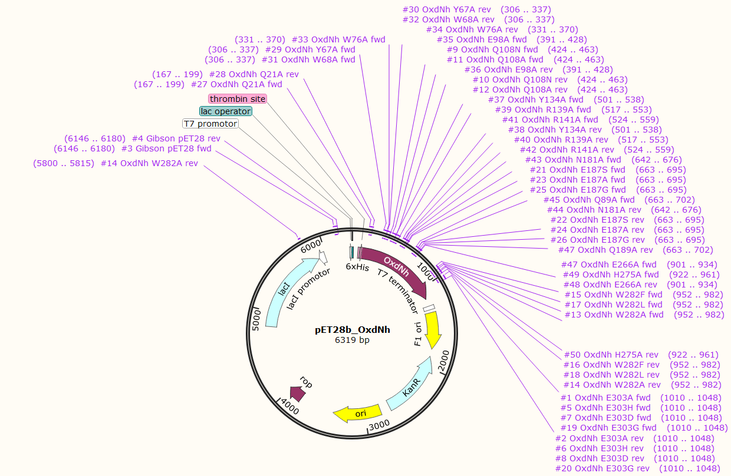
3. Cloning of OxdNh variants
E. coli BL21
Design and cloning of OxdNh alanine and active site variants (pET28b:OxdNh)
No. | OxdNh variant | alanine scan | active site | substrate channel | sequencing
1 | E303A |  | y
2 | E303H |  | y
3 | E303D |  | y
4 | Q108N |  | y
5 | Q108A |  | y
6 | W282A |  |  | y
7 | W282F |  |  | y
8 | W282L |  |  | y
9 | E187S |  | y
10 | E187A |  | y
11 | E187G |  | y
12 | E303G |  | y
13 | Q21A | y
14 | Y67A | y
15 | W68A | y
16 | W76A | y
17 | E98A | y
18 | Y134A | y
19 | R139A | y
20 | R141A | y
21 | N181A | y
22 | Q189A | y
23 | E266A | y
24 | H275A | y
Cloning was successful.
June 1st 2021
Meeting IMIC & TUG & TU Wien

Slide 22
Overview
Introduction (Nitrile-Project)- Victoria
  Overview
  Substrate scope + analytics
Aim 1: Carboxylic acid to oxime- Victoria
  CAR screening C4, C5, C6, 3-PPA
  Summary
  In situ oxime formation
Aim 2: Oxime to nitrile- Melissa
  Expression of all Oxds
  Substrate scope: direct comparison with literature-known
  Time course of C6, PAOx, VanOx
  Expression additives
  OxdNh variants
Aim 3: Acid to nitrile- Melissa
  PAA to nitrile
  Cascades
  Summary
Outlook- Melissa
E. coli RARE
E. coli BL21
June 1st 2021

Slide 23
4. One-pot chemoenzymtic cascade from PAA to nitrile
C6 cascade:
  First proof of concept showed full conversion ☺
  but at least 20% alcohol
10 OD of E.coli RARE/BL21 (DE3) pET28a:OxdBr1
20 OD of E.coli RARE (DE3) pETDuet: EcPPTase: NcCAR
300 mM HEPES, pH 7.5, 900 rpm
28°C, 21 h
10 mM substrate in n-heptane
Decrease of alcohol content, when Oxd expressed in E. coli RARE
    But almost no dehydration detected
June 1st 2021
E. coli RARE
E. coli BL21

Slide 24
4. One-pot chemoenzymtic cascade from PAA to nitrile
Improved phenylacetonitrile concentration from 0.94 mM to 7.2 mM
  reaction time prolonged
  additional OxdBr1 after 21 h
20 OD of E.coli RARE (DE3) pET28a:OxdBr1
20 OD of E.coli RARE (DE3) pETDuet: EcPPTase: NcCAR
300 mM HEPES, pH 7.5, 900 rpm
28°C, 24 h
10 mM substrate in n-heptane
June 1st 2021
E. coli RARE
E. coli BL21

Slide 25

4. One-pot chemoenzymtic cascade to nitrile
  One pot: NcCAR, NH₂OH and OxdBr1 (OxdRG-benz) added at start
20 OD of E.coli RARE (DE3) pET28a:OxdBr1
20 OD of E.coli RARE (DE3) pETDuet: EcPPTase: NcCAR
300 mM HEPES, pH 7.5, 900 rpm
28°C, 24 h
10 mM substrate in n-heptane or in KOH
June 1st 2021
E. coli RARE
E. coli BL21

Slide 26
4. In vivo cascades: SUMMARY
No. | compound | CAR activity | Oxime formation | Oxd activity | Nitrile formation | Cascade successful | comment
1 | Citronellyl | No oxime and no nitrile commercially availble
2 | C4 | +++ | +++ | +++ | +++ |  | Very volatile (ISPR)
3 | C5 | +++ | +++ | +++ | +++ |  | Very volatile (ISPR)
4 | C6 | +++ | +++ | +++ | +++ |  | ISPR
5 | C12 | + | n.a. | - | - | x
6 | Benzoic | +++ | +++ | +++ (OxdRG, RE, FG) | ++
7 | PAA | ++ | +++ | ++ | +++ |  | Prolonged reaction time and additional OxdBr1
8 | 3-PPA | ++ | +++ | ++ | ++
9 | Cinnamic | ++ | ++ | + (OxdBr1) | - | x | OxdBr1 too slow
10 | Piperonylic | +++ | +++ | - | - | x
11 | Vanillic | +++ | ++ | + (OxdBr1) | + | x | OxdBr1 too slow
Each substrate needs individual adaption of conditions
Other cascades on going
June 1st 2021
E. coli RARE
E. coli BL21

Slide 27
Overview
Introduction (Nitrile-Project)- Victoria
  Overview
  Substrate scope + analytics
Aim 1: Carboxylic acid to oxime- Victoria
  CAR screening C4, C5, C6, 3-PPA
  Summary
  In situ oxime formation
Aim 2: Oxime to nitrile- Melissa
  Expression of all Oxds
  Substrate scope: direct comparison with literature-known
  Time course of C6, PAOx, VanOx
  Expression additives
  OxdNh variants
Aim 3: Acid to nitrile- Melissa
  PAA to nitrile
  Cascades
  Summary
Outlook- Melissa
E. coli RARE
E. coli BL21
June 1st 2021

Slide 28

5. Outlook
Screening of expression and activity of OxdNh variants
  Activity screening for not converted substrates (C12, piperonylic acid)
Cascades
  Optimize nitrile formation for poor Oxd substrates (vanillic acid, cinnamic acid)
  Use best CAR and best Oxd combinations
  Increase substrate concentratioins for best cascades
  Coexpression of CAR and Oxd in one cell
June 1st 2021

Slide 29





Projekt No.: I 4607-N
Miroslav Pátek
Ludmila Martínková
Robert Rädisch
Florian Rudroff Sebastian Hecko
Astrid Schiefer
Margit Winkler
Melissa Horvat
Victoria Weilch
Associated Collaborator
Harald Gröger
Anke Hummel
June 1st 2021
Meeting IMIC & TUG & TU Wien

