Slide 1
A new chemoenzymatic route from carboxylic acids to nitriles
Melissa Horvat

Slide 2

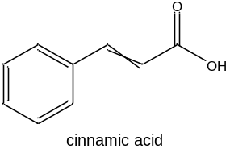
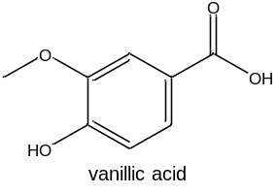
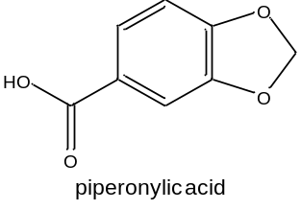
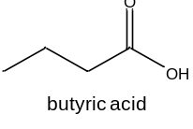
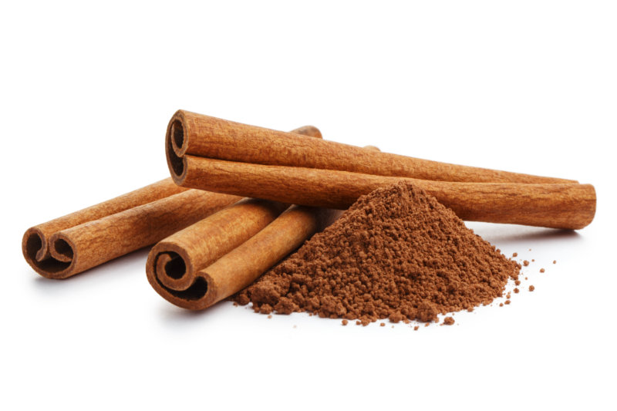
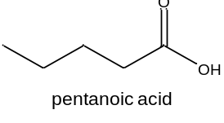
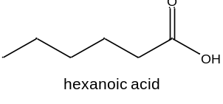
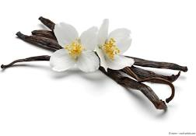
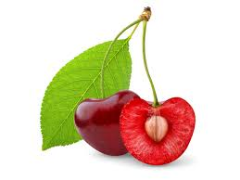
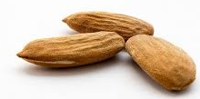
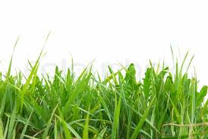
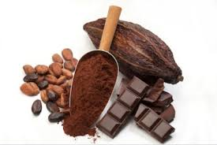

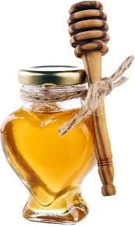

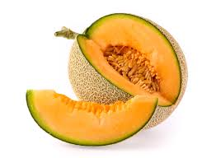
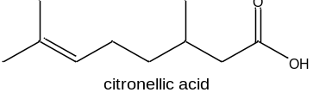
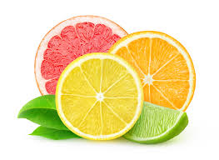
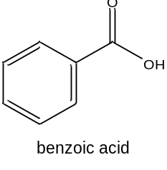
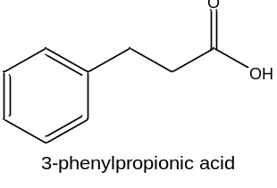
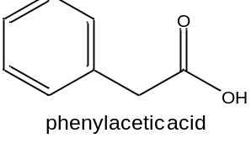
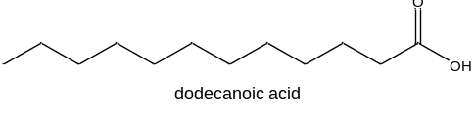
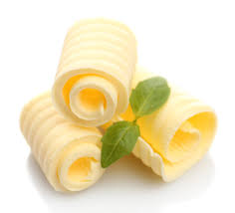
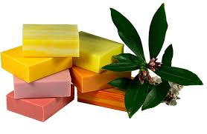
Substrate scope to be explored
Broad substrate scope (CARs) vs. smaller scope (Oxds)
May 19th 2021

Slide 3
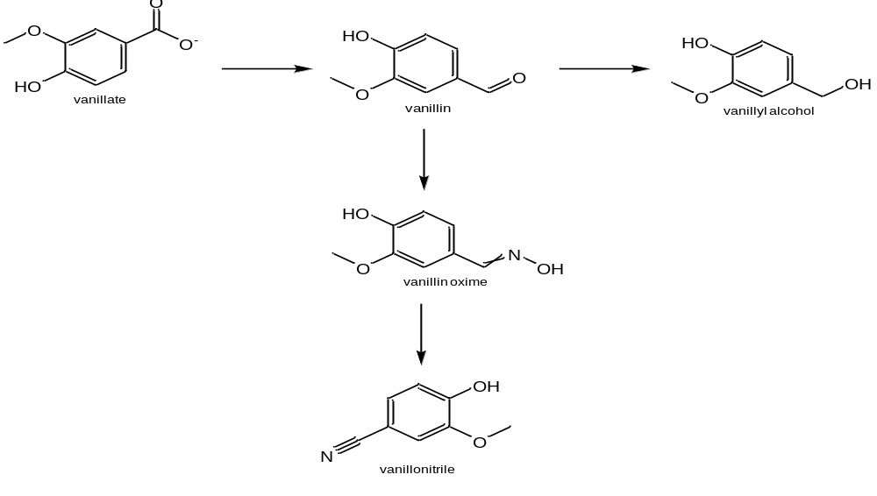
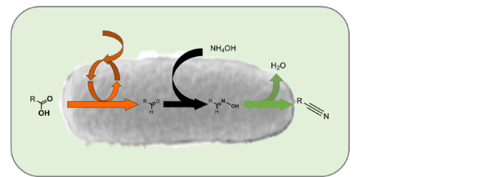
Chemoenzymatic route: carboxylic acid to nitrile
CAR
ADHs/ADRs
(CooH)
(COH)
(OH)
NH₂OH
In vivo (CAR+Oxd)
(NOH)
Oxd
(CN)
1 cascade, 5 compounds for analysis
Oximes: E/Z → 6 peaks expected
May 19th 2021
Group seminar

Slide 4
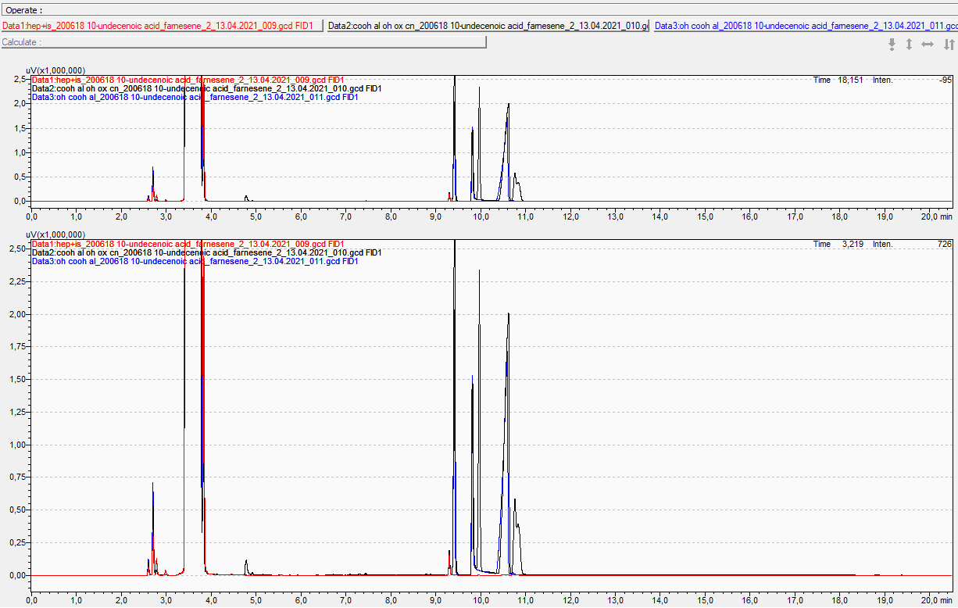
Analytics: C12 and derivatives
Methode:
210414_C12_hydroxylamine
Ox seperated from CooH peak
E/Z-Ox not seperated
AL: 9.4 min
OH: 9.8 min
CN: 9.9 min
COOH: 10.6 min
E-Ox: 10.76 min
Z-Ox: 10.83 min
C12 CN
C12 OH
C12 AL
C12 cooh
C12 Ox
May 19th 2021
Group seminar

Slide 5
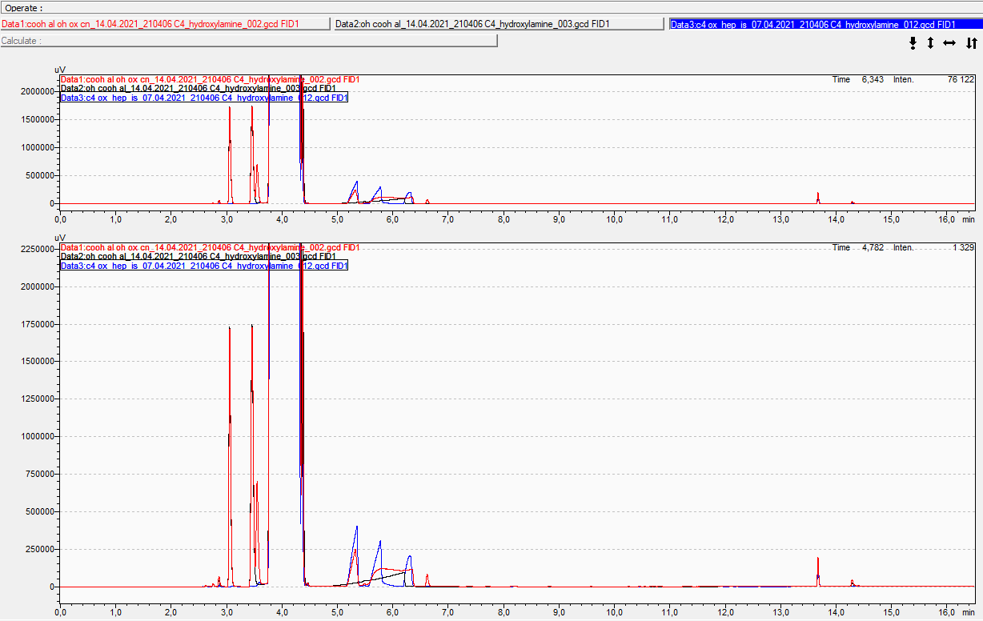
C4 cooh, al, oh, oxime and nitrile
Methode: C4_hydroxylamine
Ox not seperated from CooH peak
OH/CN very close
AL: 3.05 min
OH: 3.46 min
CN: 3.55 min
COOH: 6.2 min
E-Ox: 5.3 min
Z-Ox: 5.9 min
C4 CN
C4 OH
C4 Ox
C4 AL
C4 cooh
Possibly start with lower temp!
May 19th 2021
Group seminar

Slide 6
Analytics
No. | compound | HPLC-UV analysis | GC-FID method | cascade | Derivatization (TMS-diazomethane) | Seperate CAR and Oxd rxn | IS
1 | Citronellyl | No oxime and no nitrile commercially availble
2 | C4 |  | Butyric acid_hydroxylamine | no | no | Yes (OH/CN peaks) | n-tetradecane
3 | C5 |  | Valeric acid_hydroxylamine | yes | recommended |  | n-tetradecane
4 | C6 |  | Hexanoic acid_hydroxylamine1 | yes | recommended |  | n-tetradecane
5 | C12 |  | C12_hydroxylamine | yes | recommended |  | n-tetradecane
6 | Benzoic |  | Benzoic acid_hydroxylamine | yes | no |  | n-tetradecane
7 | PAA | DSC_cinnamic acid | Benzoic acid_hydroxylamine | yes | recommended |  | n-tetradecane
8 | 3-PPA |  | 3-PPO_hydroxylamine2 | no | no | Yes (OH/CN peaks) | n-tetradecane
9 | Cinnamic | DSC_cinnamic acid | Benzoic acid_hydroxylamine | possible | yes | OH/CN peak quite close | n-tetradecane
10 | Piperonylic | DSC_cinnamic acid | Piperonylic acid_hydroxylamine2 | no | no | yes (OH/CN peaks) | n-heptane
11 | Vanillic | MHO_van210223 | Piperonylic acid_hydroxylamine2 | no | no | yes (OH/CN peaks) | n-heptane
May 19th 2021
Group seminar

Slide 7
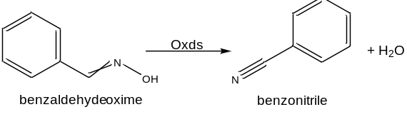
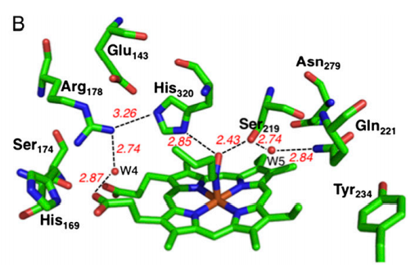
Aldoxime dehydratases
Lyases (EC 4.99.1.5-7)
Bacterial and fungal origin, low sequence identity in between (30%)
Heme-proteins (Fe²⁺ -Fe⁴⁺)
Dependent on substrate: enantioselective, Z-form preferred (aromatics)
Catalytical triad: (OxdA: R178/S219/H320)
  Recognition and specific orientation of substrate and binding
  S219 and H320 essential residues
  R178 supportive and stabilizing role
  speculative mechanism: triad not conserved (OxdB: T219)
Nomura et al. (2013) PNAS 110:2810-15.
May 19th 2021

Slide 8
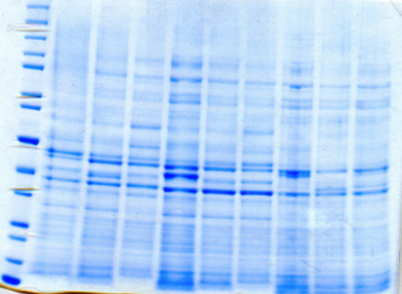
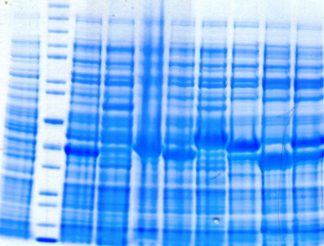
Expression E.coli BL21 pET28a:Oxds
E. coli BL21* (DE3) pET28a:Oxds (soluble)
E. coli BL21* (DE3) pET28a:Oxds (insoluble)
200
150
120
100
85
70
60
50
40
30
25
20
15
10
200
150
120
100
85
70
60
50
40
30
25
20
15
10
Std EVC Br1 Br2 Cp Nh Tv RG RE FG
EVC Std Br1 Br2 Cp Nh Tv RG RE FG
Expression: 200mL
2xYT
1mM IPTG
30°C/16°C for 24 h
Oxds
 | OxdBr1 | OxdBr2 | OxdCp | OxdNh | OxdTv | OxdRG | OxdRE | OxdFG
Organism | Bradyrhizobium sp. LTSPM299 | Bradyrhizobium sp. WSM1253 | Corynebacterium sp. Marseille-P2417 | Nectria haematococca mpVI 77-13-4 (Fusarium vanettenii 77-13-4) | Trichoderma virens Gv29-8 | Rhodococcus globerulus A-4 | Rhodo-coccus sp. N-771 | Fusarium graminearum MAFF305135
Accession Nr. | WP_044589203 | WP_007594278.1 | WP_080796375.1 | XP_003042958.1 | XP_013960347.1 | BAC99076.1 | AB094201 | AACM01000259
size [kDa] | 38.5 | 40 | 40 | 38.9 | 44.4 | 42 | 44.7/80 | 31/44

Slide 9
Oxds substrate scope all
10 OD units
300 mM HEPES, pH 7.5
10mM substrate in DMSO with n-heptane phase
1 h, 28°C
No conversion with dodecanal oxime (C12)
Poor conversion: vanillin oxime, cinnamaldehyde oxime
Good conversion: 3-PPO
Well accepted substrates: PAOx, benzaldehyde oxime, C4, C5, C6
May 19th 2021
Group seminar

Slide 10
Time curves of OxdBr1
10 OD of E.coli BL21star (DE3) pET28a:OxdBr1
300 mM HEPES, pH 7.5
28°C, 0-16.5 h
C6 +PAOx in n-heptane (biphasic)
Van (single phase, Eppendorf tubes, 900 rpm)
Within 30 mins conversion complete with good substrates.
Vanillin oxime: 15% conversion after ON incubation.
May 19th 2021
Group seminar

Slide 11
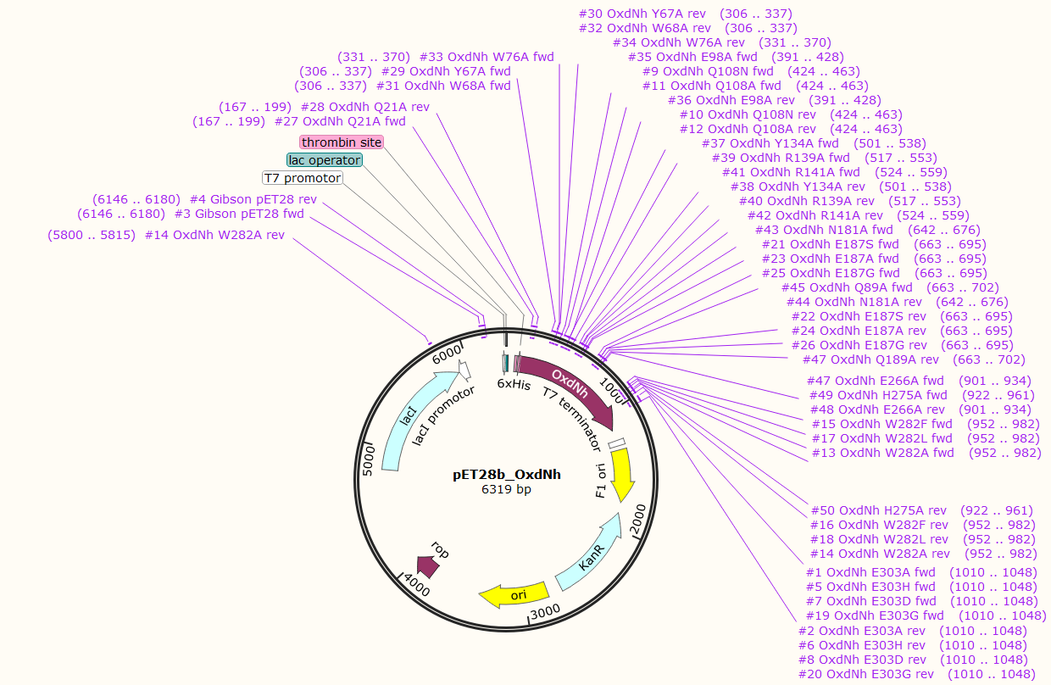
OxdNh variants: active site variants and ALA scan
No. | OxdNh variant | alanine scan | active site | substrate channel
1 | E303A |  | y
2 | E303H |  | y
3 | E303D |  | y
4 | Q108N |  | y
5 | Q108A |  | y
6 | W282A |  |  | y
7 | W282F |  |  | y
8 | W282L |  |  | y
9 | E187S |  | y
10 | E187A |  | y
11 | E187G |  | y
12 | E303G |  | y
13 | Q21A | y
14 | Y67A | y
15 | W68A | y
16 | W76A | y
17 | E98A | y
18 | Y134A | y
19 | R139A | y
20 | R141A | y
21 | N181A | y
22 | Q189A | y
23 | E266A | y
24 | H275A | y
Design of OxdNh alanine and active site variants (pET28b:OxdNh)
May 19th 2021
Group seminar

Slide 12
Optimizing Chemoenzymatic route: phenylacetic acid (PAA) to nitrile
In vivo (CAR+Oxd)
C6 cascade:
  First proof of concept showed full conversion ☺
  but at least 20% alcohol
Decrease of alcohol content, when Oxd expressed in E. coli RARE
    But almost no dehydration detected
ATP did not influence activity
May 19th 2021
Group seminar

Slide 13
Optimizing Chemoenzymatic route: phenylacetic acid (PAA) to nitrile
In vivo (CAR+Oxd)
Improved phenylacetonitrile concentration from 0.94 mM to 7.2 mM
  reaction time prolonged
  additional OxdBr1 after 21 h
May 19th 2021
Group seminar

Slide 14
In vivo cascades: SUMMARY
No. | compound | CAR activity | Oxime formation | Oxd activity | Nitrile formation | Cascade successful | comment
1 | Citronellyl | No oxime and no nitrile commercially availble
2 | C4 | +++ | +++ | +++ | ? | Analytic in progress | Very volatile (ISPR)
3 | C5 | +++ | +++ | +++ | ? | To be tested | Very volatile (ISPR)
4 | C6 | +++ | +++ | +++ | +++ |  | ISPR
5 | C12 | + | n.a. | - | - | x
6 | Benzoic | +++ | +++ | +++ (OxdRG, RE, FG) | ? | To be tested
7 | PAA | ++ | +++ | ++ | +++ |  | Prolonged reaction time and additional OxdBr1
8 | 3-PPA | ++ | +++ | ++ | ? | Analytic in progress
9 | Cinnamic | ++ | ++ | + (OxdBr1) | - | x | OxdBr1 too slow
10 | Piperonylic | +++ | +++ | - | - | x
11 | Vanillic | +++ | ++ | + (OxdBr1) | + | x | OxdBr1 too slow
In vivo (CAR+Oxd)
Each substrate needs individual adaption of conditions
Other cascades on going
March 24th 2021

Slide 15

5. Outlook
Identifying optimal Oxd and CAR for 8 substrates to optimize cascades
    OxdNh variants potential better candidate for poor substrates
Optimize analytics for cascade reactions for specific substrates
    (C4, 3-PPO)
Increase substrate concentrations for best two cascades
    C6 (aliphatic), PAA (aromatic)
May 19th 2021

Slide 16





Projekt No.: I 4607-N
Miroslav Patek Ludmila Martinkovà Robert Rädisch
Florian Rudroff Sebastian Hecko
Astrid Schiefer
Margit Winkler
Melissa Horvat
Victoria Weilch
Associated Collaborator
Harald Gröger
Anke Hummel

Slide 17
Optimizing Chemoenzymatic route: vanillic acid or cinnamic acid to nitrile
In vivo (CAR+Oxd)
Little vanillonitrile/ cinnamonitrile detected
May 19th 2021
Group seminar

