Slide 1
A new chemoenzymatic route from carboxylic acids to nitriles

Slide 2
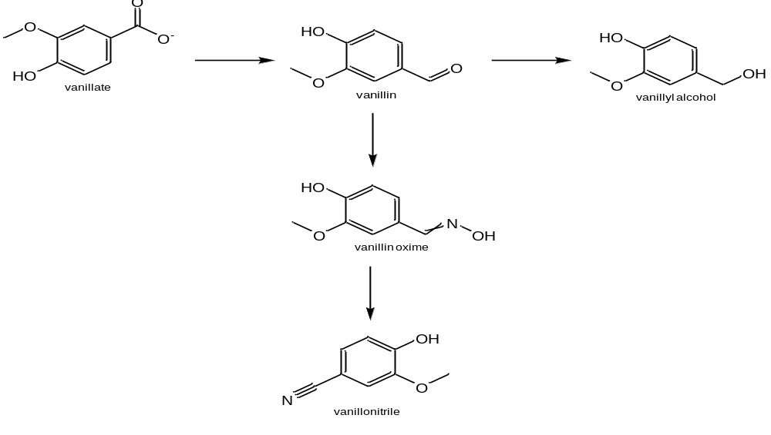
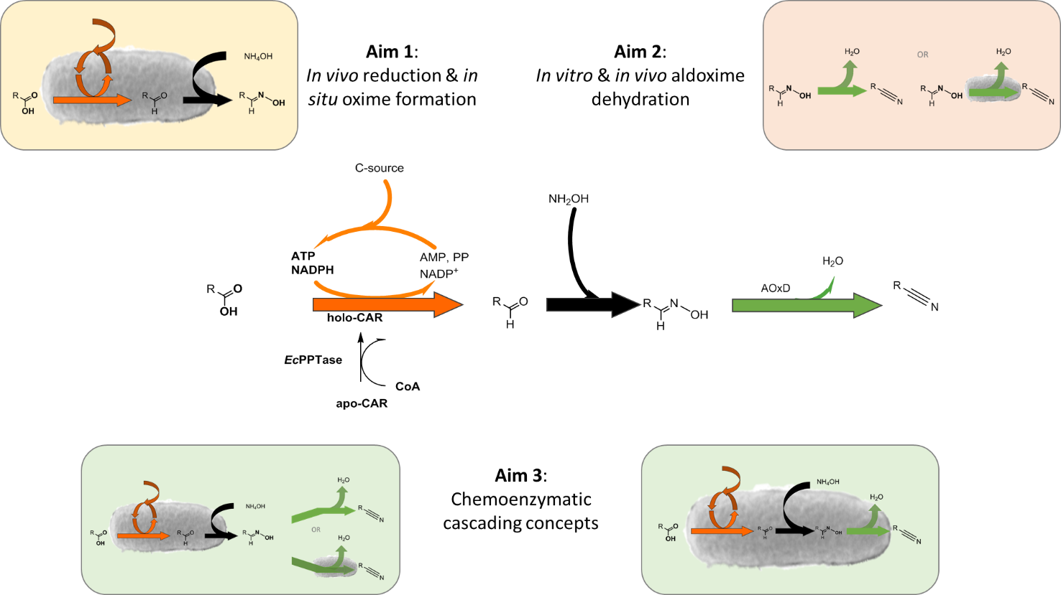
Chemoenzymatic route: carboxylic acid to nitrile
CAR
ADHs/ADRs
In vivo (CAR+Oxd)
(CooH)
(COH)
(OH)
NH₂OH
(NOH)
Oxd
In vivo (CAR) + in vitro (Oxd)
(CN)
1 cascade, 5 compounds for analysis
Oximes: E/Z → 6 peaks expected
March 24th 2021

Slide 3
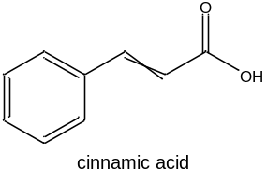
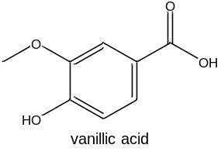
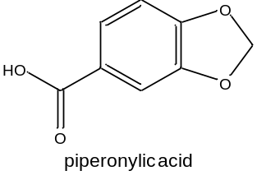
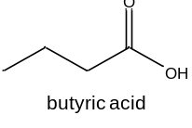
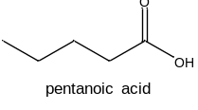
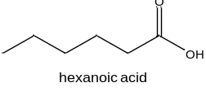
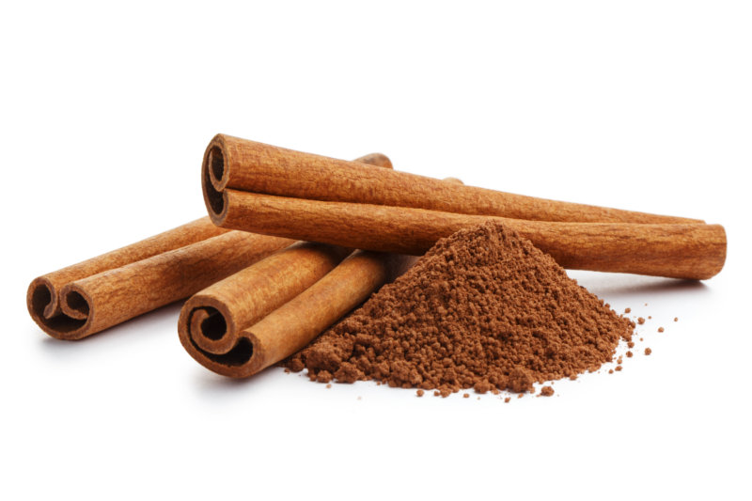
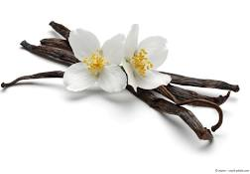
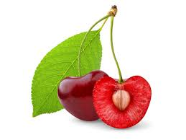
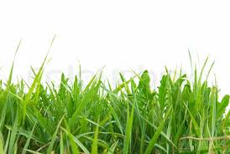
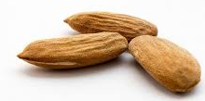
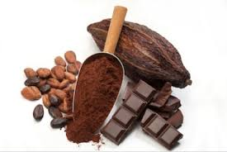

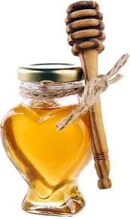

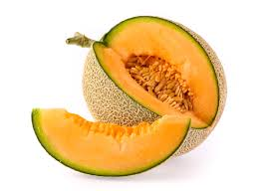
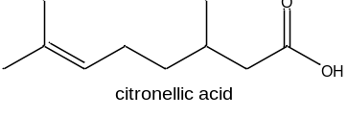
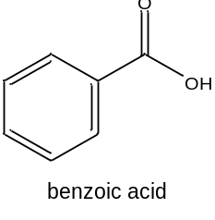
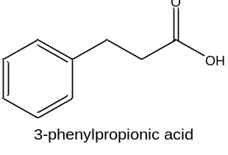
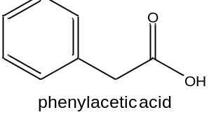
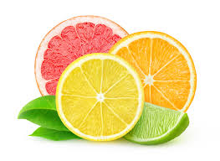
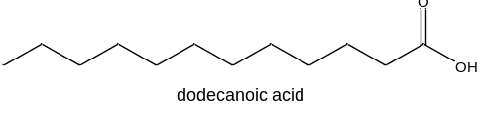
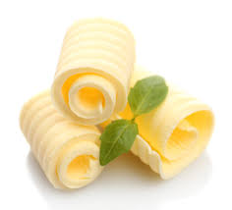
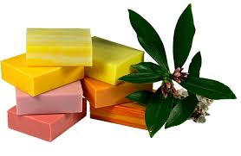
Substrate scope to be explored
Broad substrate scope (CARs) vs. smaller scope (Oxds)
March 24th 2021

Slide 4
2. Analytics
No. | compounds | HPLC-UV analysis | GC-FID method | cascade | Derivatization (TMS-diazomethane) | Seperate CAR and AOxd rxn | IS
1 | Citronellyl |  | No oxime and no nitrile commercially availble
2-3 | C4, C12 |  | Waiting for oxime
4 | C5 |  | Valeric acid_hydroxylamine | yes | yes |  | n-tetradecane
5 | C6 |  | Hexanoic acid_hydroxylamine1 | yes | yes |  | n-tetradecane
6 | Benzoic |  | Benzoic acid_hydroxylamine | yes | no |  | n-tetradecane
7 | PAA | DSC_cinnamic acid | Benzoic acid_hydroxylamine | yes | yes |  | n-tetradecane
8 | 3-PPA |  | 3-PPO_hydroxylamine2 | no | no | Yes (OH/CN peaks) | n-tetradecane
9 | Cinnamic | DSC_cinnamic acid | Benzoic acid_hydroxylamine | possible | yes | OH/CN peak quite close | n-tetradecane
10 | Piperonylic | DSC_cinnamic acid | Piperonylic acid_hydroxylamine2 | no | no | yes (OH/CN peaks) | n-heptane
11 | Vanillic | MHO_vanillic acid2 | Piperonylic acid_hydroxylamine2 | no | no | yes (OH/CN peaks) | n-heptane
March 24th 2021

Slide 5
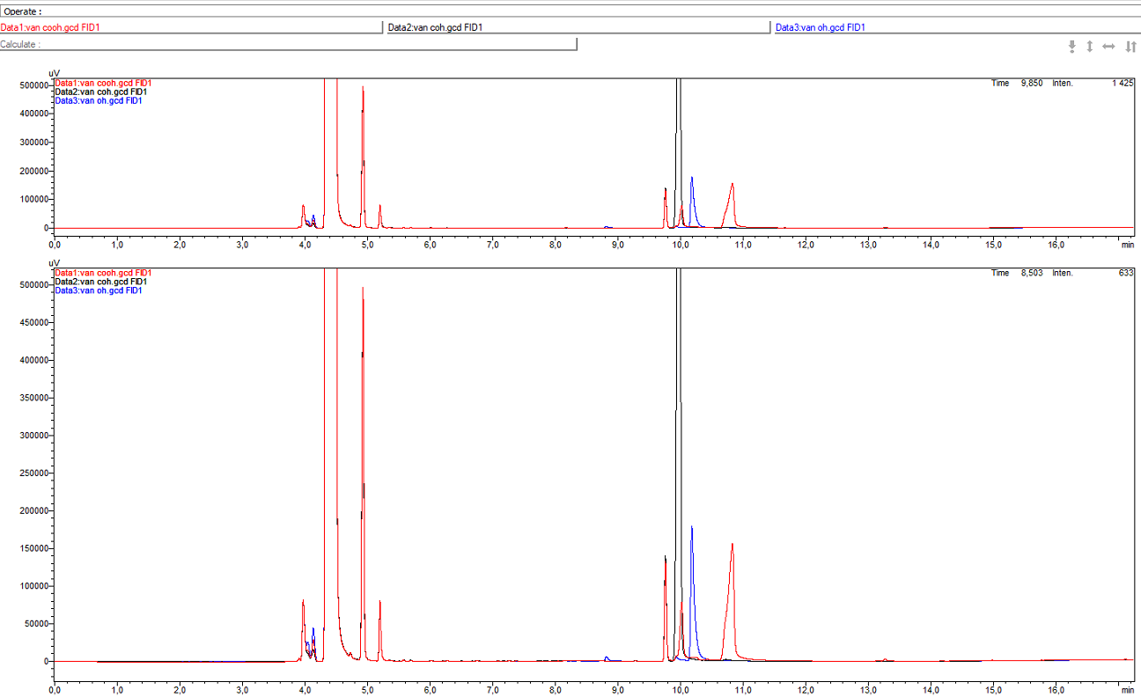
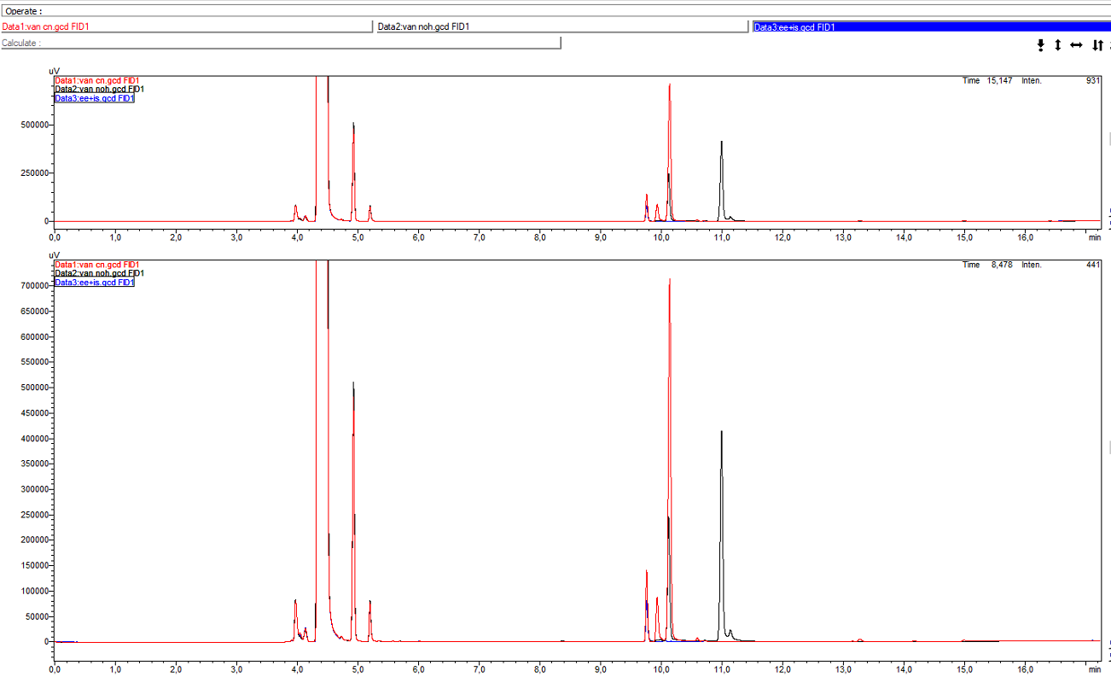
GC-FID method vanillic acid
Methode: 190402_piperonylic acid_hydroxylamine2
COH: 9.98 min
OH: 10.18 min
IS: 9.76 min
COOH: 10.83 min
Methode: 190402_piperonylic acid_hydroxylamine2
CN: 10.14
IS: 9.76 min
NOH: 10.99 min / 11.43 min
Difficulties to separate OH/CN and NOH/COOH.
March 24th 2021

Slide 6
Chemoenzymatic route: carboxylic acid to nitrile
CAR
ADHs/ADRs
In vivo (CAR+Oxd)
(CooH)
(COH)
(OH)
NH₂OH
(NOH)
Oxd
In vivo (CAR) + in vitro (Oxd)
(CN)
1 cascade, 5 compounds for analysis
Oximes: E/Z → 6 peaks expected
March 24th 2021

Slide 7
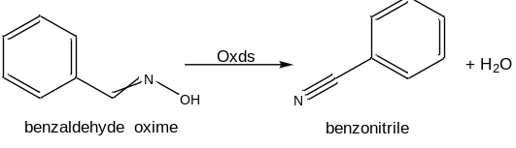
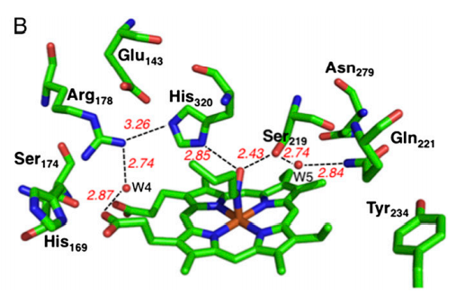
Aldoxime dehydratases
Lyases (EC 4.99.1.5-7)
Bacterial and fungal origin, low sequence identity in between (30%)
Heme-proteins (Fe²⁺ -Fe⁴⁺)
Dependent on substrate: enantioselective, Z-form preferred (aromatics)
Catalytical triad: (OxdA: R178/S219/H320)
  Recognition and specific orientation of substrate and binding
  S219 and H320 essential residues
  R178 supportive and stabilizing role
  speculative mechanism: triad not conserved (OxdB: T219)
Nomura et al. (2013) PNAS 110:2810-15.
March 24th 2021

Slide 8
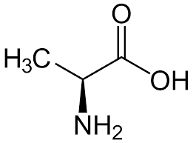
Aldoxime dehydratases- alanine scan
Multiple sequence alignment to identify potentially conserved amino acid patterns of Oxds
with Clustal Omega
  16 conserved amino acids (including 5 glycine residues)
Alanine scan to identify essential amino acid residues
Alanine
March 24th 2021

Slide 9
Aldoxime dehydratases
No. | Abbr. | Organism | Accession No. | size [kDa] | reference | comment
1 | OxdBr1 | Bradyrhizobium sp. LTSPM299 | WP_044589203 | 38.5 | 10.1016/j.ijbiomac.2018.04.103
2 | OxdBr2 | Bradyrhizobium sp. WSM1253 | WP_007594278.1 | 40.0
3 | OxdCp | Corynebacterium sp. Marseille-P2417 | WP_080796375.1 | 40.0
4 | OxdNh | Nectria haematococca mpVI 77-13-4 (Fusarium vanettenii 77-13-4) | XP_003042958.1 | 38.9
5 | OxdTv | Trichoderma virens Gv29-8 | XP_013960347.1 | 44.4 |  | plasmid contained OxdCp, received 19.3.21
6 | OxdRE | Rhodococcus sp. N-771 | AB094201 | 44.7 | 10.1016/S1389-1723(04)70200-8 | pET28a:Oxd coming soon from H. Gröger
7 | OxdRG | Rhodococcus globerulus A-4 |  | 42.2 | 10.1021/bi035092u
8 | OxdFG | Fusarium graminearum MAFF305135 | BAE48794.1/. AACM01000259 | 44.4 | 10.1271/bbb.69.2254
March 24th 2021

Slide 10
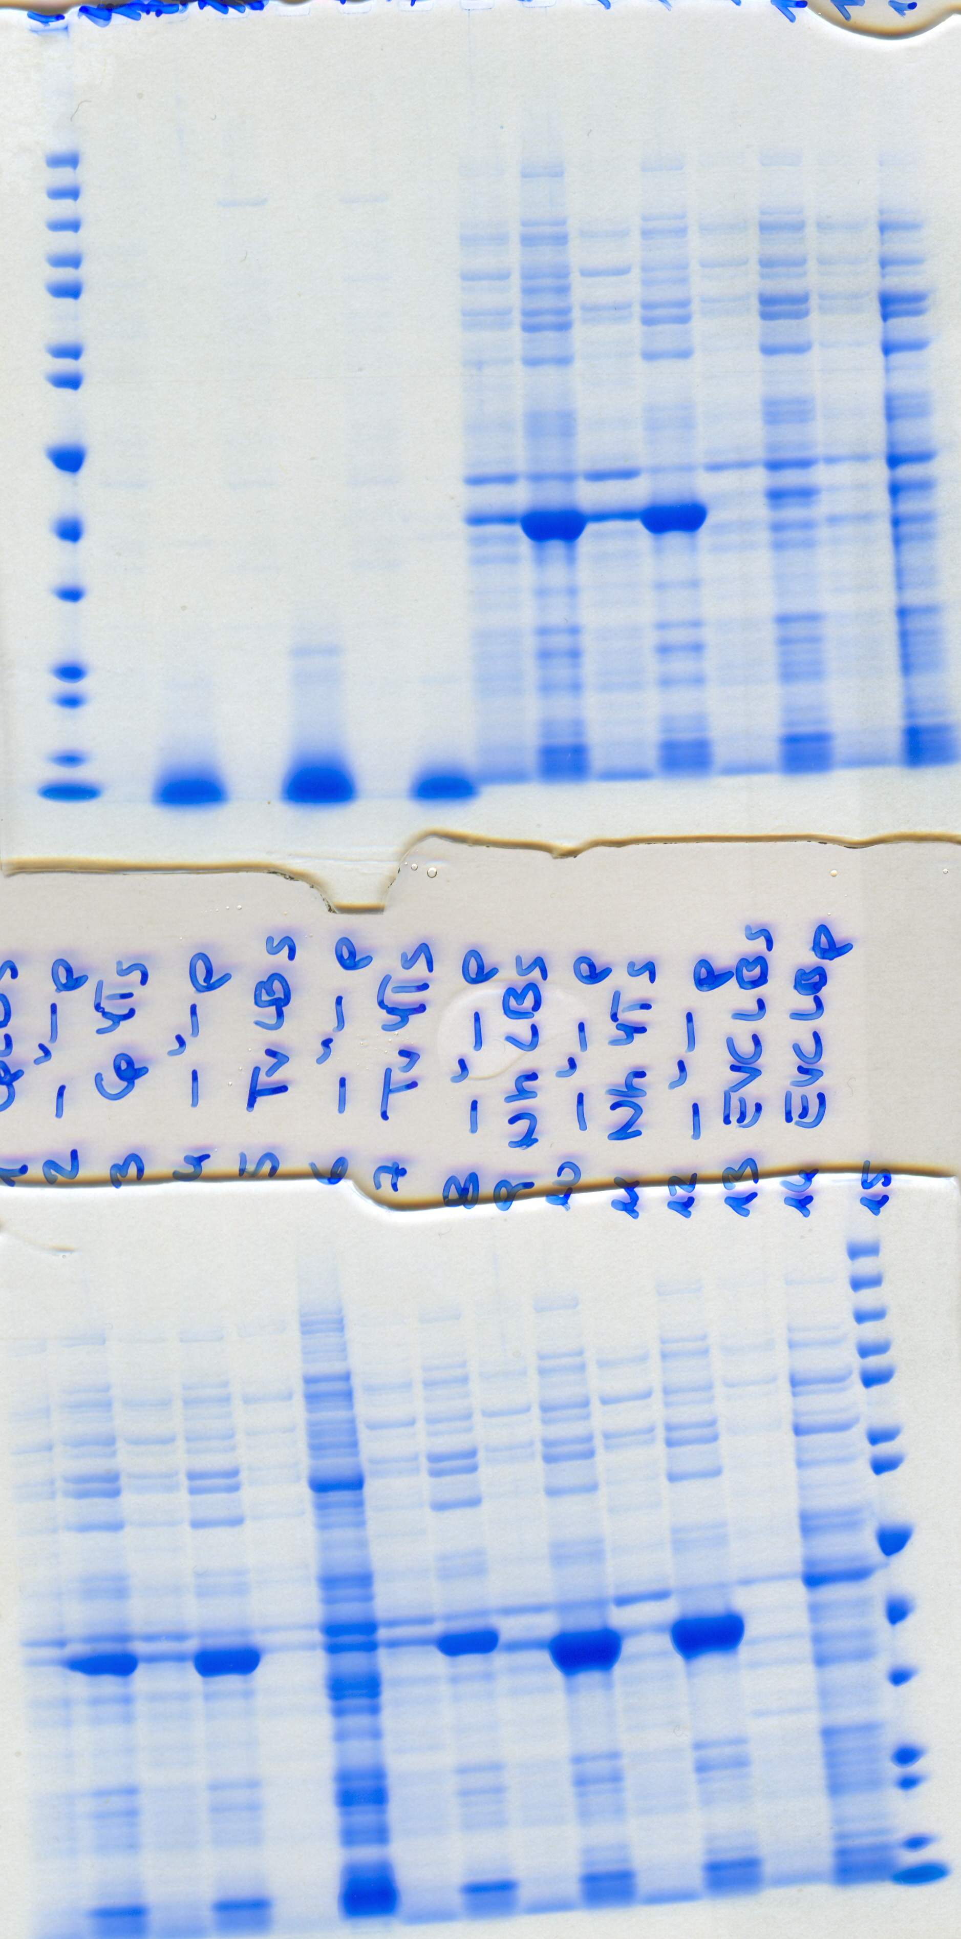
Aldoxime dehydratases-expression
OxDBr1 s
OxDBr1 is
OxDBr1 s
OxDBr1 is
OxDBr2 s
OxDBr2 is
OxDBr2 s
OxDBr2 is
OxDCp s
OxDCp is
OxDCp s
OxDCp is
OxDNh s
OxDNh is
OxDNh s
OxDNh is
EVC s
EVC is
Autoinduction | IPTG | Autoinduction | IPTG | Autoinduction | IPTG | Autoinduction | IPTG | Autoinduction
  LB-5052 KAN, 20°C for 20 h (Autoinduction)
  2YT-Kan, 1mM IPTG, 20°C for 20 h (IPTG)
Std
(kDa)
200
150
120
100
85
70
60
50
40
30
25
20
15
10
Std
(kDa)
200
150
120
100
85
70
60
50
40
30
25
20
15
10
All Oxds are mostly found in inclusion bodies (is).
Oxds
AOxDBr1 (N-terminal His₆-tag) | 40.7 kDa | AOxDCp | 40.04 kDa
AOxDBr2 | 40.1 kDa | AOxDNh | 38.97 kDa

Slide 11
Aldoxime dehydratases: whole cell-mediated conversions
15 OD units
10 mM substrate
4 h at 28°C (DWP (400µL) or Pyrex)
HEPES, pH 7.5, containing 5mM Na₂S₂O₂
Stopped with MeOH or EtOH for HPLC-UV
Or 3 M HCL and extracted with EE+IS
Substrate (NOH) | OxdBr1 | OxdBr2 | OxdCp | OxdNh
PAOx* | ++ | ~ | + | ++
vanillin oxime* | + | ~ | ~ | ~
cinnamaldehyde oxime* | ++ | ~ | ~ | +
C5 oxime | ++ | ~ | + | ++
C6 oxime
benzaldehyde oxime
Piperonal oxime
3-PPOx
++ full or almost full conversion (80-100% conversion)
+ 20-40% conversion
~slightly more product than EVC (less than 10% conversion)
* analyzed with HPLC-UV
In progress
Also in whole-cell mediated bioconversions, OxdBr1 showed best conversions.
March 24th 2021

Slide 12
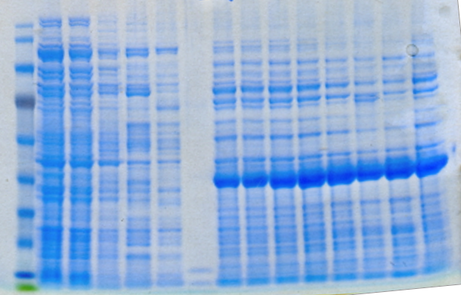
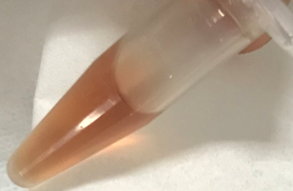
Aldoxime dehydratases-purification
E. coli BL21*(DE3) pET28a:OxdBr2
140
115
80
70
50
40
30
25
15
10
CFE FT BB WB EF1 EF2 EF3 EF4 EF5 EF6 EF7 EF8 EF9 pooled Br1
Cultivated in 450mL LB-Kan, 1mM IPTG, 20°C for 48 h
Pooled: EF3-7
Ni-affinity chromatography concentrated Oxds – still many impurities.
March 24th 2021

Slide 13
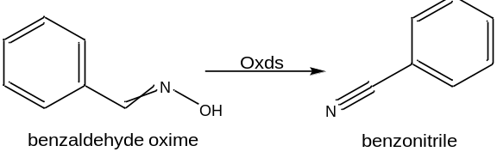
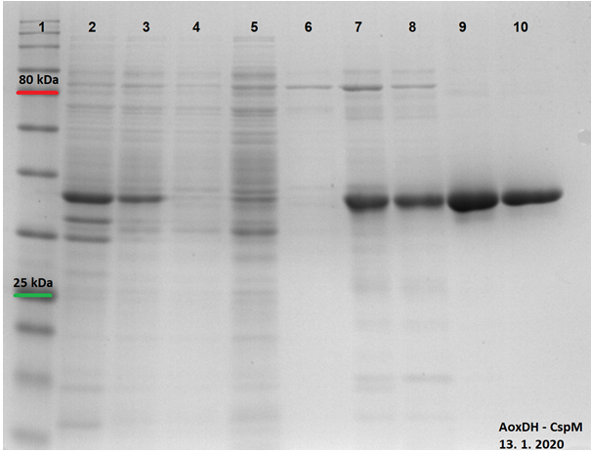
Aldoxime dehydratases-TALON purification
Cultivated in 450mL 2x YT-Kan, 1mM IPTG, 16°C for 48 h
2: insoluble fraction,
3: soluble fraction,
4: washing of TALON,
5: check of protein binding to TALON,
6-8: elution of impurities and
9-10: pure protein with HIS-tag
(+/- 10 mg of OxdCp from 125 ml of culture)
Performed by cooperation partner in Prag.
March 24th 2021

Slide 14
3. Aldoxime dehydratases-substrate scope
20 µg enzyme (1mg/ml)
2 h, 28°C
320 rpm
HEPES pH 7.5
5 mM Na₂S₂O₂
10 mM substrate
OxdBr1 showed most promising substrate scope.
March 24th 2021

Slide 15

5. Outlook
Cultivation of OxdTv and purification with TALON
Direct comparison of OxdBr1, OxdBr2, OxdCp, OxdTv and OxdNh to literature-known Oxds (OxdFG, OxdRE, OxdRG)
Oxds screen for C4 and C12
Alanine-Scan of Oxd
March 24th 2021

Slide 16





Projekt No.: I 4607-N
Miroslav Patek Ludmila Martinkovà Robert Rädisch
Florian Rudroff Sebastian Hecko
Astrid Schiefer
Margit Winkler
Melissa Horvat
Victoria Weilch
Associated Collaborator
Harald Gröger
Anke Hummel

