Slide 1

Good Scientific and Artistic Practice for Bachelor's Degree Programmes
Quality Management, Evaluation & Reporting, Graz University of Technology
October 2026
https://doi.org.10.3217/na9h1-rb285
This document is licensed under the Creative Commons Attribution 4.0 International (CC BY 4.0) license.
This document has been agreed with the NAWI Graz Coordination Office.

Slide 2
Development and Use of the Teaching Materials:
These slide sets have been developed to provide an introduction to the fundamentals of good scientific and artistic practice at Graz University of Technology (TU Graz), as well as in inter-university degree programmes such as NAWI Graz. The current set of slides has been adapted for Bachelor’s degree programmes. Where identical content or the same visual material is used across different sets of slides, no reference is made to other sets of slides, but rather to the original source of the content or material used in each instance.
This applies equally to the English-language slide sets. These are, in principle, direct translations of the German-language versions and differ only in terms of the inclusion of, or references to, English-language information and source materials.
This teaching material will be piloted at TU Graz during the 2026/2027 academic year.
Licensing:
This work by the staff Unit Quality Management, Evaluation & Reporting is licensed under CC BY 4.0. For further information, see the appendix.

Slide 3
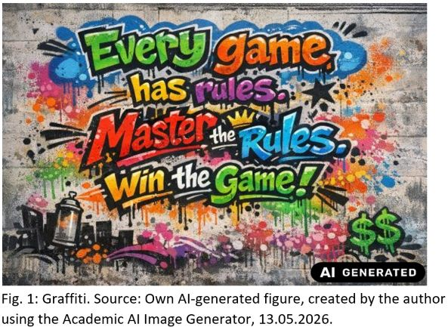
Good Scientific and Artistic Practice (GSP) – Why Is This an Issue Today?
The standards of good scientific practice ensure integrity, quality, and social responsibility in all phases of research (ÖAWI, 2026). From the very beginning of one’s studies, they provide guidance for academic work and everyday student life.

Slide 4
What can you expect?
Part 1: Fundamentals of Good Scientific and Artistic Practice (GSP)
Part 2: Examples of GSP in the Context of Academic Work
Part 3: Understanding and Avoiding Academic Misconduct
Part 4: Appendix
  Further Information, Sources, Licensing, AI Use, Acknowledgements

Slide 5

Part 1:
Fundamentals of Good Scientific and Artistic Practice (GSP)
1.1 What Is GSP?
1.2 The Importance of GSP in Research and Academic Studies
1.3 The Four Principles of Scientific Integrity
Fig. 2: Magnifying Glass. Source: Own AI-generated figure, created by the author using the Academic AI Image Generator, 17.06.2026

Slide 6
1.1 What Is GSP?
(HS-QSG, 2024)
Good Scientific and Artistic Practice:
  Covers norms and standards for scientific work
  Rules that support researchers and research institutions in addressing various challenges in the context of their work
  Examples:
    Citation of all sources used in a text
    Transparent documentation of data analysis
    Compliance with laboratory safety regulations
    Storage of research data in accordance with statutory retention periods

Slide 7
1.2 The Importance of GSP for Research and Academic Study (1/4)
(BMBWF, 2019; ÖAWI, 2015; ÖAWI, 2026)
”The quality of research is a precious asset for every society.“
(ÖAWI, 2015, p. 3)
Quality in research ensures that …
  the public can have confidence in scientific findings.
  innovations can be built on reliably documented findings.
  a high standard is set in education (= a guarantee of the quality of your education!)
  your paper/thesis is credible.

Slide 8
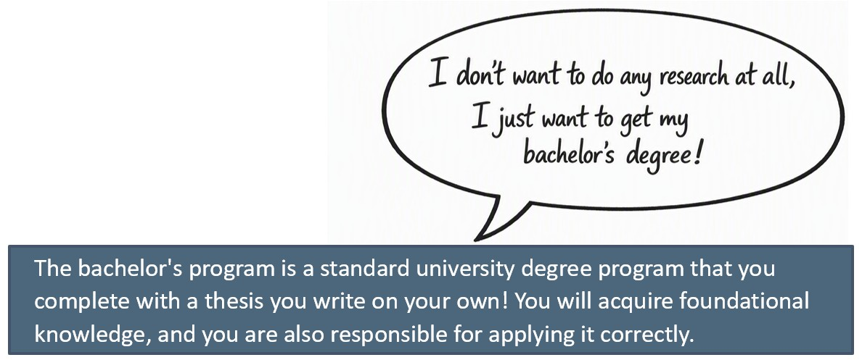
1.2 The Importance of GSP for Research and Academic Study (2/4)

Slide 9
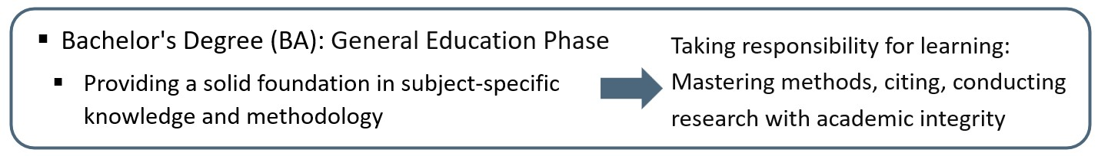
1.2 The Importance of GSP for Research and Academic Study (3/4)
(BMBWF, 2017, 2019; UG, 2002)
The higher the academic degree, the greater the scientific autonomy and responsibility for generating new knowledge
  Master‘s (MA): Advanced Studies
    Teaching of in-depth theoretical knowledge
  Doctorate (Dr./PhD): Research Studies
    Independent research, development of new scientific findings

Slide 10
1.2 The Importance of GSP for Research and Academic Study (4/4)
Adherence to the GSP guidelines will support you in your studies (among other things) with regard to:
  thorough source research
  correct citation
  correct documentation
  identifying plagiarism
  knowing how you are permitted to use Artificial Intelligence (AI)
  → and thus, in writing your own independent academic thesis!

Slide 11
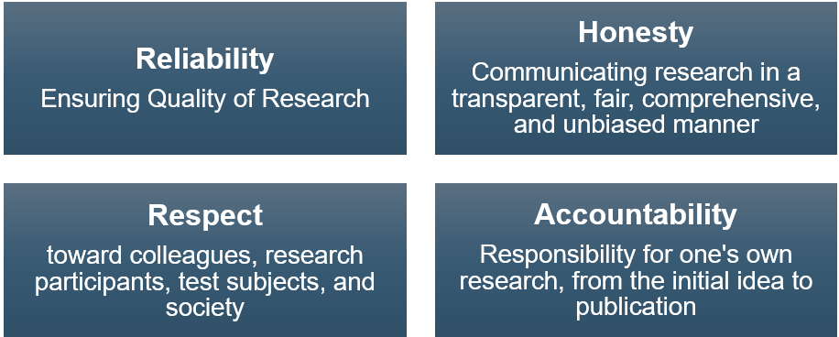
1.3 The Four Principles of Scientific Integrity (1/4)
(ALLEA, 2023, p. 5)
Following to the four principles essentially ensures compliance with GSP:

Slide 12
1.3 The Four Principles of Scientific Integrity (2/4)
(ALLEA, 2023; Wrexham University, n.d.)
Reliability:
  By working carefully and accurately, you will acquire the skills that will be required of you throughout your studies and in your professional life. By taking a methodical approach and adhering to recognized standards, you will be able to produce compelling, high-quality results.
  Honesty:
  By refraining from gaining any unfair advantages and instead working transparently and honestly, you strengthen your own credibility.

Slide 13
1.3 The Four Principles of Scientific Integrity (3/4)
(ALLEA, 2023; Wrexham University, n.d.)
Respect:
  By showing respect for the work of other researchers and citing your sources or acknowledging your colleagues, you avoid research misconduct and ensure that your work is transparent.
Accountability:
  You know what you have accomplished in your seminar paper or thesis. By presenting your work steps in writing or orally, you can credibly defend your approach—for example, during exams.

Slide 14
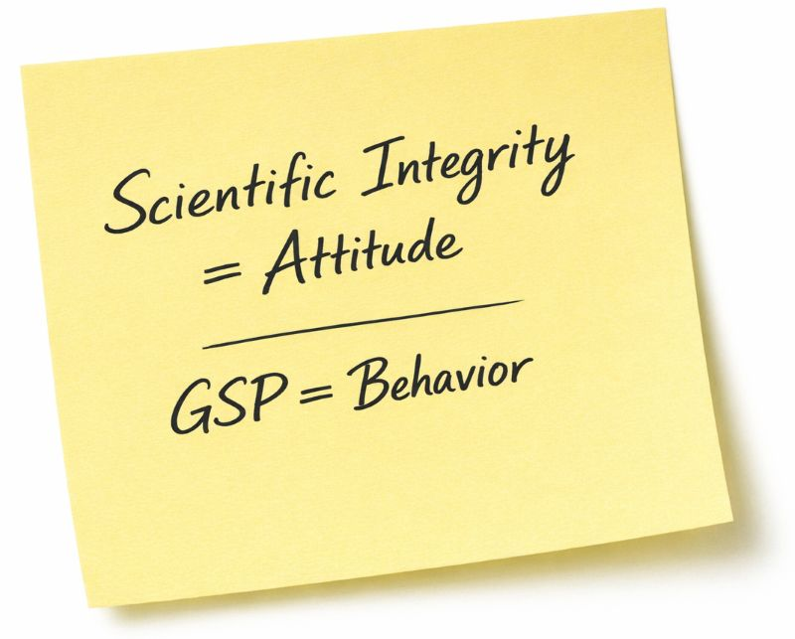
1.3 The Four Principles of Scientific Integrity (4/4)
Scientific integrity is (Wissenschaftsrat [German Science Council], 2015; ÖAWI, 2026):
  A commitment to conducting research with diligence, honesty, respect, and responsibility
GSP stands for (ALLEA, 2023):
  Adherence to rules to ensure that research is reliable, honest, respectful, and responsible

Slide 15
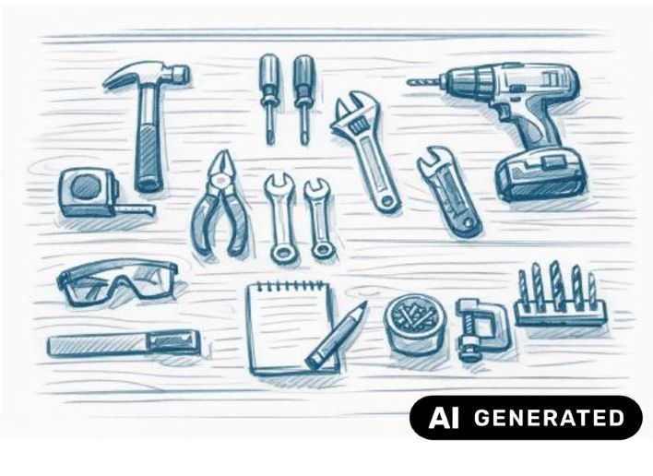
Part 2:
Examples of GSP in the Context of Scholarly Work:
Explanation Based on the Four Principles of Scientific Integrity
  2.1 Reliability
  2.2 Honesty
  2.3 Resect
  2.4 Accountability
Fig 3: Work Desk. Source: Own AI-generated figure, created by the author using the Academic AI Image Generator, 25.06.2026

Slide 16
2.1 Reliability: Working with Sources (1/4)
Sources for a text or academic paper include:
  All information on which the authors of a text rely
  Information can be derived from various types of sources, e.g.:
    Scholarly literature (books, conference proceedings, academic journals), interviews, vlogs, plans, material samples
Citing sources is an essential part of academic work
  Academic research questions are based on theoretical assumptions that are either supported or challenged by sources (ÖAWI, 2015; Pears and Shields, 2022)
  Important for the evaluation of seminar papers and theses!

Slide 17
2.1 Reliability: Working with Sources (2/4)
(ÖAWI, 2015; Pears and Shields, 2022
Sources must be cited in order to …
  distinguish between one’s own contributions and ideas and those of others
  clearly acknowledge the authorship of others and respect their scholarly contributions
  demonstrate thorough research and familiarity with standard works in a discipline
  enable readers to conduct their own research and reflect on the sources

Slide 18
2.1 Reliability: Working with Sources (3/4)
(ÖAWI, 2015; Pears and Shields, 2022
A good source meets scientific credibility standards, i.e.:
  The author is known
  Objective reasoning, no personal opinions
  Accurate presentation of theories and facts, proper citations
  Correct and transparent use of methods
  Peer-reviewed (evaluation by independent experts)
  Relevance to the academic community
  Published by a scientifically recognized publisher

Slide 19
2.1 Reliability: Working with Sources (4/4)
(Pears and Shields, 2022; Veith, 2022)
Where can you find good sources?
  Literature search via library catalogs
    Free (online) access to a wide range of academic journals and books through the Library of TU Graz as well as of University of Graz
  Literature databases (registration required for some!)
    ResearchGate, Web of Science, Google Scholar, arXiv.org, ieeexplore.org
  Technology Reviews
  (High-quality) doctoral dissertations usually contain the relevant standard literature in a given field

Slide 20
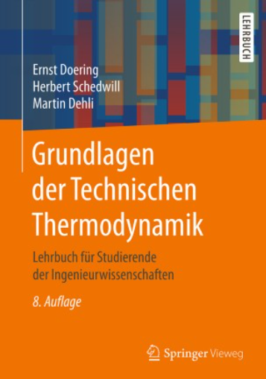
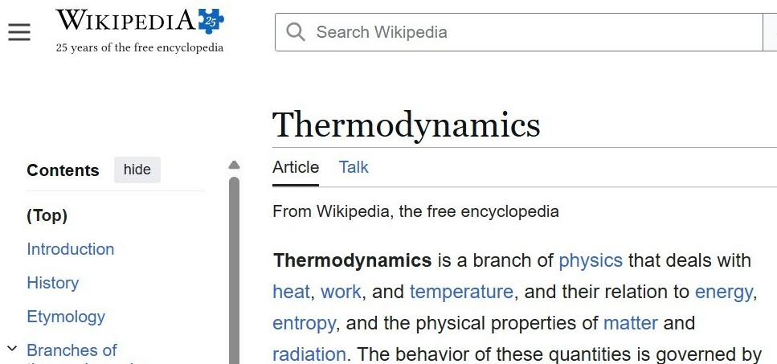
2.1 Reliability: Example for Working with Sources (1/3)
Imagine you want to cite specific facts about thermodynamics in your bachelor's thesis. Which source would you use, and why?
The textbook or the Wikipedia article?
Fig. 5: Cover © Springer, textbook *Fundamentals of Thermodynamics* (2016). Used as a quotation in accordance with § 42f of the German Copyright Act (UrhG); not licensed under CC BY 4.0.
Fig. 4: Wikipedia – Thermodynamics

Slide 21
2.1 Reliability: Example for Working with Sources (2/3)
Which source would you use, and why?
Criteria (APA, 2007; SpringerNature, 2026; Veith, 2022):
  Textbook
    Reputable publisher, verified information
    Authors’ reputation
    Usually edited and peer-reviewed
  Citable, reputable source
    → and available for you to download for free via the Libraries of TU Graz and University of Graz ;-)
Fig. 5: Cover © Springer, textbook “Fundamentals of Thermodynamics” (2016). Used as a quotation in accordance with § 42f of the German Copyright Act (UrhG); not licensed under CC BY 4.0.

Slide 22
2.1 Reliability: Example of Working with Sources (3/3)
Which source would you use, and why?
  Criteria (APA, 2010; Veith, 2022; Wikipedia, n.d):
    Online encyclopedia Wikipedia
      Provides an overview of topics and corresponding standard literature
      Entries are usually edited multiple times and are subject to change (version history available)
      Editorially reviewed but not peer-reviewed, so incorrect content is possible
      Authors and their sources are not always transparent
  → Carefully check the quality of online encyclopedias! Wikipedia is suitable for orientation and literature searches, but not as scientific evidence!

Slide 23
2.1 Reliability: Proper Citation (1/8)
(Pears and Shields, 2022; Veith, 2022)
Citing/Referencing in Written Works:
  The sources used in the preparation of a text or academic paper must be cited in accordance with the rules of a citation style and for the purpose of verifiability.
What must be cited, and when?
  In the body of the text, you must always cite a source to support any theory, idea, or research finding that is not your own!
    Immediately after the mention or at the end of the sentence in which the content was cited.
  All sources cited in the text must be listed in full in the bibliography

Slide 24
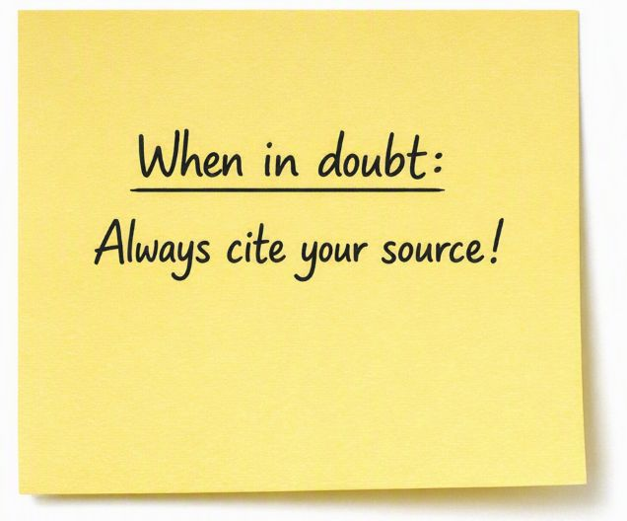
2.1 Reliability: Proper Citation (2/8)
(Pears and Shields, 2022; Veith, 2022)
What does not need to be cited?
  Common knowledge, e.g.:
    Water boils at +100°C
    The capital of a country
Knowledge that is widely accepted and generally known within the research community, e.g.:
  In electrical engineering, that frequency is measured in hertz (Hz)
  In computer science, what an algorithm is
  In architecture, what a floor plan is

Slide 25
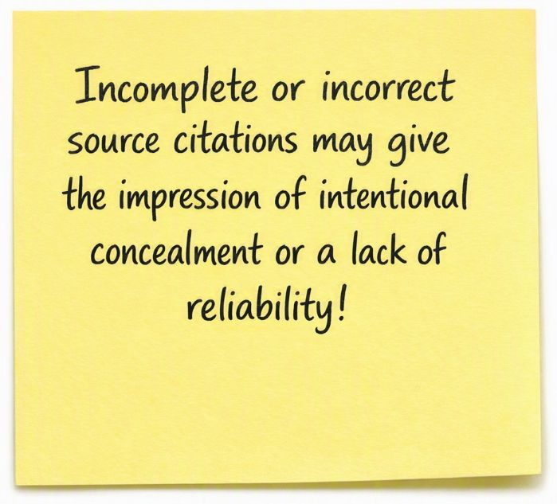
2.1 Reliability: Proper Citation (3/8)
(Pears and Shields, 2022; Veith, 2022)
As a general rule:
  Cite all sources you use, including tables, translations, and figures (be sure to check the license!)
  Follow the specified citation style and use only one citation style within a single paper or document (be consistent!)
  The language used in the main text determines the language of the citation (e.g., Pears and Shields vs. Pears und Shields)!

Slide 26
2.1 Reliability: Proper Citation (4/8)
(Pears and Shields, 2022; Veith, 2022)
Citation styles (citation guidelines) specify how different types of sources should be referenced in the body of the text and in the bibliography (Veith, 2022)
  Examples of different media and types of academic sources:
    Print media: books, academic journals, conference proceedings
    Electronic media: e-books, PDF articles, websites
    Interactive media: data portals
    Audiovisual media: vlogs, interviews, lecture recordings
    Physical objects: material samples
Different citation styles are preferred depending on the field of study and research discipline

Slide 27
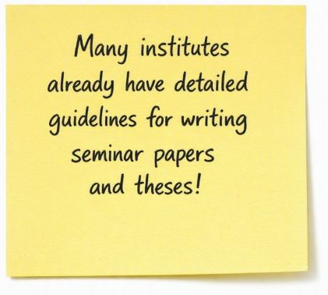
2.1 Reliability: Proper Citation (5/8)
Common citation styles in the fields of engineering and the natural sciences include:
  IEEE (Institute of Electrical and Electronics Engineers)
  Harvard referencing style
  Chicago
  Vancouver
  APA (American Psychological Association)
  MLA (Modern Language Association)
  DIN ISO 690

Slide 28
2.1 Reliability: Proper Citation (6/8)
(Pears and Shields, 2022)
The bibliographic components of a source include, among others:
  Authors, title, editors, year of publication, publisher/place of publication, edition or issue number, page numbers, information on electronic availability
Advantages of detailed source citations:
  Quick identification of the source type and targeted further research
  Enables assessment of the source’s credibility and relevance to one’s own work
The required components vary depending on the type of source and the medium being cited. The chosen citation style determines their order, highlighting, and formatting!

Slide 29
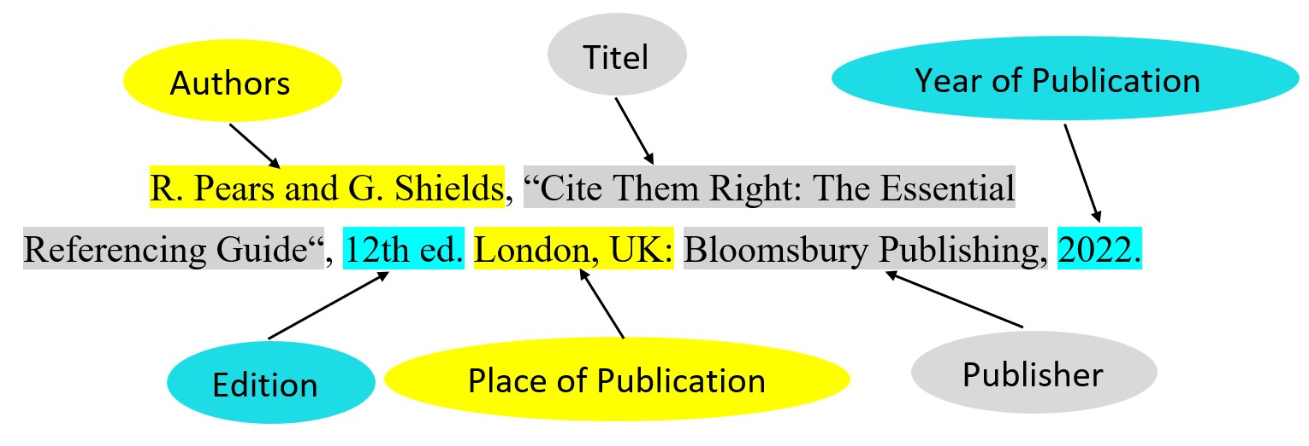
2.1 Reliability: Proper Citation (7/8)
(Pears and Shields, 2022; Veith, 2022)
Components of a source:

Slide 30
2.1 Reliability: Proper Citation (8/8)
(Pears und Shields, 2022)
The main differences in citing sources in the bibliography are:
  Order and formatting of the components
  Information on electronic availability
    URL, DOI (Digital Object Identifier), or DOI as a link
    A URL is not permanently valid and requires an access date
    If available, the DOI should always be preferred! A DOI serves to uniquely and permanently identify the source (International DOI Foundation, n.d.)
Bibliographic data formats (e.g., BibTeX) or reference management software (e.g., Citavi) support correct citation.

Slide 31
2.1 Reliability: Examples for Citing (1/3)
(Pears und Shields, 2022)
Harvard-style citation
  In the body of the text, the author(s) and year of publication are stated, e.g.,
  The citation of sources follows a clear set of rules (Swales and Feak, 2012).
  In the reference list, sources are listed in alphabetical order, e. g.,
  …
  Pears, R. and Shields, G. (2023) Cite Them Right: The Essential Referencing Guide. 12th ed. London: Bloomsbury Publishing.
  Swales, J. M. and Feak, C. B. (2012) Academic Writing for Graduate Students. 3rd ed. Ann Arbor, MI: University of Michigan Press. https://doi.org/10.3998/mpub.2173936
  …

Slide 32
2.1 Reliability: Examples for Citing (2/3)
(Pears und Shields, 2022)
IEEE
  In the running text, each source is assigned a number/reference number in the order in which it is cited; for example, [1] refers to the first source cited in the text:
  The citation of sources follows a clear set of rules [1].
  In the reference list, entries are ordered by reference number:
  [1] J. M. Swales and C. B. Feak, Academic Writing for Graduate Students, 3rd ed. Ann Arbor: University of Michigan Press, 2012. doi:10.3998/mpub.2173936
  [2] …

Slide 33
2.1 Reliability: Examples for Citing (3/3)
(Pears und Shields, 2022)
Chicago-style citation
  Sources are referenced in the body of the text using a reference symbol (usually a number), e.g.:
  The citation of sources follows a clear set of rules¹.
  The footnote appears at the bottom of the page, e.g.,
  ¹⁾ Swales, John M., and Feak, Christine B. ‘Academic Writing for Graduate Students’ (Ann Arbor: University of Michigan Press, 2012), 8.
  In the bibliography, sources are listed in alphabetical order:
  Swales, John M., and Feak, Christine B. ‘Academic Writing for Graduate Students’. 3rd ed. Ann Arbor: University of Michigan Press, 2012. https://doi.org/10.3998/mpub.2173936.

Slide 34
2.2 Honesty: Transparent Disclosure of the use of AI (1/2)
(TU Graz, 2023a; 2023b, University of Graz, 2023a)
There are clear guidelines on the use of AI:
  Graz University of Technology: Guidelines for the Use of AI-Supported Tools in Teaching
  University of Graz: Framework for Dealing with AI Systems
Common Basic Principles:
  The use of AI is generally permitted, but:
    always within the framework of good scientific practice
    in compliance with laws (copyright, data protection) and UNESCO recommendations

Slide 35
2.2 Honesty: Transparent Disclosure of AI Use (2/2)
(TU Graz, 2023a; 2023b, University of Graz, 2023a)
Instructors determine how AI may be used in their course:
  Rules must be communicated in advance in the course description
  Student Responsibilities:
    Students remain responsible for the content of their work
    AI use must be disclosed/identified (mandatory labeling, declaration of originality)
Please note that AI...
  is not a reliable search engine for sources or literature.
  does not reliably recognize different citation methods.
  sometimes collects data about you even without your consent.
  will always provide an answer, even if it is a hallucination.

Slide 36
2.2 Honesty: Avoid Plagiarism (1/4)
(TU Graz, 2025a; University of Graz 2023b)
Plagiarism is:
  “the complete or partial adoption of texts, content, ideas or artistic works, which are then presented as one’s own” (TU Graz, 2025a, p. 7) (transl. by Author)
Plagiarism (TU Graz, 2025a; University of Graz, 2023b) …
  constitutes academic misconduct
  has consequences under academic regulations
  is fraud with a view to gaining an unfair advantage

Slide 37
2.2 Honesty: Avoid Plagiarism (2/4)
Plagiarism occurs when sources, for example … (TU Graz, 2025a; University of Graz, 2023b)
  are missing
  are incorrect, fabricated (or imagined)
  do not clearly correspond to the text passage
Plagiarism can be avoided by (Pears and Shields, 2022):
  Citing all sources used (and thoroughly researched)
  Documenting sources used (possibly using a reference management program)
  Paraphrasing content correctly instead of copying it

Slide 38
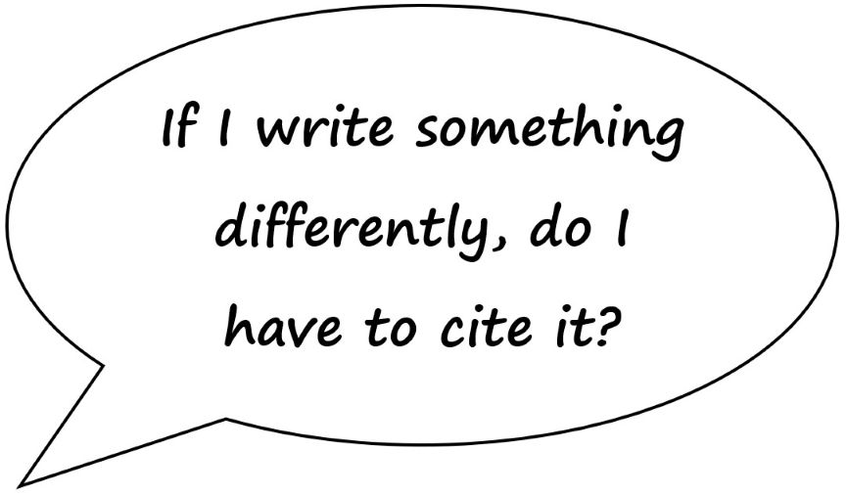
2.2 Honesty: Avoid Plagiarism (3/4)
(Pears and Shields, 2022):
Paraphrasing:
  Is a fundamental component of academic writing
  The content, theories, and findings of others are restated or summarized in one’s own words
  The source is cited!
  If you use other people's ideas or insights in a modified form without giving credit (citing), that's plagiarism!

Slide 39
2.2 Honesty: Avoid Plagiarism (4/4)
Plagiarism Check (or Similarity Check):
  Check using software
  Comparison for text similarities/text matches
Similarity Check at TU Graz (HTU TU Graz, 2023; TU Graz, 2025b):
  Not mandatory for bachelor’s theses (rather, it is at the discretion of the advisor)
  Students may request a free Similarity Check for their work three times per semester (HTU TU Graz, 2023)
Plagiarism Check at University of Graz:
  Mandatory for bachelor’s theses
  Students may request a free Similarity Check for up to 200 pages/year

Slide 40
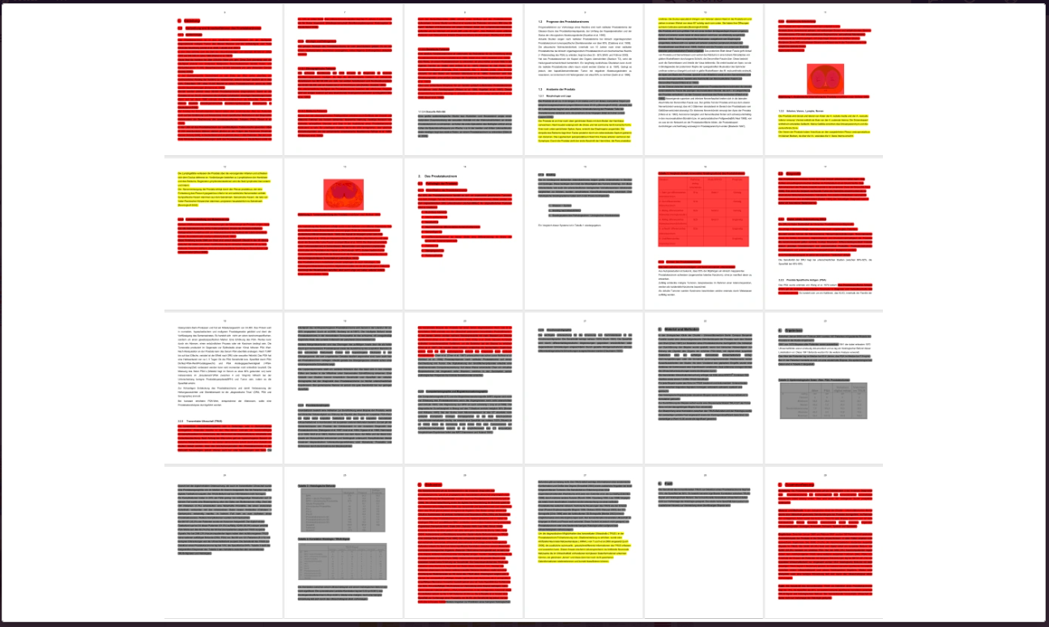
2.3 Respect: Intellectual property of others (1/2)
Plagiarism also includes:
  Theft of intellectual property
  Copyright infringement
  A sign of a lack of respect for the work of others
Fig. 6: Illustration Similarity Check. Source: VroniPlag

Slide 41
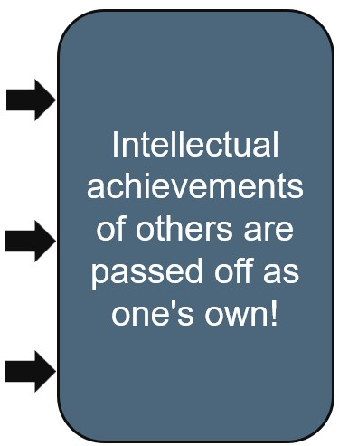
2.3 Respect: Intellectual property of others (2/2)
Different types of plagiarism (Hagenström, 2022), for example:
  Verbatim plagiarism:
    Copying entire sentences from a source without clearly attributing them (missing or unclear citation) to a specific passage in the text.
  Disguised plagiarism:
    Text is rephrased without citing the source.
  Translation plagiarism:
    A text in a foreign language is translated and reproduced without citing the source.

Slide 42
2.3 Respect: Avoid Plagiarism – Example for Paraphrasing (1/3)
  Below you will find the original text, followed by a paraphrase of it. Compare the two paragraphs: Is this a successful paraphrase or is it plagiarism?
  Original Text [ÖAWI, 2015, p. 5]
  All persons involved in research are to observe the Standards of Good Scientific Practice applicable to their respective fields, to investigate and settle any doubts as to the applicable standards, to avoid research misconduct and to immediately remedy any misconduct detected.
  Paraphrase 1:
  Any questions about how the Standards of Good Scientific Practice should be interpreted must be clarified before research begins, and these standards are to be followed throughout all research activities (ÖAWI, 2015). Misconduct is not permitted, and any violations that are discovered must be corrected without delay.
  Paraphrase 2:
  Every person engaged in research is required to observe the Standards of Good Scientific Practice relevant to their field, to investigate and settle any doubts regarding these standards, to prevent research misconduct, and promptly respond when misconduct becomes detected.

Slide 43
2.2 Respect: Avoid Plagiarism – Example for Paraphrasing (2/3)
Comparison: Few identical terms, different style, but the core message remains the same; source is clearly cited.
  Well-done paraphrase, no plagiarism!
  Original Text: ÖAWI, 2015, p. 5
  All persons involved in research are to observe the Standards of Good Scientific Practice applicable to their respective fields, to investigate and settle any doubts as to the applicable standards, to avoid research misconduct and to immediately remedy any misconduct detected.
  Paraphrase 1:
  Any questions about how the Standards of Good Scientific Practice should be interpreted must be clarified before research begins, and these standards are to be followed throughout all research activities (ÖAWI, 2015). Misconduct is not permitted, and any violations that are discovered must be corrected without delay.

Slide 44
2.2 Respect: Avoid Plagiarism – Example for Paraphrasing (3/3)
Comparison: high degree of similarity in the text; structure, semantic sequence, and wording in both sentences are very similar—requirements for paraphrase according to GSP standards are not met!
  If no source is cited -> clear plagiarism!
  If the source is cited -> classified as borderline plagiarism or plagiarism!
  Original Text: ÖAWI, 2015, p. 5
  All persons involved in research are to observe the Standards of Good Scientific Practice applicable to their respective fields, to investigate and settle any doubts as to the applicable standards, to avoid research misconduct and to immediately remedy any misconduct detected.
  Paraphrase 2:
  Every person engaged in research is required to observe the Standards of Good Scientific Practice relevant to their field, to investigate and settle any doubts regarding these standards, to prevent research misconduct, and promptly respond when misconduct becomes detected .

Slide 45
2.3 Respect for Colleagues and Researchers and Their Work
Fair Citation of Others’ Work (BMBWF, 2020; ÖAWI, 2026; TU Graz, 2025a, University of Graz 2023b):
  Cite all publications/sources that supported your work
  Cite all individuals who made a substantive contribution to a research project (This also applies to group projects during your studies)
  Individuals who did not make a direct contribution may be mentioned in an acknowledgment
Respect in collaboration (ALLEA, 2023):
  Collegiality, e.g., fair distribution of work packages in group projects (during your studies) or in collaborative efforts

Slide 46

2.4 Accountability: Responsibility in Your Studies (1/2)
(ALLEA, 2023)
Personal Responsibility for Academic Progress and Success:
  Take the initiative to familiarize yourself with
    Course requirements
    Criteria for performance evaluation
    Existing guidelines for writing (thesis) papers

Slide 47
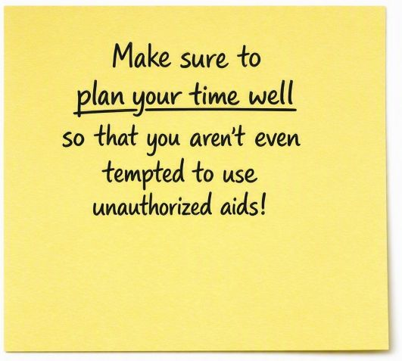
2.4 Accountability: Responsibility in Your Studies (2/2)
(ALLEA, 2023)
Personal Responsibility for your work from the initial idea through to publication:
  Responsibility for carrying out the work (including supervised work)
  Responsibility for the quality of sources
  Storage and retention of research data
  Transparent documentation of your work steps

Slide 48
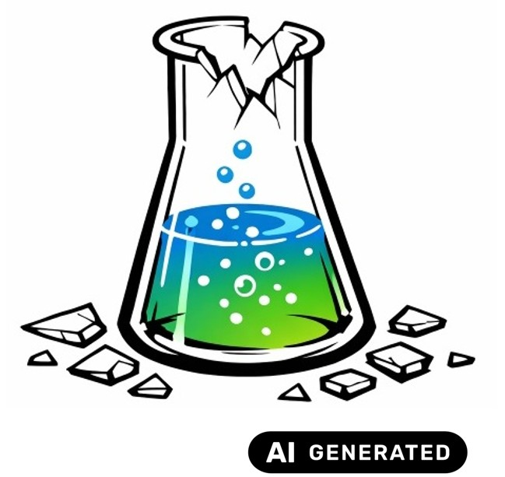
Part 3:
Violations of the GSP and Prevention of Scientific Misconduct
3.1 Definition of Research Misconduct
3.2 Academic Misconduct During Studies
Fig. 7: Laboratory Glass. Source: Own AI-generated figure, created by the author using the Academic AI Image Generator 25.06.2026

Slide 49
3.1 Definition of Research Misconduct (1/2)
Violation of the GSP (BMBWF, 2020)
  Generally, anything that does not comply with the GWP
Scientific misconduct HS-QSG, 2024; TU Graz, 2025a, University of Graz, 2023b):
  Occurs when the GSP guidelines are violated intentionally or through gross negligence
Both can have significant consequences, depending on the severity of the violation or misconduct!

Slide 50
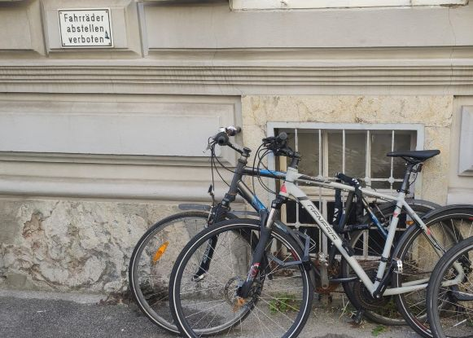
3.1 Definition of Research Misconduct (2/2)
(HS-QSG, 2024; TU Graz, 2025a; University of Graz, 2023b)
Intentional:
  A violation of standards of good scientific and artistic practice is at least considered possible and is accepted
Gross negligence:
  A violation of standards of good scientific and artistic practice resulting from a failure to exercise care, and a failure to recognize that the corresponding standards are thereby being violated
Abb. 8: Bicycles parked in a no-parking zone. Own Photo, Bicycles on Morellenfeldgasse Graz

Slide 51

3.2 Academic Misconduct During Studies: Examples
(Pears and Shields, 2022; TU Graz, 2025a, Universität Graz, 2023c)
Use of Unauthorized Aids During Exams
Plagiarism, e.g.:
  Copying from classmates (without attribution)
  Passing off collaborative work as one’s own
  Copying from sources without proper citation
Unauthorized use of AI
Fabricating data
Submitting work under someone else’s identity
Ghost writing (contract cheating)
Fig. 9: Graffiti “Do not lie and cheat” (adaptation of the original). Own Photopraph, Feuerbachgasse Graz

Slide 52
3.2 Academic Misconduct During Studies: Consequences
(TU Graz, 2025a; University of Graz, 2023c)
Consequences depend on:
  The severity of the misconduct
  The type of work (written exam, thesis, etc.) in which the misconduct occurred
  You will always lose time and forfeit your personal credibility and integrity!
Examples:
  Misconduct during examinations may result in a negative or invalid mark, loss of the right to sit the examination and/or referral to the Dean of Studies
  Serious misconduct (e.g. plagiarism): a negative mark for the work, up to and including exclusion from the degree programme for two semesters
  Revocation of the academic degree if misconduct is established after graduation

Slide 53
3.3 Academic Misconduct during Studies: How to avoid
(Spark at York University, 2013)
  Before submitting a written assignment, ask yourself…
1. Have you written your paper in your own words?
2. Have you read and understood all the sources used in your paper?
3. Have you clearly and correctly cited all the information and sources used, and have you used them appropriately?
4. When incorporating your own previous work (e.g., from other courses), have you also cited yourself?
5. Have you saved previous versions of the paper to be able to prove that it is your own work?

Slide 54
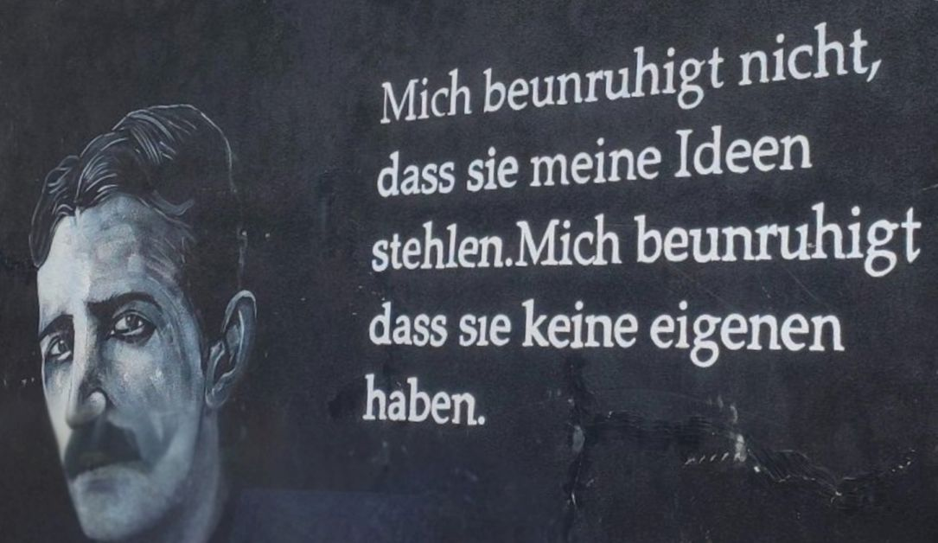
Best Luck with Your Studies!
“It doesn't worry me that they're stealing my ideas. What worries me is that they don't have any of their own.” (trans. by the author)
Nikola Tesla (1856–1943) studied in Graz from 1875 to 1877.
The world is waiting for your ideas - make the most of your studies - and play fair ;-)
Fig. 10: Graffiti “Nikola Tesla” (adaptation of the original). Own photograph, Feuerbachgasse, Graz

Slide 55
Part 4: Appendix (1/13)
4.1 Further Information for Students
  University Regulations
    Graz University of Technology (TU Graz) Satzungsteil Wissenschaftliche und Künstlerische Integrität – 12/2025 and Uni Graz
    Information and FAQs TU4U: Bachelor Paper
    AI Guide for Researchers at TU Graz and Uni Graz
    Guideline for the use of Artificial Intelligence (AI)-supported tools in the field of teaching
      Guideline for the use of Artificial Intelligence (AI)-supported tools in the field of teaching
  Graduation Support TU Graz and Uni Graz
  Plagiarism Check of HTU Graz and ÖH Uni Graz
  Ethics Compass of TU Graz

Slide 56
Part 4: Appendix (2/13)
4.1 Further Information for Students of Graz University of Technology:
  Services of Library and Archives
    Library services of TU Graz and Uni Graz
    Relevant Events of the university libraries TU Graz and Uni Graz
    Search Portals TU Graz and Uni Graz
  Overview Reference Management TU Graz and Uni Graz
  Languages, Key Competencies and In-House Training
    Key Competencies for Students
    Support-Webseite an der Uni Graz
  Point of contact for reporting suspected research misconduct: Commission for Scientific Integrity (CSI) TU Graz and Commission for Academic Integrity Uni Graz

Slide 57
Part 4: Appendix (3/13)
4.1 Further Information for Students of Graz University of Technology:
  Research Data Management (RDM) at TU Graz
    Guidelines on Safeguarding Good Scientific Practice (GSP)
    § 5 – Preservation of research data
      Work in accordance with legal regulations & ethical standards
      Clear & traceable documentation
      Subject results to critical review
      Public nature of basic research
    Want to know more?
    Contact Data Stewards: https://rdm.tugraz.at, rdmteam@tugraz.at or ub.fdm@uni-graz.at

Slide 58
Part 4: Appendix (4/13)
4.1 Further Information for Students of Graz University of Technology:
  Research Data Management (RDM) & FAIR Principles
    TU Graz RDM Services
  https://rdm.tugraz.at/dashboard Inhouse Training – Course Offer
    Uni Graz RDM-Service
    Secure Data Storage
    TU Graz Cloud and Uni Graz Cloud
    FTP Storage and File Service Uni Graz
    Network Storage
    Digital Documentation & Metadata
    eLabFTW
    GITlab at TU Graz and Uni Graz

Slide 59
Part 4: Appendix (5/13)
4.2 Bibliography (1/3)
All European Academies (ALLEA) (2023) The European Code of Conduct for Research Integrity (Revised edition). Berlin: ALLEA. Available at: https://www.allea.org/wp-content/uploads/2023/05/ALLEA-European-Code-of-Conduct-for-Research-Integrity-2023.pdf (Accessed: 14 June 2024).
American Psychological Association (APA) (2010) Publication Manual of the American Psychological Association. 6th ed. Washington, DC: American Psychological Association.
Austrian Agency for Research Integrity (ÖAWI) (2015) Guidelines for Good Scientific Practice. Vienna: ÖAWI. Available at: https://oeawi.at/gwp-richtlinien (Accessed: 27 April 2026).
Austrian Agency for Research Integrity (ÖAWI) (2026) Guideline of the Austrian Agency for Research Integrity on Good Scientific Practice. DOI: 10.5281/zenodo.21256974.
DeepL SE (2026) DeepL Translator. Available at: https://www.deepl.com/translator (Accessed: 31 August 2026).
Federal Ministry of Education, Science and Research [Bundesministerium für Bildung, Wissenschaft und Forschung, BMBWF] (2017) National Qualifications Framework. Vienna: BMBWF. Available at: https://www.qualifikationsregister.at (Accessed: 29 May 2026).
Federal Ministry of Education, Science and Research [Bundesministerium für Bildung, Wissenschaft und Forschung, BMBWF] (2019) National Development Plan for Public Universities 2022–2027. Vienna: BMBWF. Available at: https://www.bmfwf.gv.at/wissenschaft/hochschulgovernance/steuerungsinstrumente/guep.html#systemziele (Accessed: 27 April 2026).
Federal Ministry of Education, Science and Research [Bundesministerium für Bildung, Wissenschaft und Forschung, BMBWF] (2020) Practical Guide for Integrity and Ethics in Science. Vienna: BMBWF. Available at: https://oeawi.at/wp-content/uploads/2020/11/Praxisleitfaden-fuer-Integritaet-und-Ethik-in-der-Wissenschaft_Stand_29-9-2020_Final.pdf (Accessed: 15 April 2025).
Graz University of Technology (TU Graz) (2023a) Guideline for the Use of AI‑based Tools in Teaching. Graz: TU Graz. Available at: https://tu4u.tugraz.at/fileadmin/public/Studierende_und_Bedienstete/Anleitungen/Leitlinie_KI_in_der_Lehre_TU_Graz.pdf (Accessed: 29 May 2026).

Slide 60
Part 4: Appendix (6/13)
4.2 Bibliography (2/3)
Graz University of Technology (TU Graz) (2023b) Labelling the Use of Artificial Intelligence. Internal source, TU Graz Intranet. Available at: https://tu4u.tugraz.at/fileadmin/Studierende_und_Bedienstete/Information/Unsere_TU_Graz/Lehre_an_der_TU_Graz/Zitiervorschlaege_KI.pdf (Accessed: 29 May 2026).
Graz University of Technology (TU Graz) (2025a) Statute Section: Scientific and Artistic Integrity. SA 91000 SWKI 174‑01. Available at: https://tu4u.tugraz.at/fileadmin/public/Studierende_und_Bedienstete/Satzung_und_Geschaeftsordnungen_der_TU_Graz/Satzungsteil_Wissenschaftliche_und_Kuenstlerische_Integritaet.pdf (Accessed: 29 May 2026).
Graz University of Technology (TU Graz) (2025b) SIMILARITY CHECK – Plagiarism Check in the Plagiarius. Available at: https://teachcenter.tugraz.at (Accessed: 29 May 2026).
Hagenström, F. (2022) ‘Plagiate’. In: Frisch, K., Hagenström, F. and Reeg, N. (eds.) Wissenschaftliche Fairness. Wissenschaft zwischen Integrität und Fehlverhalten. Bielefeld: transcript, pp. 83–135. Available at: https://doi.org/10.14361/9783839459669.
Hochschul‑Qualitätssicherungsgesetz (HS‑QSG) (2024) Federal Act on Quality Assurance in Higher Education. BGBl. I No. 74/2011 as amended by BGBl. I No. 165/2023. Available at: https://ris.bka.gv.at/NormDokument.wxe?Abfrage=Bundesnormen&Gesetzesnummer=20007384&Artikel=&Paragraf=2a&Anlage=&Uebergangsrecht= (Accessed: 27 April 2026).
International DOI Foundation (n.d.) DOI® System. Available at: https://www.doi.org/ (Accessed: 11 August 2026).
Microsoft (2026) Microsoft Copilot. Available at: https://copilot.microsoft.com (Accessed: 21 August 2026).
Pears, R. and Shields, G. (2023) Cite Them Right: The Essential Referencing Guide. 12th ed. London: Bloomsbury Publishing.
Spark at York University (2013) Integrity in Practice. Available at: https://www.library.yorku.ca/spark/faculty/Integrity%20in%20Practice.pdf (Accessed: 6 March 2026).

Slide 61
Part 4: Appendix (7/13)
4.2 Bibliography (3/3)
Springer Nature (2026) Author Services. Available at: https://authorservices.springernature.com/ (Accessed: 14 August 2026).
Students’ Union of Graz University of Technology [Hochschülerinnenschaft der TU Graz, HTU Graz] (2023)* Plagiarism Check / Similarity Check for Students. Available at: https://htugraz.at/service/plagiats-check (Accessed: 29 May 2026).
Universities Act (UG) (2002) Universities Act 2002 – Consolidated Federal Law, version of 29 May 2026. Available at: https://www.ris.bka.gv.at/GeltendeFassung.wxe?Abfrage=Bundesnormen&Gesetzesnummer=20002128 (Accessed: 29 May 2026).
  Universität Graz (2023a) Orientierungsrahmen zum Umgang mit textgenerierenden KI-Systemen an der Universität Graz. Verfügbar unter https://static.uni-graz.at/fileadmin/_files/_project_sites/_lehren-und-lernen-mit-ki/KI-Orientierungsrahmen
  _230901.pdf (Zugriff am 23.09.2026)
  Universität Graz (2023b) Satzungsteil Grundsätze zur Sicherung guter wissenschaftlicher Praxis und zur Vermeidung von Verletzungen der Pflichten zur wissenschaftlichen Integrität. Verfügbar unter https://mitteilungsblatt.uni-graz.at/de/2023-24/12.c/pdf/ (Zugriff am 23.09.2026)
  Universität Graz (2023c) Studienrechtliche Bestimmungen. Verfügbar unter https://mitteilungsblatt.uni-graz.at/de/2025-26/33.a/pdf/ (Zugriff am 23.09.2026)
  Veit, D. (2022) Die wissenschaftliche Arbeit für Studierende der Ingenieurwissenschaften. München: Carl Hanser Verlag. https://doi.org/10.3139/9783446474659.fm
Wikipedia (n.d.) Wikipedia: Citing Wikipedia. Available at: https://en.wikipedia.org/wiki/Wikipedia:Citing_Wikipedia (Accessed: 10 August 2026).
Wissenschaftsrat (2015) Recommendations on Scientific Integrity. Position Paper (DRS. 4609‑15). Cologne. Available at: https://www.wissenschaftsrat.de/download/archiv/4609-15.html (Accessed: 5 May 2026).
Wrexham University (n.d.) Academic Integrity – Brief Guide for Students. Available at: https://wrexham.ac.uk/media/marketing/quality-and-student-admin-documents/Academic-Integrity-a-brief-guide-for-students.pdf (Accessed: 6 March 2026).

Slide 62
Part 4: Appendix (8/13)
4.3 List of Figures
  Fig. 1: Graffiti (AI-generated image created by the author using the Academic AI Image Generator, May 13, 2026).
  Fig. 2: Magnifying glass (AI-generated image created by the author using the Academic AI Image Generator, June 17, 2026).
  Fig. 3: Work Desk (AI-generated image created by the author using the Academic AI Image Generator, June 25, 2026).
  Fig. 4: Screenshot: Wikipedia article on thermodynamics (Wikipedia, n.d.), available at: https://de.wikipedia.org/wiki/Thermodynamik (Accessed: June 24, 2026).
  Fig. 5: Cover © Springer, textbook *Fundamentals of Thermodynamics* (2016). Used as a quotation in accordance with § 42f UrhG; not licensed under CC BY 4.0.
  Fig. 6: Fig. 7: Illustration of plagiarism check. “Alm col.,” VroniPlag Wiki, n.d., available at: https://vroniplag.fandom.com/de/wiki/VroniPlag_Wiki:Illustration?file=Alm_col.png (accessed: March 25, 2026).
  Fig. 7: Broken laboratory glassware (AI-generated image created by the author using the Academic AI Image Generator, June 25, 2026)
  Fig. 8: No bicycle parking sign on Morellenfeldgasse, Graz. (Photo: Sigrid Hackl-Wimmer, May 20, 2026).
  Fig. 9: Graffiti reading “Tuts nicht lügen [Do not lie]” (own adaptation of the original: a section of the original selectively highlighted) on Feuerbachgasse, Graz. Artist: Mario Paukovic (Photo: Sigrid Hackl-Wimmer on May 22, 2026).
  Fig. 10: Graffiti “Nikola Tesla” (own adaptation of the original: retouching for improved visibility) on Feuerbachgasse in Graz. Artist: Mario Paukovic (Photo: Sigrid Hackl-Wimmer on May 22, 2026).

Slide 63
Part 4: Appendix (9/13)
4.4 Licensing
  This set of slides of the staff unit Quality Management, Evaluation and Reporting is licensed under the Creative Commons Attribution 4.0 International (CC BY 4.0) license.
  Unless otherwise noted, this set of slides is licensed under the Creative Commons Attribution 4.0 International (CC BY 4.0) license. This means that the set of slides may be reproduced, distributed, modified, and otherwise used under the terms of the CC BY 4.0 license.
    Terms of Use at https://creativecommons.org/licenses/by/4.0/
  Third-Party Content:
    Illustration, photographs, book covers, logos, and other content accompanied by a separate source or rights notice are not covered by the CC BY 4.0 license. Their use is governed by the respective notices provided. To the extent that such content is used within the scope of the statutory right to quote (§ 42 f UrhG), this is done exclusively for the specific purpose of quotation as stated.

Slide 64
Part 4: Appendix (10/13)
4.5 AI Use
  AI Use in this document
    Text and accessible design:M365 Copilot and GPT-5 were used to correct style, shorten text and ensure accessible design. All decisions regarding content and changes to content, as well as word choice and rewording, were made exclusively by the author.
    Self-generated images and text visualizations were created using Academic AI (Graz University of Technology).
    DeepL (2026) was used to support translation and to check for grammar and style. Changes to the content or phrasing were made exclusively by the author.

Slide 65
Part 4: Appendix (11/13)
4.5 AI Use: Prompts
  Self-generated images were created using Academic AI (TU Graz):
    Academic AI, prompt dated 13 May 2026: “Depict the slogan ‘Every game has rules. Master the rules, win the game!’ as a piece of wall graffiti. Use bright colours. The lettering should be very legible (semi-wildstyle). The lettering should not be on a single line, but should span at least three lines. The graffiti should consist solely of the lettering.” Used to create “Fig. 1: Graffiti”.
    Academic AI, prompt dated 17 June 2026: “Depict, schematically, a sheet of paper with writing on it being examined through a magnifying glass. The characters should only be hinted at; no actual letters should be recognizable.” Used to create “Fig. 2: Magnifying glass”.
    Academic AI, prompt dated 25 June 2026: “Depict a broken, upright laboratory glass or flask. It should be a schematic representation, but the contents of the glass may be coloured. The shards lying around should be similar in size and shape to the broken shards.” Used to create “Fig. 7: Broken laboratory glassware”.
    Academic AI, prompt from June 26, 2026: “Draw a schematic representation of a workbench on which various tools and implements are carefully arranged. It should be clearly evident that this is a fictional/naturalistic depiction and not a realistic one. It should be soft-focused, like a sketch with minimal color (only dark blue and teal), and no more than 15 tools should be depicted. Only the workbench should be shown from a top-down view; no tools should be hanging on the wall!” Used to create “Fig. 3: Work Desk.”

Slide 66
Part 4: Appendix (12/13)
4.5 Use of AI: Prompts
  Text visualizations were created using Academic AI (Graz University of Technology).
    Academic AI, prompt dated 15 May 2026: “The image should look like a yellow Post-it note. Write the following text on it in clearly legible handwriting: ‘Academic integrity = attitude’ and, below that, ‘GWP = behaviour!’ The text should be centred and large enough to fill the entire Post-it note.” For a representation of the text on the Post-it note.
    Academic AI, prompt dated 20 May 2026: “The image should look like a yellow Post-it note. Write the following text on it in clearly legible handwriting: ‘A great many institutions already have detailed guidelines for writing seminar papers and dissertations!’ The text should be large enough to fill the entire Post-it note.” For a visual representation of the text on the Post-it note.
    Academic AI, prompt dated 27 May 2026: “The image should look like a yellow Post-it note. Write the following text on it in clearly legible handwriting: ‘Incomplete or incorrect references may give the impression of deliberate concealment or a lack of diligence!’ Do not underline anything; centre the text.” For a Post-it note.
    Academic AI, Prompt vom 02.06.2026: „The image should look like a yellow Post-it note. Write the following text on it in clearly legible handwriting: ‘Incomplete or incorrect references may give the impression of deliberate concealment or a lack of diligence!’ Do not underline anything; centre the text: „When in doubt: Always cite your source!“ Visual representation of the text on the Post-it note.
    Academic AI, prompt dated 8 June 2026: “The image should look like a yellow Post-it note. Write the following text on it in clearly legible handwriting: ‘Read your department’s guidelines!’ Underline ‘Read’.”
    Academic AI, prompt dated 17 June 2026: “The image should look like a yellow Post-it note. Write the following text on it in clearly legible handwriting: ‘Make sure, through good time management, that you are not even tempted to use unauthorised aids!’ Underline ‘not even’.” The text on the Post-it note.

Slide 67
Part 4: Appendix (13/13)
Acknowledgements
Acknowledgements for their valuable input:
Martin Ebner, Eva Felber, Maria Haas, Claire Jean-Quartier, Daniel Kurzmann, Christoph Ladurner, Volker Lang, Gerlinde Maxl, Viola Mayerhofer, Verena Schwägerl-Melchior
Acknowledgements for the coordination with NAWI-Graz to:
Thomas Schweitzer

Slide 68
Contact:
Graz University of Technology
Quality Management, Evaluation & Reporting
Sigrid Hackl-Wimmer
Rechbauerstraße 12
8010 Graz, Austria
gwp@tugraz.at
www.tugraz.at/go/qm

