Slide 1
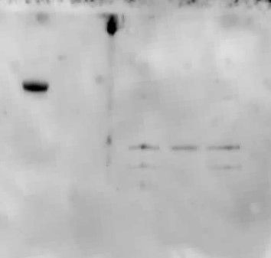
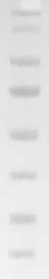
Western blot: 22-06-17, K. phaffii clones culture supernatant + controls
WT
A6
K11
K9
K6
kDa
140
115
PEP4 ?
YPS1 ?
KEX
Proteases
https://sfamjournals.onlinelibrary.wiley.com/doi/full/10.1111/1751-7915.13499
80
65
50
40
30
25

Slide 2
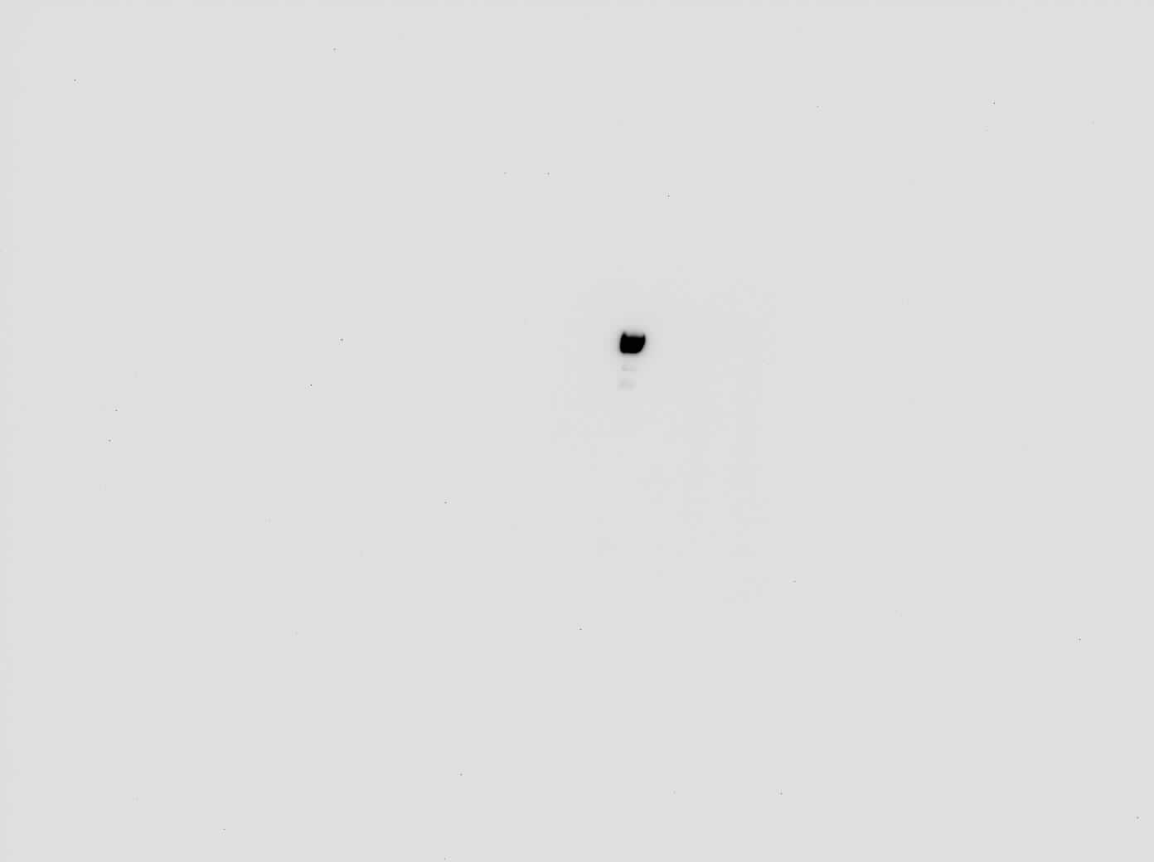
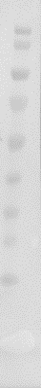
Western blot: 22-07-22, K. phaffii clones intracellular + controls
K1 pH 6
K10 pH 6
K1 pH 7.5
K10 pH 7.5
kDa
WT
MmCAR
140
115
80
65
50
40
30
25
15

Slide 3
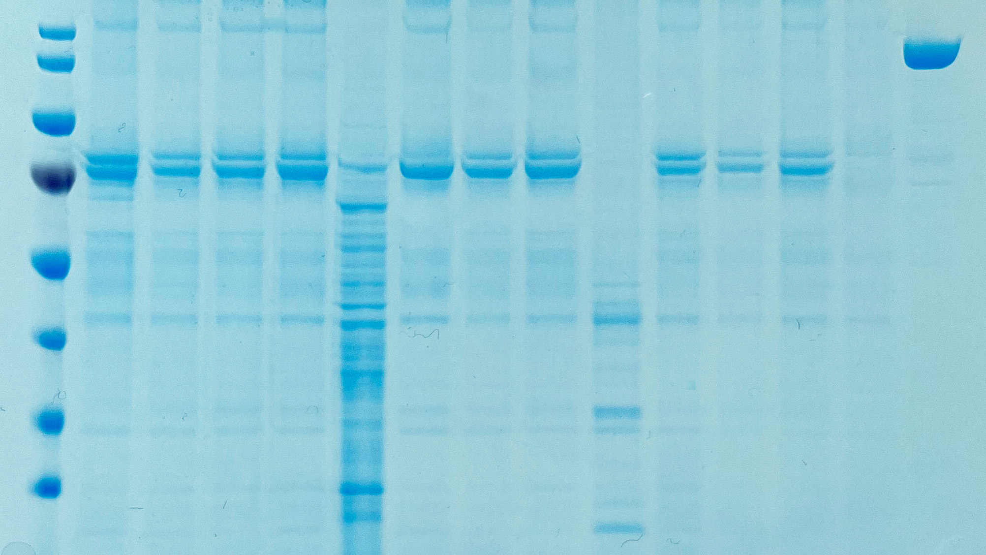
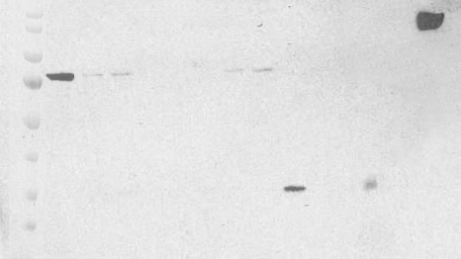
MmCAR A Domain 20.09.22
K9 K10 K11 K12 K13 K14 K15 K16 K17 K18 K19 K20 WT MmCAR
kDa
140
115
80
K9 K10 K11 K12 K13 K14 K15 K16 K17 K18 K19 K20 WT MmCAR
65
50
40
30
25

