Slide 1

Good Scientific and Artistic Practice for the Master’s programme
Quality Management, Evaluation & Reporting, Graz University of Technology
October 2026
https://doi.org.10.3217/vet0m-aad63
This document is licensed under the Creative Commons Attribution 4.0 International (CC BY 4.0) licence.
This document has been agreed with the NAWI Graz Coordination Office.

Slide 2
Development and Use of the Teaching Materials:
These slide sets have been developed to provide an introduction to the fundamentals of good scientific and artistic practice at Graz University of Technology (TU Graz) as well as in inter-university degree programmes within the NAWI Graz framework. The current set of slides has been adapted for Master’s programmes. Where identical content or the same visual material is used across different sets of slides, no reference is made to other sets of slides, but rather to the original source of the content or material used in each instance.
This applies equally to the English-language slide sets. These are, in principle, direct translations of the German-language versions and differ only in terms of the inclusion of, or references to, English-language information and source materials.
This teaching material will be piloted at TU Graz during the 2026/2027 academic year.
Licensing:
This work by the staff unit Quality Management, Evaluation & Reporting is licensed under CC BY 4.0. For further information, see the appendix.

Slide 3
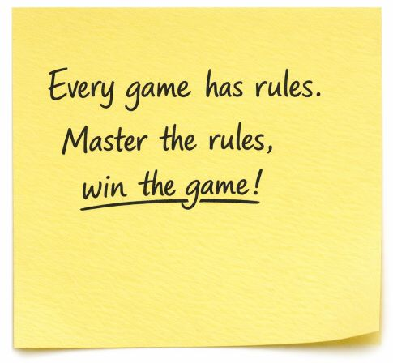
Good Scientific and Artistic Practice (GSP) – Why Is This an Issue Today?
The standards of good scientific practice ensure integrity, quality, and social responsibility in all phases of research (ÖAWI, 2026). From the very beginning of one’s studies, they provide guidance for academic work and everyday student life.

Slide 4
What Can You Expect?
Part 1: Fundamentals of Good Scientific and Artistic Practice (GSP)
Part 2: Examples of GSP in the Context of Academic Work
Part 3: Understanding and Avoiding Academic Misconduct
Part 4: Appendix
  Further Information, Sources, Licensing, AI Use, Acknowledgements

Slide 5

Part 1:
Fundamentals of Good Scientific and Artistic Practice (GSP)
1.1 What Is GSP?
1.2 The Importance of GSP in Research and Academic Studies
1.3 The Four Principles of Scientific Integrity
Fig. 1: Magnifying Glass. Source: Own AI-generated figure, created by the author using the Academic AI Image Generator, 17.06.2026

Slide 6
1.1 What Is GSP?
(HS-QSG, 2024)
Good Scientific and Artistic Practice:
  Covers norms and standards for scientific work
  Rules that support researchers and research institutions in addressing various challenges in the context of their work
Inclusion of the principle of good scientific and artistic practice in the Higher Education Quality Assurance Act (HS-QSG, 2024, Section 2a):
  To standardize quality standards for all Austrian higher education institutions
    Research focused on the acquisition of knowledge or the generation of knowledge
    Research focused on expression, interpretation, or the use of creative processes

Slide 7
1.2 The Importance of GSP for Research and Academic Study (1/2)
(BMBWF, 2019; ÖAWI, 2015; ÖAWI, 2026)
”The quality of research is a precious asset for every society.“
(ÖAWI, 2015, p. 3)
Quality in research ensures that …
  the public can have confidence in scientific findings.
  innovations can be built on reliably documented findings.
  a high standard is set in education (= a guarantee of the quality of your education!)
  your paper/thesis is credible.

Slide 8
1.2 The Importance of GSP for Research and Academic Study (2/2)
Following the GSP guidelines will support you in your studies (among other things) with regard to:
  thorough source research
  correct citation
  correct documentation
  identifying plagiarism
  knowing how you are permitted to use Artificial Intelligence (AI)
  → and thus, in writing your own independent academic thesis!

Slide 9
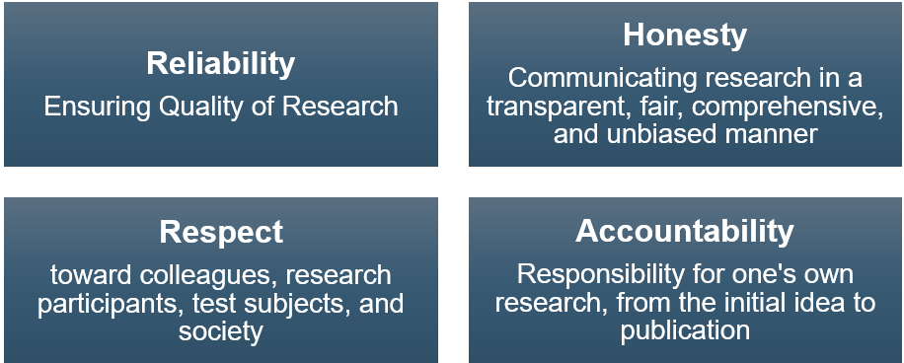
1.3 The Four Principles of Scientific Integrity (1/7)
(ALLEA, 2023, p. 5)
Adherence to the four principles essentially ensures compliance with GSP:

Slide 10
1.3 The Four Principles of Scientific Integrity (2/7)
(ALLEA, 2023; Wrexham University, n.d.)
Reliability:
  By working carefully and accurately, you will acquire the skills that will be required of you throughout your studies and in your professional life. By taking a methodical approach and adhering to recognized standards, you will be able to produce compelling, high-quality results.
  Honesty:
  By refraining from gaining any unfair advantages and instead working transparently and honestly, you strengthen your own credibility.

Slide 11
1.3 The Four Principles of Scientific Integrity (3/7)
(ALLEA, 2023; Wrexham University, n.d.)
Respect:
  By showing respect for the work of other researchers and citing your sources or acknowledging your colleagues, you avoid research misconduct and ensure that your work is transparent.
  Accountability:
  You know what you have accomplished in your seminar paper or thesis. By presenting your work steps in writing or orally, you can credibly defend your approach—for example, during exams.

Slide 12
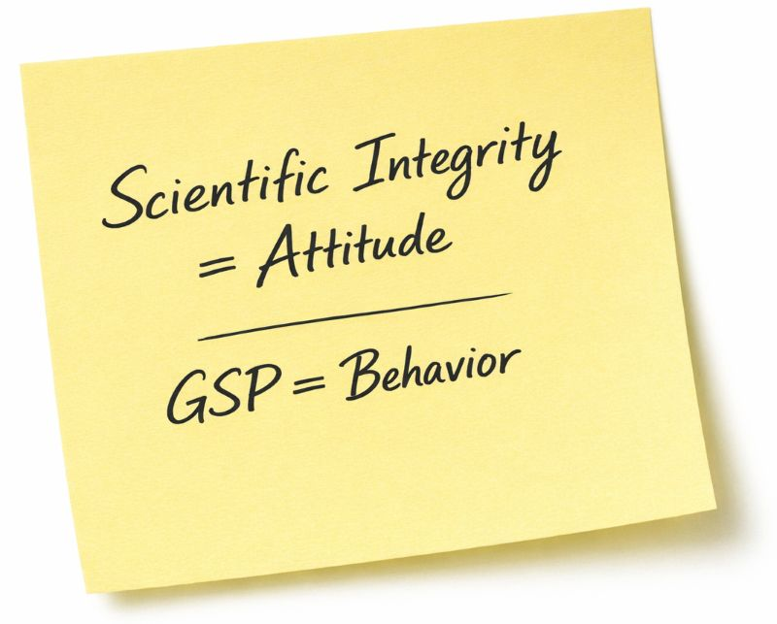
1.3 The Four Principles of Scientific Integrity (4/7)
Scientific integrity is (Wissenschaftsrat [German Science Council], 2015; ÖAWI, 2026):
  A commitment to conducting research with diligence, honesty, respect, and responsibility
GSP stands for (ALLEA, 2023):
  Adherence to rules to ensure that research is reliable, honest, respectful, and responsible

Slide 13
1.3 The Four Principles of Scientific Integrity (5/7)
(ALLEA, 2023, p. 5)
Below are some examples of compliance with GSP. Can you match the examples to the principles of scientific integrity?
  Transparent documentation of data collection and analysis
  Compliance with laboratory safety regulations
  Citation of all sources used in a text
  Storage of research data in accordance with statutory retention periods

Slide 14
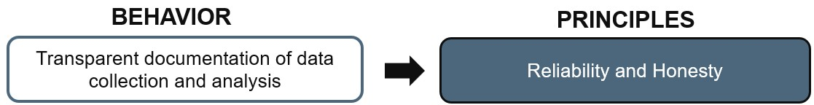
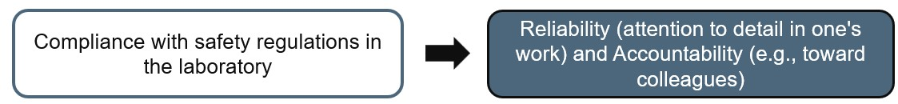
1.3 The Four Principles of Scientific Integrity (6/7)
The examples can be categorized according to the principles of academic integrity as follows:

Slide 15
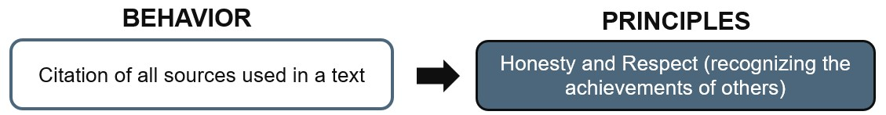
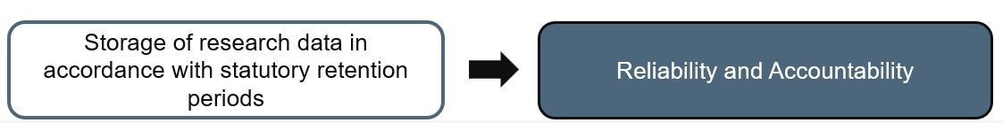
1.3 The Four Principles of Scientific Integrity (7/7)
The examples can be categorized according to the principles of academic integrity as follows:

Slide 16
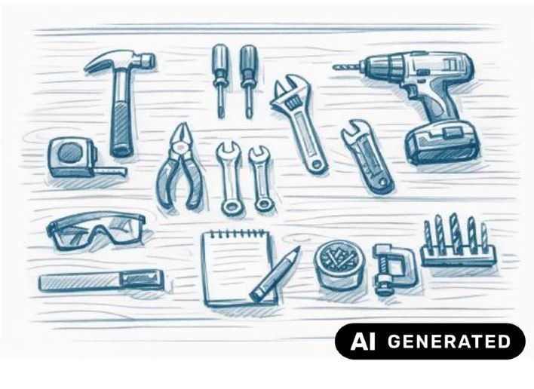
Part 2:
Examples of GSP in the Context of Scholarly Work:
Explanation Based on the Four Principles of Scientific Integrity
  2.1 Reliability
  2.2 Honesty
  2.3 Resect
  2.4 Accountability
Fig 2: Work Desk. Source: Own AI-generated figure, created by the author using the Academic AI Image Generator, 25.06.2026

Slide 17
2.1 Reliability: Working with Sources (1/3)
Sources are:
  All the information referred to in a paper or text
    E.g., scholarly literature, interviews, vlogs, plans, material samples
Based on the sources, the following steps are carried out:
  Scientific statements are substantiated and contextualized
  Scientific statements that are transparent and verifiable
  Academic papers are assessed

Slide 18
2.1 Reliability: Working with Sources (2/3)
(ÖAWI, 2015; Pears and Shields, 2022
Sources must be cited in order to:
  distinguish between one’s own contributions and ideas and those of others
  clearly acknowledge the authorship of others and respect their scholarly contributions
  demonstrate thorough research and familiarity with standard works in a discipline
  enable readers to conduct their own research and reflect on the sources

Slide 19
2.1 Reliability: Working with Sources (3/3)
(ÖAWI, 2015; Pears and Shields, 2022
A good source meets scientific credibility standards, i.e.:
  The author is known
  Objective reasoning, no personal opinions
  Accurate presentation of theories and facts, proper citations
  Correct and transparent use of methods
  Peer-reviewed (evaluation by independent experts)
  Relevance to the academic community
  Published by a scientifically recognized publisher

Slide 20
2.1 Reliability: Example of Working with Sources (1/5)
Which of the sources listed below are suitable for your seminar paper, bachelor’s or master’s thesis? Which ones should you avoid?
  Think about an answer for each source. Recommendations follow on the next slides!
  Journal „Advanced Composites and Hybrid Materials“
  Seminar papers, Bachelor‘s theses and Master‘s theses
  Online encyclopedias

Slide 21

2.1 Reliability: Example of Working with Sources (2/5)
(Pears and Shields; Veith, 2022)
Which sources are suitable for seminar papers, bachelor’s theses or master’s theses?
  Journal „Advanced Composites and Hybrid Materials”
    Reputable publisher
    Peer-reviewed information
    Journal with a good reputation within the research community
    → Reputable source, suitable for citation!
    … and available for you to download free of charge via the TU/University of Graz Libraries ;-)
Fig. 3: Cover: @Springer Publishers, journal Advanced Composites and Hybrid Materials (2026). Used as a quotation in accordance with Section 42f of the German Copyright Act (UrhG); not licensed under CC BY 4.0.

Slide 22
2.1 Reliability: Example of Working with Sources (3/5)
(Sandberg, 2012; Veith, 2022)
Which of the sources listed below are suitable for your seminar paper, bachelor’s or master’s thesis?
  Seminar papers, Bachelor‘s theses and Master‘s theses
    Avoid citing seminar papers in your seminar papers or final theses
    Cite Bachelor’s and Master’s theses only in exceptional cases (e.g., original source, very specific research questions, no academic article on the topic available to date)
  Online encyclopedias
    Check the level of acceptance within the research community
    Wikipedia is not suitable for academic evidence

Slide 23
2.1 Reliability: Example of Working with Sources (4/5)
(Elmore and Weston, 2020)
Why is it important to check the quality of a source?
  → Among other reasons, because of the rise in predatory journals!
  Business models of predatory journals/publishers:
    Revenue from fees for rapid, inadequately reviewed publications
    Appropriation of other people’s research findings (Vandevelde, 2025)
  Damage to research caused by predatory journals/publishers:
    Incorrect findings are disseminated (usually no peer review, no possibility of retracting flawed articles)
    → leads to distorted findings and a loss of trust in research

Slide 24
2.1 Reliability: Example of Working with Sources (5/5)
(Elmore and Weston, 2020)
Consequences for researchers:
  Journals that are not listed are overlooked by reputable databases, thus valuable findings are not discovered or cited
  If journals end up on ‘blacklists’, their publications lose their value
  The appropriation of research findings by others diminishes the value of one’s own findings (doubts regarding origin, traceability and credibility)
Protection against predatory journals:
  Check the quality of editors, journals and publishers
  Be aware of warning signs, e.g., promises of (unrealistically) rapid publication
  Use blacklists (e.g., beallist.net)
  Follow checklists for identifying predatory journals (e.g., thinkchecksubmit.org)

Slide 25
2.1 Reliability: Proper Citation (1/4)
(Pears and Shields, 2022; Veith, 2022)
All sources used in the preparation of a paper must be cited correctly
  The following must be cited:
    All content (theories, ideas, research findings, etc.) that does not originate from you!
  The following do not need to be cited:
    General knowledge
    Knowledge that is common knowledge within the relevant research community
  As a rule: If in doubt, always cite the source!

Slide 26
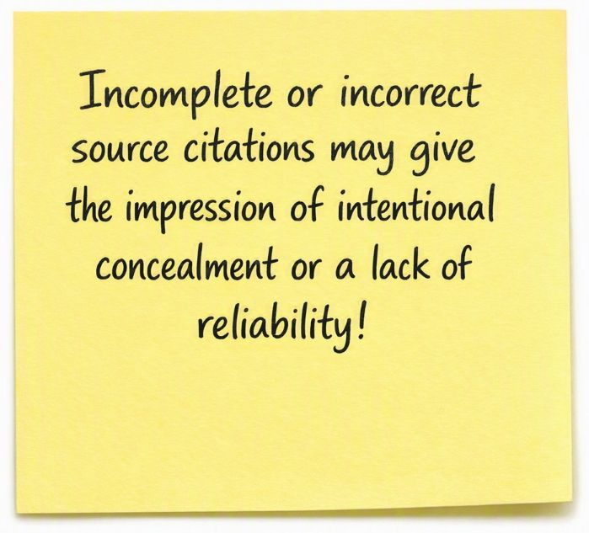
2.1 Reliability: Proper Citation (2/4)
(Pears and Shields, 2022; Veith, 2022)
As a general rule:
  Cite all sources you use, including tables, translations, and figures (be sure to check the license!)
  Follow the specified citation style and use only one citation style within a single paper or document (be consistent!)
  The language used in the main text determines the language of the citation (e.g., Pears and Shields vs. Pears und Shields)!

Slide 27
2.1 Reliability: Proper Citation (3/4)
Citation styles (citation guidelines) specify how different types of sources should be referenced in the body of the text and in the bibliography (Veith, 2022)
  (Literature-)Sources contain several components (Pears and Shields, 2022):
    Authors, title, year of publication, editors, online availability, etc.
  Depending on the source (and citation guidelines!), these components are ordered or emphasized differently
    Advantages:
      Quick identification of the type of source, which determines the subsequent search strategy
      Relevance to one’s own work or the source’s credibility can be assessed

Slide 28
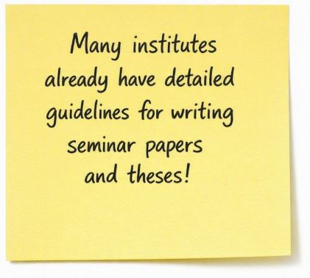
2.1 Reliability: Proper Citation (4/4)
Common citation styles in the fields of engineering and the natural sciences include:
  IEEE (Institute of Electrical and Electronics Engineers)
  Harvard referencing style
  Chicago
  Vancouver
  APA (American Psychological Association)
  MLA (Modern Language Association)
  DIN ISO 690

Slide 29
2.1 Reliability: Examples for different citation styles
Harvard citation style:
  In the main text, e.g.: “Predatory journals misrepresent their editorial board (Elmore and Weston, 2020).”
  In the reference list (in alphabetical order):
  Elmore, S.A. and Weston, E.H. (2020) ‘Predatory Journals: What They Are and How to Avoid Them’, Toxicologic Pathology, 48(4), pp. 607–610. doi:10.1177/0192623320920209.
Citation according to IEEE:
  In the main text, a number is assigned to the source (in the order in which it is cited), e.g.: “... their editorial board [1].”
  In the reference list: (listed by number)
  [1] S. A. Elmore and E. H. Weston, “Predatory Journals: What They Are and How to Avoid Them,” Toxicologic Pathology, vol. 48, no. 4, pp. 607–610, 2020, doi:10.1177/0192623320920209.
Citation according to Chicago Notes:
  In the main text, e.g.: “Predatory journals misrepresent their editorial board1.”
  In the footnotes, e.g.: 1) Susan A. Elmore and Elizabeth H. Weston, “Predatory Journals: What They Are and How to Avoid Them,” Toxicologic Pathology 48, no. 4 (2020): 607–610, https://doi.org/...
  In the reference list: (alphabetical order)
  Elmore, Susan A., und Elizabeth H. Weston. “Predatory Journals: What They Are and How to Avoid Them.” Toxicologic Pathology 48, Nr. 4 (2020): 607–610. https://doi.org/10.1177/0192623320920209

Slide 30
2.1 Reliability: Online Sources
Date of Access for online sources:
  Online articles with a DOI do not require a date of access (the Digital Object Identifier does not change)
  Online sources that may change usually require an exact date of access (document your access to a URL!)
Example of an online video (YouTube):
  Styria – Ambassadors with Heart (2024) Johanna Pirker: Forbes “30 Under 30” and the Creative World of Computer Science. June 12. Available at: https://www.youtube.com/watch?v=b6mPJl2fLsc. (Accessed on: June 1, 2026)
Example of a patent (from Pears and Shields, 2022, pp. 87–88):
  Padley, S. (2015) Radiator isolating valve, UK Intellectual Property Office Patent No. GB2463069. Available at: https://wordwide.espacenet.com/ (Accessed: May 24, 2021).

Slide 31
2.2 Honesty: Transparent Disclosure of the use of AI (1/2)
(TU Graz, 2023a; 2023b, University of Graz, 2023a)
There are clear guidelines on the use of AI:
  Graz University of Technology: Guidelines for the Use of AI-Supported Tools in Teaching
  University of Graz: Framework for Dealing with AI Systems
Common Basic Principles:
  The use of AI is generally permitted, but:
    always within the framework of good scientific practice
    in compliance with laws (copyright, data protection) and UNESCO recommendations

Slide 32
2.2 Honesty: Transparent Disclosure of AI Use (2/2)
(TU Graz, 2023a; 2023b, University of Graz, 2023a)
Instructors determine how AI may be used in their course:
  Rules must be communicated in advance in the course description
  Student Responsibilities:
    Students remain responsible for the content of their work
    AI use must be disclosed/identified (mandatory labeling, declaration of originality)
Please note that AI...
  is not a reliable search engine for sources or literature.
  does not reliably recognize different citation methods.
  sometimes collects data about you even without your consent.
  will always provide an answer, even if it is a hallucination.

Slide 33
2.2 Honesty: Avoid Plagiarism (1/4)
(TU Graz, 2025a; University of Graz, 2023b)
Plagiarism is:
  “the complete or partial adoption of texts, content, ideas or artistic works, which are then presented as one’s own” (TU Graz, 2025a, p. 7) (transl. by Author)
Plagiarism (TU Graz, 2025a; University of Graz, 2023b) …
  constitutes academic misconduct
  has consequences under academic regulations
  is fraud with a view to gaining an unfair advantage

Slide 34
2.2 Honesty: Avoid Plagiarism (2/4)
Plagiarism occurs when sources, for example … (TU Graz, 2025a; University of Graz, 2023b)
  are missing
  are incorrect, fabricated (or imagined)
  do not clearly correspond to the text passage
Plagiarism can be avoided by (Pears and Shields, 2022):
  Citing all sources used (and thoroughly researched)
  Documenting sources used (possibly using a reference management program)
  Paraphrasing content correctly instead of copying it

Slide 35
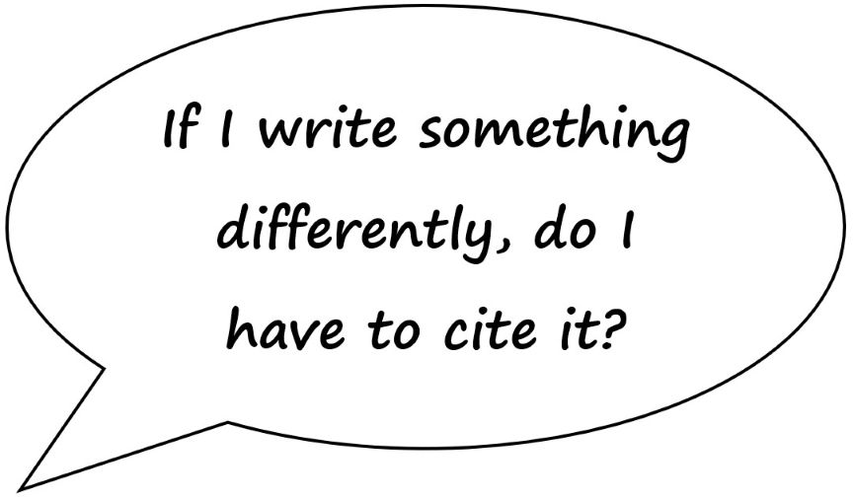
2.2 Honesty: Avoid Plagiarism (3/4)
(Pears and Shields, 2022)
Paraphrasing :
  Is a fundamental component of academic writing
  The content, theories, and findings of others are restated or summarized in one’s own words
  The source is cited!
  If you use other people's ideas or insights in a modified form without giving credit (citing), that's plagiarism!

Slide 36
2.2 Honesty: Avoid Plagiarism (4/4)
Plagiarism Check (or Similarity Check):
  Check using software
  Comparison for text similarities/text matches
Similarity Check at TU Graz and University of Graz (HTU TU Graz, 2023; TU Graz, 2025b; ÖH Uni Graz 2026):
  Mandatory for Master’s theses
    Students may request a free Similarity Check for their work
      TU Graz: three times per semester (HTU TU Graz, 2023)
      University of Graz: ree Similarity Check for up to 200 pages/year

Slide 37
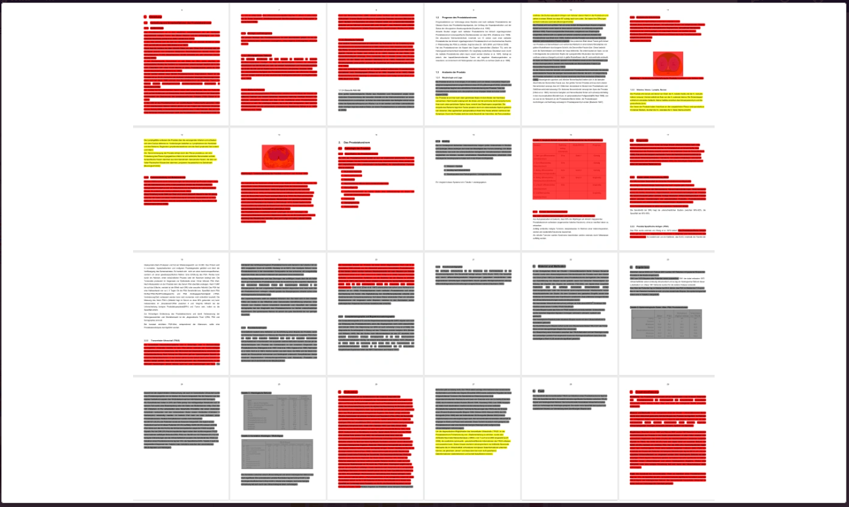
2.3 Respect: Intellectual property of others (1/2)
Plagiarism also includes:
  Theft of intellectual property
  Copyright infringement
  A sign of a lack of respect for the work of others
Fig. 4: Illustration Similarity Check. Source: VroniPlag

Slide 38
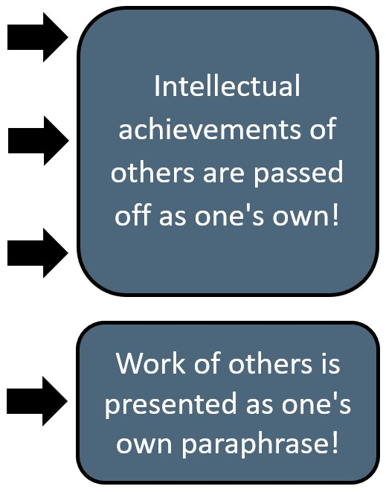
2.3 Respect: Intellectual property of others (2/2)
Different types of plagiarism (Hagenström, 2022), for example:
  Verbatim plagiarism:
    Copying entire sentences from a source without clearly attributing them (missing or unclear citation) to a specific passage in the text.
  Disguised plagiarism:
    Text is rephrased without citing the source.
  Translation plagiarism:
    A text in a foreign language is translated and reproduced without citing the source.
  Sacrificial Pawn:
    Direct reproduction of text, including the source, but without quotation marks (this suggests that the text is an indirect quote or a paraphrase)

Slide 39
2.2 Respect: Avoid Plagiarism – Example for Paraphrasing
  Original Text [ÖAWI, 2015, p. 5]
  All persons involved in research are to observe the Standards of Good Scientific Practice applicable to their respective fields, to investigate and settle any doubts as to the applicable standards, to avoid research misconduct and to immediately remedy any misconduct detected.
  Paraphrase 1 – Plagiarism
  It is important to understand that all persons involved in research are to observe the Standards of Good Scientific Practice applicable to their respective fields, to investigate and settle any doubts as to the applicable standards, to avoid research misconduct and to immediately remedy any misconduct detected (ÖAWI, 2015).
  Paraphrase 2 – Indirect Quote (no plagiarism)
  It is important to understand that “all persons involved in research are to observe the Standards of Good Scientific Practice applicable to their respective fields, to investigate and settle any doubts as to the applicable standards, to avoid research misconduct and to immediately remedy any misconduct detected” (ÖAWI, 2015, p.15).

Slide 40
2.3 Respect for Colleagues and Researchers and their Work
Fair Citation of Others’ Work (BMBWF, 2020; ÖAWI, 2026; TU Graz, 2025a, University of Graz, 2023b):
  Cite all publications/sources that supported your work
  Cite all individuals who made a substantive contribution to a research project (This also applies to group projects during your studies)
  Individuals who did not make a direct contribution may be mentioned in an acknowledgment
Respect in collaboration (ALLEA, 2023):
  Collegiality, e.g., fair distribution of work packages in group projects (during your studies) or in collaborative efforts

Slide 41
2.3 Respect for Colleagues and Researchers and their Work
(ALLEA, 2023)
Scientific work also means treating all people, living beings, and areas affected by research with respect.
  This consideration in one’s own scientific research practice ensures, e.g., that:
    Participants who provide information and data are protected
    Research objects (e.g., materials, samples, artifacts) are handled with care
    Cultural heritage is not damaged by improper practices
    Unnecessary environmental impacts resulting from experiments are avoided
    Gender sensitivity and diversity are considered

Slide 42

2.4 Accountability: Responsibility in Your Studies (1/2)
(ALLEA, 2023)
Personal Responsibility for Academic Progress and Success:
  Take the initiative to familiarize yourself with
    Course requirements
    Criteria for performance evaluation
    Existing guidelines for writing (thesis) papers

Slide 43
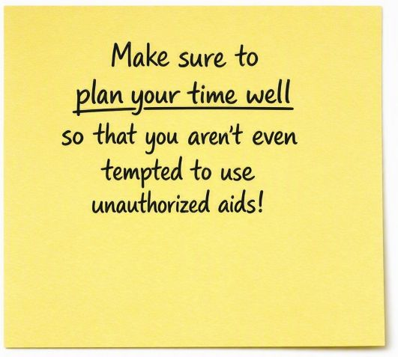
2.4 Accountability: Responsibility in Your Studies (2/2)
(ALLEA, 2023)
Personal Responsibility for your work from the initial idea through to publication:
  Responsibility for carrying out the work (including supervised work)
  Responsibility for the Quality of sources
  Storage and retention of research data
  Transparent documentation of your work steps

Slide 44
2.4 Accountability in Research Projects (1/2)
Responsibility for research participants
  Participation must be voluntary: “Informed consent”
    Full disclosure of the background and purpose of the study, including any deception (at the latest during the debriefing)
    Withdrawal is possible at any time (without giving reasons and/or facing consequences)
  Respect for human dignity
  No discrimination! No danger, no harm, and a commitment to minimizing risk!
  Protection of (vulnerable) individuals/groups who cannot give consent on their own
    The universities’ Ethics Committees assess relevant ethical aspects of research

Slide 45
2.4 Accountability in Research Projects (2/2)
(Kurzmann and Plaschke, 2023; WMA, 2024)
Responsibility for research participants involved in research projects
  Protection of personal data and confidentiality, for example through:
    Pseudonymization (allowing participants to be linked to data) or complete anonymization (preventing participants from being linked to data) of the data
    Separate storage of research data and participant data
    Access rights, encrypted storage
    Training of staff regarding data protection and ethical standards
  Ethics committees assess the ethical acceptability

Slide 46
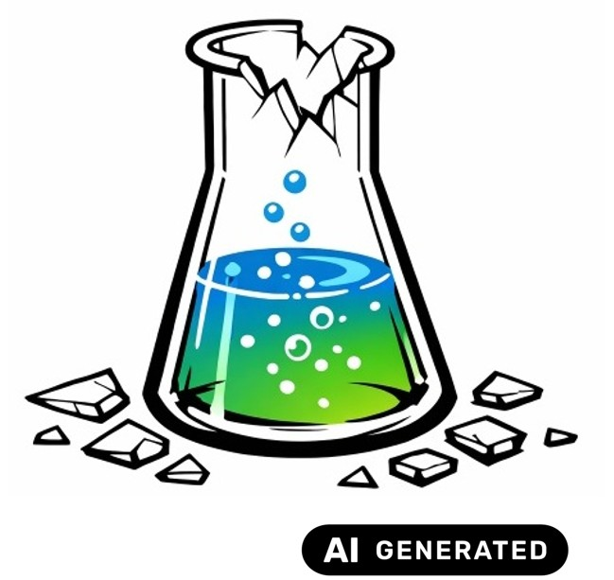
Part 3:
Violations of the GSP and Prevention of Scientific Misconduct
3.1 Definition of Research Misconduct
3.2 Questionable Research Practices
3.3 Research Misconduct: An Example
3.4 Avoiding Academic Misconduct
Fig. 5: Laboratory Glass. Source: Own AI-generated figure, created by the author using the Academic AI Image Generator 25.06.2026

Slide 47
3.1 Definition of Research Misconduct
Violation of the GSP (BMBWF, 2020)
  Generally, anything that does not comply with the GWP
Scientific misconduct HS-QSG, 2024; TU Graz, 2025a; University of Graz, 2023b):
  Applies when there is an intentional or grossly negligent violation of the GSP
    Intentional: A violation of GSP standards is at least considered possible and accepted
    Grossly negligent: A violation of GSP standards resulting from a failure to exercise due care and a failure to recognize that this constitutes a violation of the GSP standards
Both can have significant consequences, depending on the severity of the violation or misconduct!

Slide 48
3.2 Questionable Research Practices (1/3)
(ENAI, 2019; ÖAWI, 2026)
Behaviors that constitute a violation of the GSP, e.g.:
  Distortion of results (e.g., by concealing conflicts of interest or omitting important limitations in a study)
  Selective citation of certain works to please editors or reviewers
  Inclusion of individuals as authors who do not meet the recognized criteria for scientific authorship (e.g., as a favor or solely for proofreading or editing work)

Slide 49
3.2 Questionable Research Practices (2/3)
Side Note on Authorship:
“Authorship is based on (1) significant, scientifically relevant contributions to the design of a research project, data collection and analysis, and/or interpretation, and (2) significant contributions to the drafting of the text. In addition, authors must (3) approve the final version and thereby assume (4) responsibility for the content of the publication (unless—based on a statement by the authors—this responsibility is divided among the co-authors for different sections)” (ÖAWI, 2026, p. 7, transl. by Author).

Slide 50
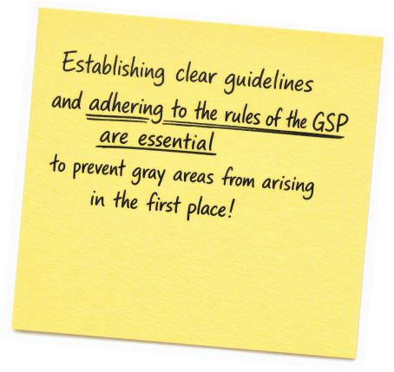
3.2 Questionable Research Practices (3/3)
(BMBWF, 2020; ENAI, 2019; ÖAWI, 2026)
Questionable research practices often do not constitute a direct violation, but they are problematic:
  Hinder the establishment of GSP standards
    Incorrect work practices are increasingly viewed as “normal”
    Gray areas arise
  Distort results
  Erode trust in science

Slide 51
3.3 Research Misconduct: An Example and Its Consequences (1/2)
Compare the two paragraphs below — paraphrase or plagiarism? (Example transl. by Author)
  Original text from 2002:
  The call for a clearer division of responsibilities between the EU and member states or regions is central to all considerations. A catalog of competences—alongside the Charter of Fundamental Rights—“currently represents the concrete expression of the constitutional idea”²⁶⁶.
  [Note: Footnote 266 in the original: Felder/Grunow: “As in ...,” 2001, op. cit., p. 52.].
  Excerpt from a 2006 dissertation:
  The call for a clearer division of responsibilities between the European Union and member states or regions has been, and remains to this day, central to numerous discussions. For many, a catalog of competences—alongside the Charter of Fundamental Rights—represented the concrete embodiment of the constitutional idea.
  [Note: no footnote, no reference to sources used]

Slide 52
3.3 Research Misconduct: An Example and Its Consequences (2/2)
Original text (Volkmann-Schluck, 2002) (all transl. by Author)
  The call for a clearer division of responsibilities between the EU and member states or regions is central to all considerations. A catalog of competences—alongside the Charter of Fundamental Rights—“currently represents the concrete expression of the constitutional idea”²⁶⁶.
Excerpt from the 2006 dissertation of K.-T. zu Guttenberg:
The call for a clearer division of responsibilities between the European Union and member states or regions has been, and remains to this day, central to numerous discussions. For many, a catalog of competences—alongside the Charter of Fundamental Rights—represented the concrete embodiment of the constitutional idea.
Revocation of K.-T. zu Guttenberg’s 2011 dissertation due to the nature (deception) and extent of the plagiarism
Finding of copyright infringements relevant under criminal law!
→ Trigger for increased scrutiny of theses by prominent individuals, especially politicians!

Slide 53
3.4 Avoiding Academic Misconduct: Consequences
(TU Graz, 2025a; University of Graz, 2023c)
Consequences depend on:
  The severity of the misconduct
  The type of work (written exam, thesis, etc.) in which the misconduct occurred
  You will always lose time and forfeit your personal credibility and integrity!
Examples:
  Misconduct during examinations may result in a negative or invalid mark, loss of the right to sit the examination and/or referral to the Dean of Studies
  Serious misconduct (e.g. plagiarism): a negative mark for the work, up to and including exclusion from the degree programme for two semesters
  Revocation of the academic degree if misconduct is established after graduation

Slide 54
3.4 Avoiding Academic Misconduct (1/3)
(BMBWF, 2020; Pears and Shields, 2022; TU Graz, 2025a; University of Graz, 2023c)
Preventing scientific misconduct involves both individual and institutional measures, e.g.:
    Fabrication or falsification of data:
      → Peer review by a team or by individuals familiar with the subject matter
      → Comprehensive documentation of all steps
    Plagiarism:
      → Compliance with citation guidelines
      → Clear distinction between one’s own ideas, assumptions, and findings and those of others
    Unjustified denial of access to original data or its premature deletion
      → Compliance with legal retention and deletion periods, data management plans
      GSP standards: 10-year retention period for research data
54

Slide 55
3.4 Avoiding Academic Misconduct (2/3)
(BMBWF, 2020; ENAI, 2019; TU Graz, 2025a; University of Graz, 2023c)
  Some forms of research misconduct may be prevented at the institutional level through clear rules:
    Obstructing the academic careers of others, particularly early-career researchers
    Neglecting supervisory responsibilities
    Obstructing or sabotaging the research of others
    Aiding and abetting others’ violations or actively participating in others’ violations of the GSP
    → Transparency in communication regarding the institute’s resources and timelines
    → Transparent criteria for authorship
    Providing false information in grant applications
    → Dual-review process during submission
55

Slide 56
3.4 Avoiding Academic Misconduct (3/3)
(Spark at York University, 2013)
  Before submitting a written assignment, ask yourself…
1. Have you written your paper in your own words?
2. Have you read and understood all the sources used in your paper?
3. Have you clearly and correctly cited all the information and sources used, and have you used them appropriately?
4. When incorporating your own previous work (e.g., from other courses), have you also cited yourself?
5. Have you saved previous versions of the paper to be able to prove that it is your own work?

Slide 57
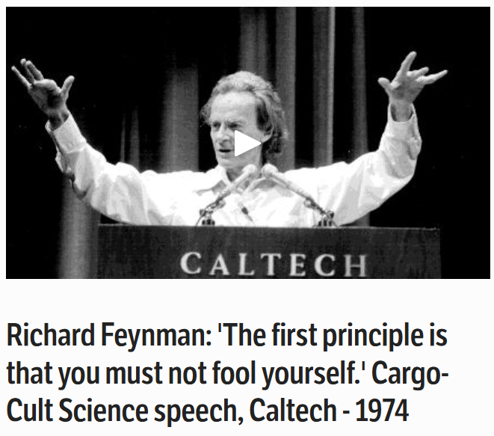
Cargo-Cult Science Speech
(Feynman, 1974)
Message from Richard Feynman:
  Self-deception as a threat to scientific integrity and the quality of research
  Prevention through personal responsibility:
    Hold yourself to the highest standards
    Be honest with yourself
    Critically reflect on your own hypotheses and results
    Actively search for errors or the causes of results
→ Stay curious, (self-)critical, and fair! ;-)
Abb. 8: Screenshot. Speakola Richard Feynman.
57

Slide 58
Part 4: Appendix (1/15)
4.1 Further Information for Students:
  University Regulations
    Bylaws of Satzungsteil Wissenschaftliche und Künstlerische Integrität – 12/2025 and Uni Graz
    AI Guide for Researchers at TU Graz and Uni Graz
      Guideline for the use of Artificial Intelligence (AI)-supported tools in the field of teaching
  Graduation Support TU Graz and Uni Graz
  Plagiarism Check of HTU Graz and ÖH Uni Graz
  Ethics Compass of TU Graz
58

Slide 59
Part 4: Appendix (2/15)
4.1 Further Information for Students:
  Services of Library and Archives
    Library services of TU Graz and Uni Graz
    Relevant Events of the university libraries TU Graz and Uni Graz
    Search Portals TU Graz and Uni Graz
  Overview Reference Management TU Graz and Uni Graz
  Languages, Key Competencies and In-House Training
    Key Competencies for Students
    Support-Webseite an der Uni Graz
  Point of contact for reporting suspected research misconduct: Commission for Scientific Integrity (CSI) TU Graz and Commission for Academic Integrity Uni Graz
59

Slide 60
Part 4: Appendix (3/15)
4.1 Further Information for Students:
  Research Data Management (RDM)
    Guidelines on Safeguarding Good Scientific Practice (GSP)
    § 5 – Preservation of research data
      Work in accordance with legal regulations & ethical standards
      Clear & traceable documentation
      Subject results to critical review
      Public nature of basic research
    Want to know more?
    Contact Data Stewards: https://rdm.tugraz.at, rdmteam@tugraz.at or ub.fdm@uni-graz.at
60

Slide 61
Part 4: Appendix (4/15)
4.1 Further Information for Students:
  Research Data Management (RDM) & FAIR Principles of TU Graz and Uni Graz
    TU Graz RDM Services
  https://rdm.tugraz.at/dashboard Inhouse Training – Course Offer
    Uni Graz RDM-Service
    Secure Data Storage
    TU Graz Cloud and Uni Graz Cloud
    FTP Storage and File Service Uni Graz
    Network Storage
    Digital Documentation & Metadata
    eLabFTW
    GITlab at TU Graz and Uni Graz

Slide 62
Part 4: Appendix(5/15)
4.2 Bibliography
  All European Academies (ALLEA) (2023) Europäischer Verhaltenskodex für wissenschaftliche Integrität - Überarbeitete Fassung 2023. Berlin: ALLEA. Verfügbar unter: https://allea.org/wp-content/uploads/2024/09/CoC2023-German.pdf (Zugriff am 14.06.2024)
  Bundesministerium für Bildung, Wissenschaft und Forschung (BMBWF) (2017) Nationaler Qualifikationsrahmen. Wien: BMBWF. Verfügbar unter: https://www.qualifikationsregister.at (Zugriff am 29.05.2026)
  Bundesministerium für Bildung, Wissenschaft und Forschung (BMBWF) (2019) Nationaler Entwicklungsplan für öffentliche Universitäten 2022–2027. Wien: BMBWF. Verfügbar unter: https://www.bmfwf.gv.at/wissenschaft/hochschulgovernance/steuerungsinstrumente/guep.html#systemziele (Zugriff am 27.04.2026)
  Bundesministerium für Bildung, Wissenschaft und Forschung (BMBWF) (2020) Praxisleitfaden für Integrität und Ethik in der Wissenschaft. Wien: BMBWF. Verfügbar unter: https://oeawi.at/wp-content/uploads/2020/11/Praxisleitfaden-fuer-Integritaet-und-Ethik-in-der-Wissenschaft_Stand_29-9-2020_Final.pdf (Zugriff am 15.04.2025)
  Elmore, S.A. und Weston, E.H. (2020). Predatory Journals: What They Are and How to Avoid Them. Toxicologic Pathology, 48(4), S. 607-610. DOI: 10.1177/0192623320920209.
  European Network for Academic Integrity (ENAI) (2019) General Guidelines for Academic Integrity Report (amended version). Verfügbar unter: https://academicintegrity.eu/wp/wp-content/uploads/2022/04/Guidelines_amended_version_1.1_09_2019.pdf (Zugriff: 14.04.2025)
  Feynman, R. (1974) Cargo Cult Science. Rede an Caltech, 14. Juni 1974. Wiederveröffentlicht auf Speakola. Verfügbar unter: https://speakola.com/grad/richard-feynman-caltech-1974 (Zugriff am 13.05.2026).
  GuttenPlag Wiki (2011): Seite 115. Verfügbar unter: https://guttenplag.fandom.com/de/wiki/Seite_115 (Zugriff am 09.04.2026)
62

Slide 63
Part 4: Appendix(6/15)
4.2 Bibliography
  Hagenström, F. (2022) ‚Plagiate‘ In: K. Frisch, F. Hagenström und N. Reeg (Hrsg.), Wissenschaftliche Fairness. Wissenschaft zwischen Integrität und Fehlverhalten. Bielefeld: transcript. (S. 83–135). Verfügbar unter: https://doi.org/10.14361/9783839459669
Hochschüler*innenschaft der TU Graz (HTU Graz) (2023) Plagiats‑Check / Similarity Check für Studierende. Verfügbar unter: https://htugraz.at/service/plagiats-check (Zugriff am 29.05.2026)
Hochschul‑Qualitätssicherungsgesetz (HS‑QSG) (2024) Bundesgesetz über die Qualitätssicherung in der Hochschulbildung. BGBl. I Nr. 74/2011 idF BGBl. I Nr. 165/2023. Verfügbar unter: https://ris.bka.gv.at/NormDokument.wxe?Abfrage=Bundesnormen&
Gesetzesnummer=20007384&Artikel=&Paragraf=2a&Anlage=&Uebergangsrecht= (Zugriff am 27.04.2026)
Korrektur.de (2026). GuttenPlag-Wiki – die historische Plattform aus 2011. Verfügbar unter: https://korrektur.de/guttenplag-wiki-historie (Zugriff: 24.08.2026).
  Kurzmann, D. und Plaschke, C. (2023) Handbuch Datenschutz. Technische Universität Graz, Qualitätsmanagement, Evaluation & Berichtswesen. Verfügbar unter: https://www.tugraz.at/fileadmin/public/Studierende_und_Bedienstete/Anleitungen
  /Handbuch_Datenschutz_TU_Graz.pdf (Zugriff am 12.08.2026).
  Microsoft: Microsoft Copilot. Online verfügbar unter: https://copilot.microsoft.com (abgerufen am 21.08.2026)
  Österreichische Agentur für wissenschaftliche Integrität (ÖAWI) (2015) Richtlinien zur guten wissenschaftlichen Praxis. Wien. Verfügbar unter: https://oeawi.at/gwp-richtlinien (Zugriff am 27.04.2026)
  Österreichische Agentur für wissenschaftliche Integrität (ÖAWI) (2026). Richtlinie der Österreichischen Agentur für wissenschaftliche Integrität zur guten wissenschaftlichen Praxis. DOI: 10.5281/zenodo.21256974
  Pears, R. und Shields, G. (2023) Cite Them Right: The Essential Referencing Guide. 12th ed. London: Bloomsbury Publishing.
63

Slide 64
Part 4: Appendix (7/15)
4.2 Bibliography
  ÖH Uni Graz (Hochschülerinnen- und Hochschülerschaft (2026) Kostenloser Plagiatscheck für Studierende. Verfügbar unter: https://oehunigraz.at/plagiatssoftware/ (Zugriff am 23.09.2026)
  Sandberg, B. (2012) Wissenschaftlich arbeiten von Abbildung bis Zitat. Ein Lehr- und Übungsbuch für Bachelor, Master und Promotion. München: Oldenbourg.
  Spark at York University (2013) Integrity in practice. Verfügbar unter: https://www.library.yorku.ca/spark/faculty/
  Integrity%20in%20Practice.pdf (Zugriff am 06.03.2026)
  Springer Nature (2026): Author Services. Verfügbar unter: https://authorservices.springernature.com/ (Zugriff am 21.08.2026)
  Technische Universität Graz (TU Graz): AcademicAI. Online verfügbar unter: https://tugraz.academic-ai.at/ (Zugriff am 21.08.2026).
  Technische Universität Graz (TU Graz) (2023b) Kennzeichnung des Einsatzes von Künstlicher Intelligenz. Interne Quelle, Intranet der TU Graz. Verfügbar unter: https://tu4u.tugraz.at/fileadmin/Studierende_und_Bedienstete/
  Information/Unsere_TU_Graz/Lehre_an_der_TU_Graz/Zitiervorschlaege_KI.pdf (Zugriff am 29.05.2026)
  Technische Universität Graz (TU Graz) (2025a) Satzungsteil Wissenschaftliche und Künstlerische Integrität. SA 91000 SWKI 174-01. Verfügbar unter: https://tu4u.tugraz.at/fileadmin/public/Studierende_und_Bedienstete/
  Satzung_und_Geschaeftsordnungen_der_TU_Graz/Satzungsteil_Wissenschaftliche_und_Kuenstlerische_Integritaet.pdf (Zugriff am 29.05.2026)
64

Slide 65
Part 4: Appendix(8/15)
4.2 Bibliography
  Technische Universität Graz (TU Graz) (2025b) SIMILARITY CHECK – Plagiarism check in the TeachCenter. Verfügbar unter: https://teachcenter.tugraz.at (Zugriff am 29.05.2026)
  Universitätsgesetzt (UG) (2002) Universitätsgesetz 2002 - Bundesrecht konsolidiert, Fassung vom 29.05.2026. Verfügbar unter: https://www.ris.bka.gv.at/GeltendeFassung.wxe?Abfrage=Bundesnormen&Gesetzesnummer=20002128 (Zugriff am 29.05.2026)
  Universität Graz (2023a) Orientierungsrahmen zum Umgang mit textgenerierenden KI-Systemen an der Universität Graz. Verfügbar unter https://static.uni-graz.at/fileadmin/_files/_project_sites/_lehren-und-lernen-mit-ki/KI-Orientierungsrahmen
  _230901.pdf (Zugriff am 23.09.2026)
  Universität Graz (2023b) Satzungsteil Grundsätze zur Sicherung guter wissenschaftlicher Praxis und zur Vermeidung von Verletzungen der Pflichten zur wissenschaftlichen Integrität. Verfügbar unter https://mitteilungsblatt.uni-graz.at/de/2023-24/12.c/pdf/ (Zugriff am 23.09.2026)
  Universität Graz (2023c) Studienrechtliche Bestimmungen . Verfügbar unter https://mitteilungsblatt.uni-graz.at/de/2025-26/33.a/pdf/ (Zugriff am 23.09.2026)
  Vandevelde, W. (2025): Predatory and papermill practices in a small predatory journal – A case study involving a journal with links towards Turkey, Pakistan and Iran [OR-17]. Vortrag auf der European Network of Research Integrity Offices (ENRIO) Conference 2025, 23. September 2025. Verfügbar unter: https://event.enrio2025.si/event/files/13/events/program/
  ENRIO2025/admin/export/tex/single/pdf/c9d50a7f-c177-4204-a72a-63c8cddb414e.pdf (Zugriff: 19.08.2026).
65

Slide 66
Part 4: Appendix (9/15)
4.2 Bibliography
  Veit, D. (2022) Die wissenschaftliche Arbeit für Studierende der Ingenieurwissenschaften. München: Carl Hanser Verlag. https://doi.org/10.3139/9783446474659.fm
  Volkmann-Schluck, S. (2002) Die VerfassungsdVolkmann-Schluck, S. (2002) Die Verfassungsdebatte zur Zukunft der Europäischen Union. Hrsg. von C. Giering und I. Müller. München: Centrum für angewandte Politikforschung (C·A·P), Ludwig-Maximilians-Universität München. Verfügbar unter: http://www.cap.uni-muenchen.de/download/2002/2002_wp_eu_verfassung.pdf (Zugriff: 15.04.2026)
  Wikipedia (n.d..) Wikipedia: Citing Wikipedia. Verfügbar unter: https://en.wikipedia.org/wiki/Wikipedia:Citing_Wikipedia (Zugriff: 10.08.2026)
  Wissenschaftsrat (2015) Empfehlungen zu wissenschaftlicher Integrität. Positionspapier (Drs. 4609‑15). Köln. Verfügbar unter: https://www.wissenschaftsrat.de/download/archiv/4609-15.html (Zugriff am 05.05.2026)
  Wrexham University (n.d.) Academic integrity – brief guide for students. Verfügbar unter: https://wrexham.ac.uk/media/
  marketing/quality-and-student-admin-documents/Academic-Integrity-a-brief-guide-for-students.pdf (Zugriff am: 06.03.2026).
66

Slide 67
Part 4: Appendix (10/15)
4.3 List of Figures
  Fig. 1: Magnifying glass (AI-generated image created by the author using the Academic AI Image Generator, June 17, 2026).
  Fig. 2: Work Desk (AI-generated image created by the author using the Academic AI Image Generator, June 25, 2026).
  Fig. 3: Cover: @Springer Publishing, journal *Advanced Composites and Hybrid Materials* (2026). Used as a citation in accordance with § 42f of the German Copyright Act (UrhG); not licensed under CC BY 4.0. Available at: https://link.springer.com/journal/42114 (accessed May 28, 2026)
  Fig. 4: Illustration of plagiarism check. Wikipedia: GuttenPlag Wiki. Available at: https://de.wikipedia.org/wiki/GuttenPlag_Wiki (accessed April 9, 2026)
  Fig. 5: Erlenmeyer flask (original AI-generated image, created with Academic AI Image Generator, June 25, 2026).
  Fig. 6: Screenshot. Speakola Richard Feynman. Speakola (2026). Photo accompanying: Richard Feynman – “Cargo Cult Science” speech, Caltech 1974. Available at: https://speakola.com/grad/richard-feynman-caltech-1974 (Accessed May 13, 2026)

Slide 68
Part 4: Appendix (11/15)
4.4 Licensing
  This set of slides of the staff unit Quality Management, Evaluation and Reporting is licensed under the Creative Commons Attribution 4.0 International (CC BY 4.0) license.
  Unless otherwise noted, this set of slides is licensed under the Creative Commons Attribution 4.0 International (CC BY 4.0) license. This means that the set of slides may be reproduced, distributed, modified, and otherwise used under the terms of the CC BY 4.0 license.
    Terms of Use at https://creativecommons.org/licenses/by/4.0/
  Third-Party Content:
    Illustration, photographs, book covers, logos, and other content accompanied by a separate source or rights notice are not covered by the CC BY 4.0 license. Their use is governed by the respective notices provided. To the extent that such content is used within the scope of the statutory right to quote (§ 42 f UrhG), this is done exclusively for the specific purpose of quotation as stated.

Slide 69
Part 4: Appendix (12/15)
4.5 AI Use
  AI Use in this document
    Text and accessible design:M365 Copilot and GPT-5 were used to correct style, shorten text and ensure accessible design. All decisions regarding content and changes to content, as well as word choice and rewording, were made exclusively by the author.
    Self-generated images and text visualizations were created using Academic AI (Graz University of Technology).
    DeepL (2026) was used to support translation and to check for grammar and style. Changes to the content or phrasing were made exclusively by the author.

Slide 70
Part 4: Appendix (13/15)
4.5 AI Use: Prompts
  Self-generated images were created using Academic AI (TU Graz):
    Academic AI, prompt dated 13 May 2026: “Depict the slogan ‘Every game has rules. Master the rules, win the game!’ as a piece of wall graffiti. Use bright colours. The lettering should be very legible (semi-wildstyle). The lettering should not be on a single line, but should span at least three lines. The graffiti should consist solely of the lettering.” Used to create “Fig. 1: Graffiti”.
    Academic AI, prompt dated 17 June 2026: “Depict, schematically, a sheet of paper with writing on it being examined through a magnifying glass. The characters should only be hinted at; no actual letters should be recognizable.” Used to create “Fig. 2: Magnifying glass”.
    Academic AI, prompt dated 25 June 2026: “Depict a broken, upright laboratory glass or flask. It should be a schematic representation, but the contents of the glass may be coloured. The shards lying around should be similar in size and shape to the broken shards.” Used to create “Fig. 7: Broken laboratory glassware”.

Slide 71
Part 4: Appendix (14/15)
4.5 Use of AI: Prompts
  text visualizations were created using Academic AI (Graz University of Technology).
    Academic AI, prompt dated 15 May 2026: “The image should look like a yellow Post-it note. Write the following text on it in clearly legible handwriting: ‘Academic integrity = attitude’ and, below that, ‘GWP = behaviour!’ The text should be centred and large enough to fill the entire Post-it note.” See slide 12 for a representation of the text on the Post-it note.Academic AI, prompt dated 20 May 2026: “The image should look like a yellow Post-it note. Write the following text on it in clearly legible handwriting: ‘A great many institutions already have detailed guidelines for writing seminar papers and dissertations!’ The text should be large enough to fill the entire Post-it note.” See slide 26 for a visual representation of the text on the Post-it note.
    Academic AI, prompt dated 27 May 2026: “The image should look like a yellow Post-it note. Write the following text on it in clearly legible handwriting: ‘Incomplete or incorrect references may give the impression of deliberate concealment or a lack of diligence!’ Do not underline anything; centre the text.” Display the text on the Post-it note on slide 24.Academic AI, Prompt vom 02.06.2026: „Das Bild soll aussehen wie ein gelbes Post-it. Schreibe in gut leserlicher Handschrift den folgenden Text darauf: „Im Zweifelsfall: Immer die Quelle angeben!“ Bitte unterstreiche nur “Im Zweifelsfall“, zentriere den Text.“ Zur Darstellung des Texts auf dem Post-it auf Folie 23.
    Academic AI, prompt dated 8 June 2026: “The image should look like a yellow Post-it note. Write the following text on it in clearly legible handwriting: ‘Read your department’s guidelines!’ Underline ‘Read’. Display the text on the Post-it note on slide 45.”
    Academic AI, prompt dated 17 June 2026: “The image should look like a yellow Post-it note. Write the following text on it in clearly legible handwriting: ‘Make sure, through good time management, that you are not even tempted to use unauthorised aids!’ Underline ‘not even’.” The text on the Post-it note is shown on slide 46.

Slide 72
Part 4: Appendix (15/15)
Acknowledgements
We acknowledge with thanks the valuable input of:
Martin Ebner, Eva Felber, Maria Haas, Claire Jean-Quartier, Daniel Kurzmann, Christoph Ladurner, Volker Lang, Gerlinde Maxl, Viola Mayerhofer, Verena Schwägerl-Melchior
We acknowledge with thanks for the coordination with NAWI-Graz:
Thomas Schweitzer

Slide 73
Contact:
Graz University of Technology
Quality Management, Evaluation & Reporting
Sigrid Hackl-Wimmer
Rechbauerstraße 12
8010 Graz, Austria
gwp@tugraz.at
www.tugraz.at/go/qm

