Slide 1
Confidence Levels of Performance Map Based Drive Cycle Analysis for Induction Motors
Kourosh Heidarikani
Electric Drives and Power Electronic Systems Institute
Graz University of Technology
22. May 2026

Slide 2





CREATOR Context
CREATOR
Collaborative Research Centre – TRR361/F90:
CREATOR – Computational Electric Machine Laboratory
www.creator.tugraz.at
First German-Austrian Collaborative Research Centre
Overcoming the limits of traditional design and analysis workflows
Four scientific project areas:
Electromagnetics, fluid mechanics, numerics, and optimization
Integrated to address:
  Model consistency and design optimization
  Advanced material modeling and losses
  Data-driven and surrogate modeling with uncertainties
  Multiphysics and thermal design
Project A01
Notes:
CREATOR is a German-Austrian research center focused on advanced computational electric-machine analysis and design.
The overall objective is to improve both modeling accuracy and computational efficiency for modern electric-machine systems.
I will now briefly introduce the motivation behind this work.

Slide 3
Introduction
Introduction
Rising energy demand + CO₂ reduction → shift to electrified transportation
Need for high-efficiency EV powertrains
Traction systems operate across wide, dynamic torque–speed operating points (OPs)
Real operation represented by drive cycles
Drive cycle-based analysis → core for EV motor performance evaluation
Induction motor (IM) in the propulsion systems:
  No rare-earth materials → lower supply chain risk
  Strong robustness under thermal and dynamic loading
  IM selected as industry relevant benchmark for this study
Source: APC, S&P Global, BNEF, Wood Mackenzie, GlobalData, Rho Motion (2025–2026)
Source: APC, S&P Global, BNEF, Rho Motion (2025)
Notes:
Transportation electrification is continuously expanding Unlike conventional industrial drives, EV traction systems operate over highly dynamic and wide torque-speed ranges.
Their real operating behavior is represented through drive cycles
Therefore, drive cycle analysis plays a central role in evaluating electric-machine performance.
Among different machine types, Induction motors are increasingly used in EV propulsion due to their rare-earth-free design, reduced supply-chain dependency, and high robustness under thermal and dynamic loading.
it is seeing growing adoption in future EV platforms can be seen in this trend, showing that around 4 out of 19 million EV motor productions in 2035 are expected to be induction motors.
Therefore, the induction motor was selected as the benchmark machine for this study.”

Slide 4
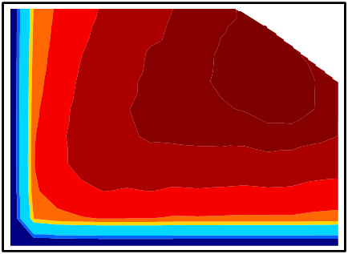


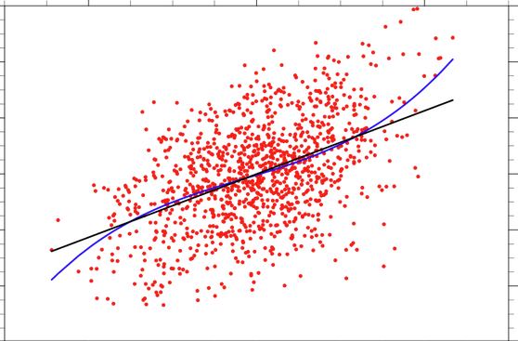
Introduction
Introduction
Existing approaches for drive cycle analysis
Efficiency maps
+ Fast, low cost
- - No transient
2. Time-stepping models
3. Experimental testing
4. Data-driven models
+ High accuracy
+ Consider transient
- High cost
+ Real validation
+ High fidelity
- Time and cost
+ Efficient, fast
- Data-dependent
Laboratory drive cycle emulation:
Full-scale testbeds → costly, bulky, and inflexible
Lab-scale setups → power scaling mismatch with real EV operation
Research gaps:
No systematic comparison of methods
Limited validation under real drive cycles
Uncertainty quantification in efficiency maps
No reliable lab-scale emulation
Notes:
Finally, data-driven approaches offer fast predictions, but they strongly depend on training data
In parallel, laboratory drive-cycle emulation also remains challenging because full-scale EV test benches are expensive and inflexible.
Based on the literature review, several research gaps were identified:
lack of systematic comparison between methods,
limited experimental validation under real drive cycles,
insufficient quantification of interpolation uncertainty,
and limited physically consistent laboratory emulation strategies.
Based on these gaps, the following research questions were formulated.

Slide 5
Research Questions
Introduction
Group 1: Accuracy of methods
RQ1
To what level of confidence can steady-state efficiency maps predict IM drive cycle performance under dynamic conditions, and how does the map derivation methods (analytic, FEA, experimental) affect accuracy?
RQ2
How do grid density, placement, and temperature affect the accuracy and confidence of efficiency maps?
RQ3
How do analytical and FEA time-stepping models compare to experimental drive cycle measurements in accuracy?
RQ4
What factors (e.g., assumptions, simplifications, electro-thermal transients) limit the accuracy of drive cycle analysis?
Group 2: Practical implementation
RQ5
What are the trade-offs between computational cost, accuracy, confidence, and uncertainty in drive cycle analysis methods?
RQ6
How can physically consistent down-scaling methods enable realistic smaller laboratory reproduction of drive cycle torque–speed and transient behavior without high-power test benches?
Notes:
The first group focuses on the accuracy and confidence of efficiency-map-based and time-stepping drive-cycle analysis, including the influence of map generation methods, grid density, temperature, and model assumptions.
The second group focuses on practical implementation aspects, such as the tradeoff between computational cost and accuracy, as well as physically consistent down-scaling methods for laboratory reproduction of real drive-cycle behavior.”

Slide 6
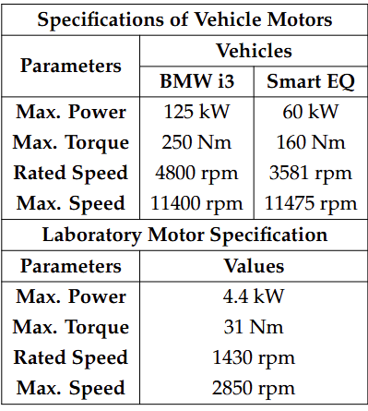
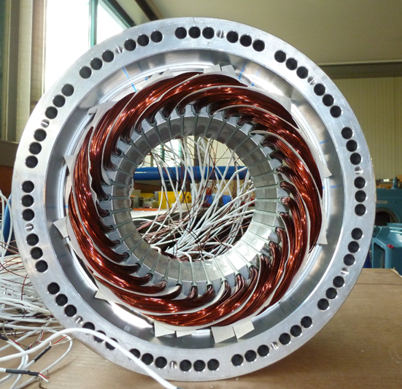
Selected Drive Cycles and Vehicles
Baseline Determination
Three drive cycles: WLTP class 3b, Artemis 130, BCDC
Two vehicles: BMW i3, Smart EQ
  Induction motor in the EALS laboratory
Notes:
As shown, the large rating difference between the EVs and the laboratory motor motivates the application of the down-scaling approach

Slide 7


Down-Scaling
Baseline Determination
Original drive cycle
Quasi-static longitudinal vehicle model
N/A
Ops beyond available motor rating
BMW i3 & Smart EQ
Down-scaling
Down-scaled drive cycle
Quasi-static longitudinal vehicle model
Ops within lab motor rating
BMW i3 & Smart EQ
Notes:
The next slide presents the proposed transient-consistent down-scaling approach

Slide 8
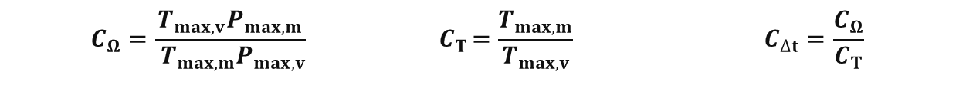
Transient-Consistent Down-Scaling Method
Baseline Determination
Down-scaled drive cycles (with BMW i3)
Proposed down-scaling method flowchart
Two-stage procedure:
  Steady-state: derive vehicle motor OPs → scale to laboratory motor domain → compute speed and torque coefficients → transient behavior not preserved
  Transient: compute time-scaling coefficient → reconstruct scaled drive cycle → apply to QSS model → obtain transient test-bench outputs
  Limitations:
    Thermal scaling
    Limited thermal dynamics
WLTP
Artemis
Speed scaling
Torque scaling
Time scaling
$$C_{Ω}=\frac{T_{max,v}P_{max,m}}{{ T}_{max,m}P_{max,v}} { C}_{T}=\frac{T_{max,m}}{T_{max,v}} C_{∆t}=\frac{C_{Ω}}{C_{T}}$$
BCDC
[1] P. K. Dhakal, K. Heidarikani, et al., “A Study on the Down-Scaling of Transient Drive Cycles for Experimental Analyses With Laboratory Based Small Motors,” IET Electric Power Applications, vol. 20, no. 1, p. e70139, 2026.
Notes:
However, this alone does not preserve transient behavior.
this allowed preservation of:
acceleration behavior, transient operating-point evolution,
“Thermal behaviour cannot be scaled identically, since torque and power scale with machine volume, while heat dissipation scales with surface area. Due to the large thermal mass and lower losses of the laboratory motor, only limited thermal dynamics were observed during the investigated drive cycles.
“With these scaling considerations in mind, the experimental test rig used for the laboratory investigations is introduced next.”

Slide 9
Experimental Framework
Test Rig Setup and Modifications
Test rig of the IM
Rotor field-oriented control (RFOC) for IM
PMSM in torque-control mode as load and driving machine (LDM)
No-load frictional torque test
Distributed temperature sensors
Schematic diagram of the test rig
Frictional torque against speed
Notes:
To experimentally reproduce the drive cycles, the laboratory test rig was modified.
We performed a no-load frictional torque test to model the friction losses as a function of speed, and this model was then integrated into our simulations.

Slide 10
Performance Analysis Methods
Analysis Methodologies and Modeling Setups
Steady-state efficiency map (look-up table, LUT) methods:
  5 grid densities (22, 44, 66, 87, and 113 OPs) × 2 operating conditions
Overall performance analysis framework
Baseline
Direct time-stepping (T-S) approaches:
  Electro-thermal analytic model and direct 2D-magnetic FEA
  Measurements of 2 vehicle-based × 3 down-scaled drive cycles used as benchmark
Performance of methods evaluated using:
  Drive cycle energy efficiency
Individual drive cycle OP efficiencies
Notes:
the main analysis framework can now be introduced.”
So far, the experimental baseline and test operating points have been defined.”
The thesis compares two main categories of performance prediction methods.
All methods were benchmarked against experimentally reproduced down-scaled drive cycles.

Slide 11
Analytic model
Analysis Methodologies and Modeling Setups
ECM of the IM in SRF
Equivalent circuit model (ECM) of the IM built in MATLAB/Simulink
RFOC is used
Coupled electro (ECM)–thermal (LPTN) analysis
All losses are modelled based on experimental tests
Overall analytic model structure
Simple LPTN for the IM
Node | Component
0 | Cooling jacket
1 | Stator yoke
2 | Stator teeth
3 | Stator winding
4 | Rotor
Notes:
“Now, I would like to explain the models used within this framework.”

Slide 12
FEA Model
Analysis Methodologies and Modeling Setups
2D and 3D models developed in JMAG
Mesh sensitivity analysis
Development of an electro-thermal analysis workflow
  Very high computational cost
Electro-thermal analysis workflow
Effect of mesh resolution on accuracy and runtime
2D magnetic model
3D magnetic + thermal model
OP : 15.5 Nm , 1550 rpm, efficiency= 86.26 %

Slide 13




Benchmark and Evaluation Methods
Performance Evaluation and Accuracy Assessment
Time-stepping measurement of the 6 down-scaled drive cycles
Negligible temperature rise due to low thermal utilization of down-scaling
Efficiency plot of the IM Ops during direct measurement
Temperature rise profile during WLTP (with BMW i3)
WLTP (with BMW i3)
Artemis (with BMW i3)
BCDC (with BMW i3)
Temperature rise in K
Evaluation metrics
Drive cycle output and input energy evolution (WLTP)
  Drive cycle energy conversion efficiency (loss)
$$η_{ec}=\frac{W_{out}}{W_{in}} ×100\%$$
$${W_{loss}=W}_{in}−W_{out}$$
  Mean absolute efficiency error (MAE per OP)
$$MAE= \frac{1}{N}\sum_{i=1}^{N}{\left|A_{i}−F_{i}\right|}$$
Cumulative energy in kJ
Notes:
the measured time-stepping approach is first established as the reference benchmark.”
The distribution of efficiency across the drive cycles also reflects the nature of each profile
In addition, the thermal behavior during the measurements was monitored using distributed temperature sensing.
As shown in the upper-right figure, only a relatively small temperature rise was observed.
This is mainly because the down-scaling framework preserves electromechanical dynamics, while the thermal utilization remains relatively low compared to full-scale EV operation.
For the evaluation itself, two main metrics were used.
First, the drive-cycle energy conversion efficiency, which compares total output energy to input energy over the complete cycle.
Second, the mean absolute efficiency error, or MAE, which evaluates the average operating-point efficiency deviation relative to the experimental benchmark.
Finally, the lower-right figure illustrates the cumulative input and output energy evolution during the WLTP cycle, where the difference between both curves represents the total loss energy.

Slide 14
Time-Stepping (Direct) Methods
Performance Evaluation and Accuracy Assessment
Efficiency plots of the IM Ops (WLTP, BMW i3)
Absolute OP efficiency difference (WLTP, BMW i3)
Analytic
FEA
Analytic
FEA
Drive cycle energy conversion efficiency of T-S methods
Loss energy analysis of T-S methods
Method | BMW i3 |  |  | Smart EQ
 | WLTP | Artemis | BCDC | WLTP | Artemis | BCDC
Analytic | 52.7 % | 69.3 % | 29.3 % | 57.5 % | 73.0 % | 37.3 %
FEA | 55.2 % | 71.8 % | 32.4 % | 62.0 % | 73.5 % | 40.5 %
Experiment | 52.5 % | 70.6 % | 28.4 % | 58.2 % | 73.6% | 37.8 %
Notes:
“With the evaluation framework now defined, I will begin with the first main method.”
First, the direct time-stepping approaches were evaluated.
Overall, both approaches reproduce the general efficiency behavior reasonably well.
The lower-right figure compares the total loss energies.
Overall, the analytical model reproduced the experimental losses more accurately than the direct FEA workflow.
The larger errors in this region are caused by the high sensitivity of the power flow at very low mechanical power levels. Since the losses are comparable to the output power, even small loss estimation errors can make the efficiency physically undefined and force it to zero, leading to large deviations from the experimental results.
Transition:
To better understand these differences, the overall error behavior and computational cost were analyzed in more detail.

Slide 15
Time-Stepping (Direct) Methods
Performance Evaluation and Accuracy Assessment
Mean absolute efficiency error of T-S methods
Analytic T-S → higher accuracy in both metrics.
Analytic loss error → friction loss instability
Direct FEA loss underestimation → iron loss modeling and friction loss uncertainties
Largest deviations area → negative torque and low-speed/high negative torque regions
Analytic T-S computationally efficient; direct FEA computationally expensive
T-S methods: computational time vs. overall error
Method | Drive cycle | Computational time | Average energy efficiency difference | Average MAE
Analytic | WLTP | 8 min | 0.68 % | 1.18 %
 | Artemis | 4 min
 | BCDC | 7 min
FEA | WLTP | ~ 24 hours | 2.40 % | 2.68 %
 | Artemis | ~ 15 hours
 | BCDC | ~ 22 hours
[1] K. Heidarikani et al., “Comparative Study of Steady-State Efficiency Maps and Time-Stepping Methods for Induction Motor Drive Cycle Performance Analysis,” Energies, vol. 18, no. 22, p. 5928, Nov. 2025
Notes:
Finally, computational cost differed dramatically between both methods.
Computationally, the difference was substantial.
The analytical model required only several minutes per drive cycle, whereas direct FEA required approximately:15 to 24 hours.Therefore, although direct FEA provides higher physical fidelity, the analytical time-stepping approach offered the best balance between:prediction accuracy,robustness,and computational efficiency.

Slide 16
Steady-State Approaches
Performance Evaluation and Accuracy Assessment
Drive cycle OPs
Grid points
Drive cycle OPs efficiency plots
Efficiency maps
Analytical
FEA
Experimental
Interpolation

Slide 17
Steady-State Approaches
Performance Evaluation and Accuracy Assessment
Loss energy analysis of LUT-based methods (with Smart EQ)
Effect of grid density
BCDC loss underestimation
Analytic
FEA
Experiment
Drive cycle energy efficiency of LUT-based methods (with Smart EQ)
Notes:
Here, I compare different steady-state LUT-based approaches for drive-cycle prediction using different grid densities, from g1 to g5.
Loss prediction accuracy strongly depends on grid resolution for all LUT-based methods.
No LUT-based method consistently outperforms the others for all drive cycles, although the analytic and FEA-based LUT approaches generally achieve better accuracy at moderate and high grid densities.
To better understand these differences, the characteristics of the individual drive cycles are analyzed in more detail.”
For most cases, all LUT-based methods underestimate the BCDC drive cycle losses due to its strong stop-and-go behavior and transient effects, which cannot be fully captured by steady-state efficiency maps.

Slide 18
Steady-State Approaches
Performance Evaluation and Accuracy Assessment
Trade-off analysis of grid size, runtime, and MAE
Optimal grid density exists for evenly spaced grids
LUT-based methods’ accuracy→ dependent on grid density and interpolation
FEA LUT-based → lowest average MAE; experimental LUT → largest deviations
Analytic LUT-based→ fastest method with accuracy comparable to FEA
Largest deviations → low-torque and generating regions
FEA- Smart EQ
WLTP
Artemis
BCDC
Experimental- Smart EQ
Average MAE of OP efficiency in steady-state methods
WLTP
Method | Grid |  |  |  |  | Average
 | g1 | g2 | g3 | g4 | g5
Analytic | 5.45% | 3.98% | 3.11% | 3.13% | 2.45% | 3.62%
FEA | 5.01% | 3.73% | 2.91% | 3.04% | 2.4% | 3.41%
Experiment | 6.19% | 4.43% | 3.44% | 4.12% | 3.4% | 4.31%
Artemis
BCDC
[1] K. Heidarikani et al., “Comparative Study of Steady-State Efficiency Maps and Time-Stepping Methods for Induction Motor Drive Cycle Performance Analysis,” Energies, vol. 18, no. 22, p. 5928, Nov. 2025
Notes:
These results suggest that an optimal grid density exists, beyond which further refinement does not necessarily improve accuracy and may even introduce local artifacts.
Based on these observation we can summarizes the main findings of the steady-state LUT-based approaches.
Among the investigated approaches, the FEA-based LUT achieved the lowest average MAE, while the experimental LUT showed the largest deviations. However, the analytic LUT was the fastest method and still provided an accuracy comparable to FEA
low-torque and generating regions due to interpolation, power-flow sensitivity, and loss-modeling uncertainties

Slide 19
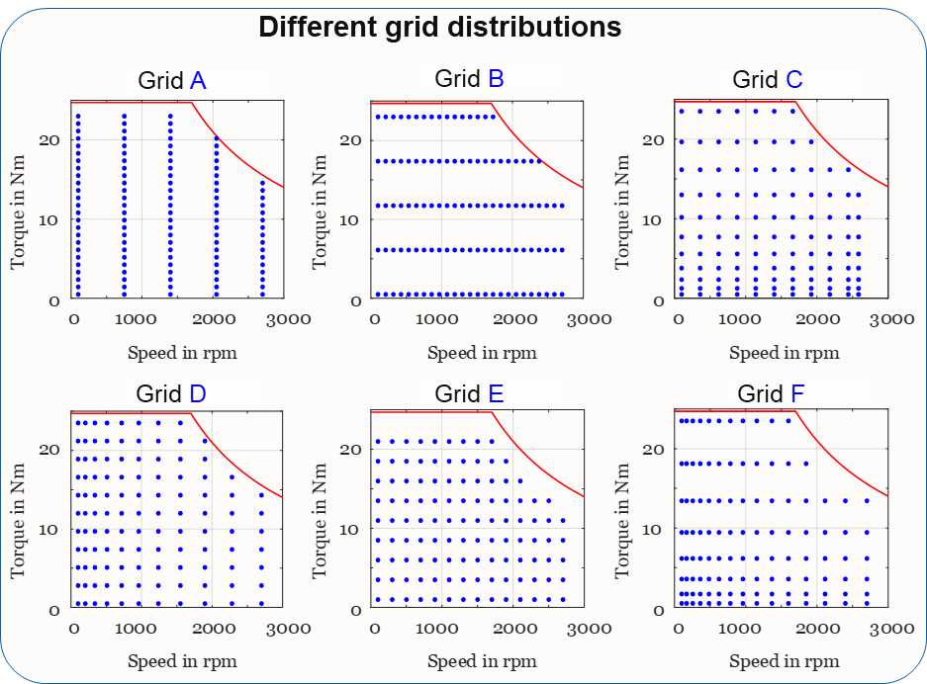
Factors Influencing Efficiency Maps
Performance Evaluation and Accuracy Assessment
Grid distribution
  6 different grid distributions with “g5” grid size
  MAE variation → up to threefold
  Drive cycle energy efficiency variation → up to 25%
  Efficiency variation →very high in low torque regions
Examples of grid distributions
Grid B
Grid C
Grid F
Contour plots of the IM efficiency gradient
Quantification of interpolation effects
(Example: BMW i3-based drive cycles)
Notes:
After analyzing the steady-state methods themselves, the next step is to investigate the factors influencing the efficiency maps.

Slide 20
Factors Influencing Efficiency Maps
Performance Evaluation and Accuracy Assessment
  Measured vs. reference torques for grid “g5”
Reference and measured torque misalignment
Average torque mismatch → ΔT_{rms} ≈ 0.51 Nm
Efficiency maps deviations:
  Experiment vs FEA → 4.22 %
  Experiment vs analytical → 4.32 %
  Analytical vs FEA → 0.45 %
  Largest deviations occur in low-torque regions
    high efficiency sensitivity and interpolation effects
  Efficiency maps from grid “g5”
  Efficiency map differences (grid “g5” )
Experiment
FEA
Analytic
Analytic-Experiment
FEA-Experiment
Analytic-FEA
Notes:
this misalignments directly propagate into the resulting efficiency maps and amplify interpolation errors, As a result, this method exhibits larger efficiency-map deviations compared to other methods.

Slide 21
Factors Influencing Efficiency Maps
Performance Evaluation and Accuracy Assessment
  Efficiency maps of different temperatures
Temperature effect
Performance evaluation at 20°C, 60°C, and 100°C
Efficiency degradation → effect on copper and rotor cage losses
Highest MAE at 100°C → largest thermal mismatch with experimental condition (~30°C)
20 °C
  MAE of OP efficiencies for the analytic method
100 °C
Notes:
Temperature effects were also investigated using maps generated at different temperatures.
Increasing temperature reduced efficiency mainly due to increased copper and rotor losses.
The largest deviations occurred at 100 degrees because this condition differed most strongly from the experimental operating temperature.

Slide 22
Accuracy-Cost Trade-off and Method Selection
Performance Evaluation and Accuracy Assessment
Interpolation errors → dominant source of inaccuracy in LUT-based methods
Friction and iron-loss modeling → main factors in analytic and FEA methods
Takeaway
Well-designed analytical LUTs offer a strong balance between computational efficiency and prediction accuracy.
Computational time vs. overall error of all methods
Method | Computational time | Average energy efficiency difference | Average MAE
Analytic T-S | ~4 - 8 mins | 0.68 % | 1.18 %
Direct FEA | ~ 15 - 24 hours | 2.40 % | 2.68 %
LUT-based analytic | ~ 8 - 38 s for all grids | 1.09 - 3.64 % | 2.45 - 5.45 %
LUT-based FEA | 21 - 98 mins for all grids | 0.89 – 2.88 % | 2.40 - 5.01 %
LUT-based experiment | 24.5 - 133.5 for all grids | 2.66 – 5.14 % | 3.44 – 6.19 %
RQ5
What are the trade-offs between computational cost, accuracy, confidence, and uncertainty in drive cycle analysis methods?
Notes:
Finally, the thesis systematically quantified the trade-off between:
accuracy, confidence, and computational effort.
The results showed that:
interpolation dominates LUT uncertainty,
while friction and iron-loss modeling dominate direct-method accuracy.
Overall,, analytical time-stepping provided the highest predictive reliability.
However, optimized analytical LUTs achieved a very strong balance between:
computational efficiency,
and prediction accuracy.
from this work, it can be concluded that…

Slide 23
Conclusion
Conclusion
Down-scaling framework:
  Preserved realistic drive cycle torque–speed dynamics
  Thermal scaling remains limited → future work on temperature scaling (phase 2)
Time-stepping approaches:
  Analytic time-stepping → best balance of accuracy and cost
  Direct FEA → highest fidelity, but high deviation and computational cost.
Steady-state efficiency maps:
  Prediction accuracy → dependent on grid density, OP placement, and loss models
  Optimal grid density and grid distribution and temperature effects
  Experimental LUTs → larger deviations due to OP misalignment
Accuracy limitation factors:
  LUT methods → mainly limited by interpolation errors
  All modelling approaches → affected by loss modelling (iron and friction losses)
  Other factors → control method, mesh resolutions, and temperature effect
Accuracy–cost trade-off
  Optimized analytic LUTs → best compromise between accuracy and cost
RQ6
How can physically consistent down-scaling methods enable realistic smaller laboratory reproduction of drive cycle torque–speed and transient behavior without high-power test benches?
RQ3
RQ1
How do analytical and FEA time-stepping models compare to experimental drive cycle measurements in accuracy?
To what level of confidence can steady-state efficiency maps predict IM drive cycle performance under dynamic conditions, and how does the map derivation methods (analytical, FEA, experimental) affect accuracy?
RQ2
RQ4
How do grid density, placement, and temperature affect the accuracy and confidence of efficiency maps?
What factors (e.g., assumptions, simplifications, electro-thermal transients) limit the accuracy of drive cycle analysis?
RQ5
What are the trade-offs between computational cost, accuracy, confidence, and uncertainty in drive cycle analysis methods?
4
1
2
4
5
2
3
5
6
1
3
6
RQ1 | RQ2 | RQ3 | RQ4 | RQ5 | RQ6
Notes:
In conclusion, this thesis established a confidence-oriented framework for induction-motor drive-cycle analysis.

Slide 24
References
Referfences
[1] K. Heidarikani, P. K. Dhakal, R. Seebacher, and A. Muetze, “Comparative Study of Steady-State Efficiency Maps and Time-Stepping Methods for Induction Motor Drive Cycle Performance Analysis,” Energies, vol. 18, no. 22, p. 5928, Nov. 2025.
[2] A. Muetze, K. Heidarikani, P. K. Dhakal, R. Seebacher, and S. Schöps, “‘CREATOR case’: PMSM and IM electric machine data for validation and benchmarking of simulation and modeling approaches,” COMPEL, vol. 44, no. 4, pp. 392–410, Mar. 2025.
[3] K. Heidarikani, P. K. Dhakal, A. Muetze, and R. Seebacher, “CREATOR Case: Induction Motor Data.” Graz University of Technology, Nov. 2024. doi: https://doi.org/10.3217/kh3v7-dhn98
[4] K. Heidarikani, P. K. Dhakal, R. Seebacher, and A. Muetze, “Quantification of Steady-State Efficiency Maps and Time-Stepping Solutions for Drive Cycle Performance Analysis of Induction Motors,” in 2024 27th International Conference on Electrical Machines and Systems (ICEMS), Fukuoka, Japan, Nov. 2024, pp. 1–6.
[5] K. Heidarikani, P. K. Dhakal, R. Seebacher, and A. Muetze, “Baseline Determination for Drive Cycle Performance Analysis of Induction Motors,” in 2023 IEEE Transportation Electrification Conference and Expo, Asia-Pacific (ITEC Asia-Pacific), Chiang Mai, Thailand, Nov. 2023, pp. 1–6.
[6] P. K. Dhakal, K. Heidarikani, R. Seebacher, and A. Muetze, “A Study on the Down-Scaling of Transient Drive Cycles for Experimental Analyses With Laboratory Based Small Motors,” IET Electric Power Applications, vol. 20, no. 1, p. e70139, 2026
[7] P. K. Dhakal, K. Heidarikani, R. Seebacher, and A. Muetze, “A Comparative Study on Drive Cycle Performance of Laboratory PMSMs Using Efficiency Maps and Time-Stepping Approaches,” Energies, vol. 18, no. 21, p. 5802, Nov. 2025.
[8] P. K. Dhakal, R. Seebacher, K. Heidarikani, and A. Muetze, “Active Damping Method for Drive Cycle Testing of Small Laboratory PMSMs,” in 2025 ECCE, Oct. 2025, pp. 1–7.
[9] P. K. Dhakal, K. Heidarikani, A. Muetze, and R. Seebacher, “CREATOR Case: Permanent Magnet Synchronous Motor Data.” Graz University of Technology, Nov. 2024. doi: 10.3217/sns1d-77m43.
[10] P. K. Dhakal, K. Heidarikani, R. Seebacher, and , A. Muetze,. "Efficiency Map Versus Time-Stepping Solutions for Drive Cycle Performance Analysis of Permanent Magnet Synchronous Motors." In 2024 27th International Conference on Electrical Machines and Systems (ICEMS), pp. 336-340. IEEE, 2024.
[11] P. K. Dhakal, K. Heidarikani, R. Seebacher, and , A. Muetze,. "Baseline Determination for Drive Cycle Performance Analysis of Permanent Magnet Synchronous Motors." In 2023 IEEE Transportation Electrification Conference and Expo, Asia-Pacific (ITEC Asia-Pacific), pp. 1-6. IEEE, 2023.
[12] P.K. Dhakal, K. Heidarikani, and A. Muetze, ‘Down-scaling of Drive Cycles for Experimental Drive Cycle Analyses’, in 12th International Conference on Power Electronics, Machines and Drives (PEMD 2023), Brussels, Belgium, Oct. 2023.
[13] K. Heidarikani, P. K. Dhakal, R. Seebacher, and , A. Muetze. "MULTI-PHYSICS DRIVE CYCLE PERFORMANCE COMPUTATION OF ELECTRIC MACHINES USING FEA." Authorea Preprints (2025).
[14] K. Heidarikani, P. K. Dhakal, R. Seebacher, and A. Muetze, “Model-Based and Experimental Analysis of Drive Cycle Performance Using Small Laboratory Motors,” IET Electric Power Applications, under review.
Notes:
Thank you very much for your attention throughout this presentation and again for attending my dissertation defense today.

Slide 25
Thank you for your attention!

Slide 26





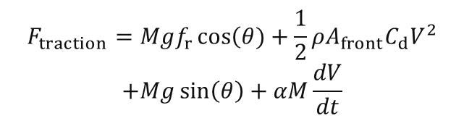
QSS Model
$$F_{traction}=F_{rolling}+F_{aero}+F_{grade}+F_{accel}$$
$$T_{wheel}=F_{traction}×r_{wheel}$$
$$T_{motor}=\frac{T_{wheel}}{i}$$
$$F_{traction}=Mgf_{r}\cos\left(θ\right.)+\frac{1}{2}ρA_{front}C_{d}V^{2}$$
$$+Mg\sin\left(θ\right)+αM\frac{dV}{dt}$$
$$ω_{wheel}=\frac{υ}{r_{wheel}}$$
$$ω_{motor}=i×ω_{wheel}$$

Slide 27




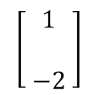
Dimensionless method
  Utilize the steady-state variables (P_{max}, T_{max}).
  Consider the system parameters N(T, Ω) and physical dimensions M(length, mass, time) to describe the system parameters. T [m²kgs⁻²], Ω [s⁻¹], P [m²kgs⁻³].
  [m²] and [kg] are combined into a single composite dimension [m²kg] resulting M=2 dimensions.
  Formation of π groups: Q = N + S – M = 2 + 2 - 2 = 2.
 | T | Ω | T_{max} | P­_{max}
m² kg | 1 | 0 | 1 | 1
s | -2 | -1 | -2 | -3
π_{1,mop} | 1 | 0 | -1 | 0
π_{2,mop} | 0 | 1 | 1 | -1
 | Another parameter | Repeating Parameters
Dimensions | B_{D} | A_{D}
π-groups | I | C_{π}
$$T=\left[\begin{aligned}m^{2}kg \\ \\ s^{−2}\end{aligned}\right]$$
$$\left[\begin{aligned}1 \\ \\ −2 \end{aligned}\right]$$
${\text{π}}_{1,mop,m}={\text{π}}_{1,mop,v}⟹\frac{T_{m}}{T_{max,m}}=\frac{T_{v}}{T_{max,v}}⟹T_{m}=T_{v}\frac{T_{max,m}}{T_{max,v}}$
$$C_{T}$$
${\text{π}}_{2,mop,m}={\text{π}}_{2,mop,v}$ $⟹\frac{{ Ω_{m}T}_{max,m}}{P_{max,m}}=\frac{{Ω_{v}T}_{max,v}}{P_{max,v}}⟹Ω_{m}=Ω_{v}\frac{T_{max,v}P_{max,m}}{{ T}_{max,m}P_{max,v}}$
$$C_{Ω}$$

Slide 28
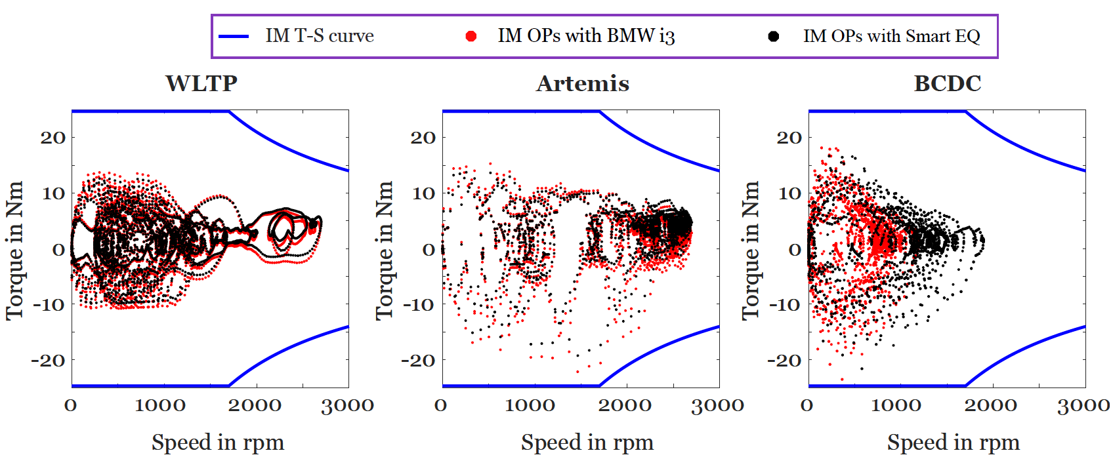
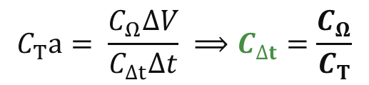

Transient Down-Scaling Method
  T_{accel} is the dominating output torque from the quasi-static vehicle model.
  Root-mean squared error of ΔT_{rms} between T_{m.s-s} and T_{m.tr} (0.016, 0.009, 0.02)
$$T_{accel}=αM\frac{dV}{dt}r_{wheel}$$
$$C_{T}a= \frac{C_{Ω}∆V}{C_{∆t}∆t} ⟹C_{∆t}=\frac{C_{Ω}}{C_{T}}$$

Slide 29
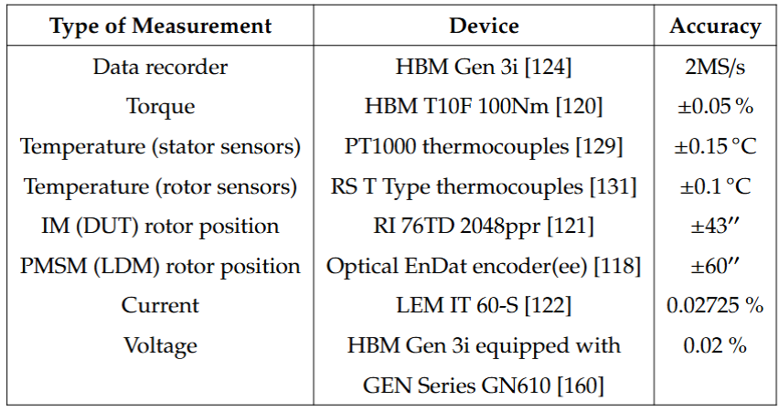
Measurement Devices

Slide 30
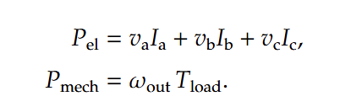
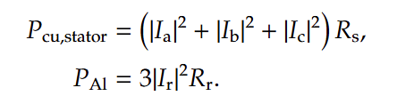

ECM in MATLAB

Slide 31
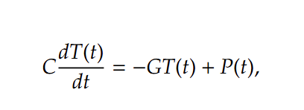
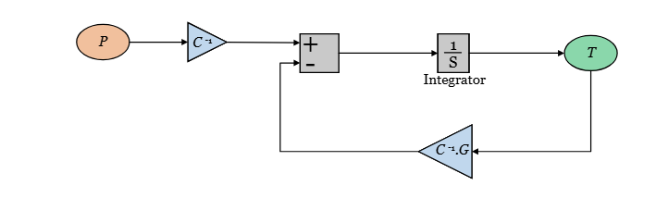
Transient LPTN
Temperature rise in ECM-LPTN model (WLTP, BMW i3)
Temperature difference with measurement (WLTP, BMW i3)

Slide 32
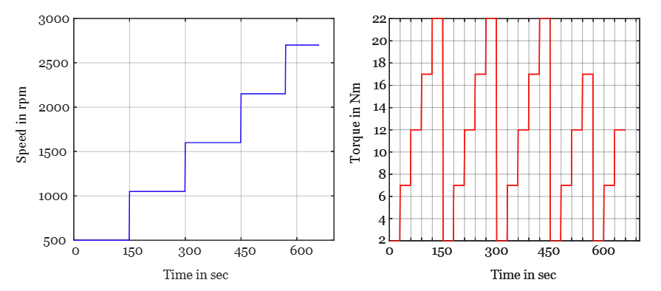
Analytic S-S Simulation

Slide 33
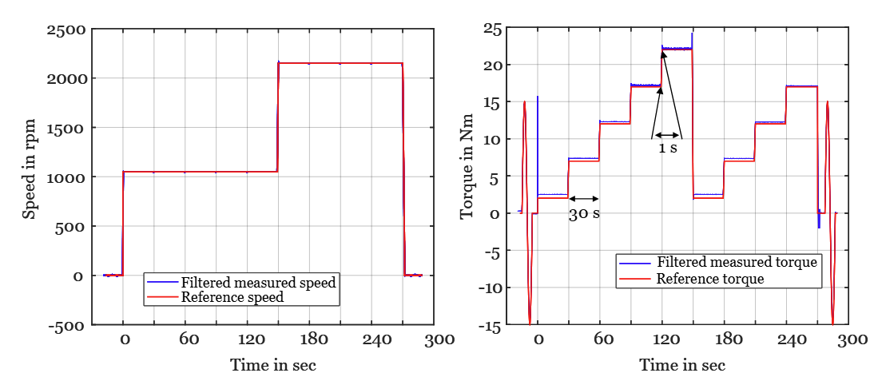
Experimental S-S Simulation

Slide 34
Experimental WLTP Example

Slide 35
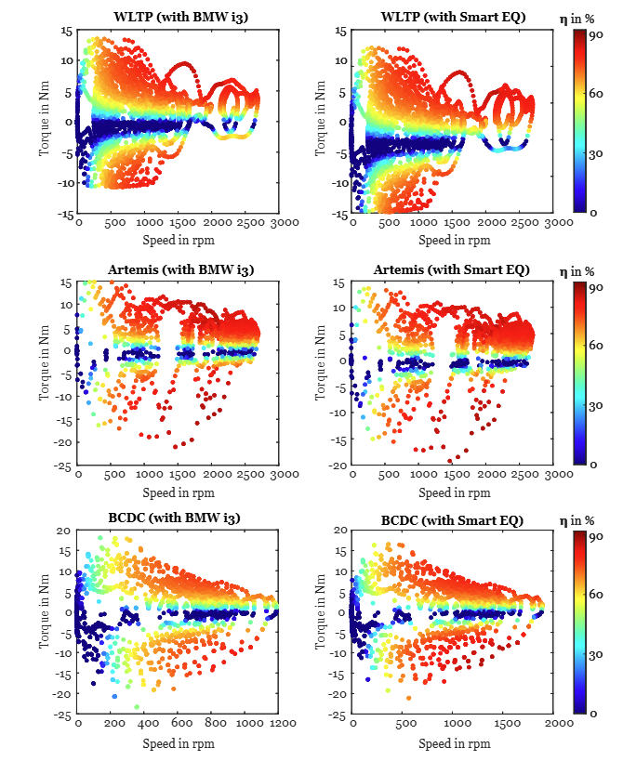
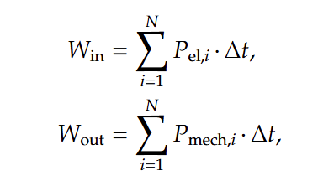
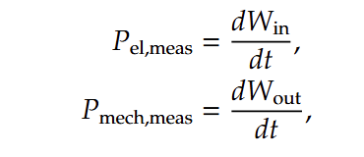
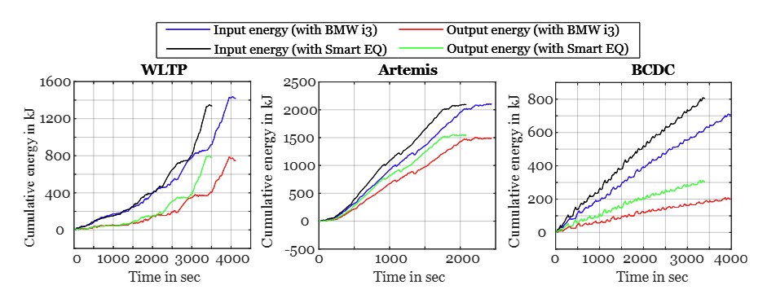
Experimental benchmark

Slide 36
Experimental Temperature

Slide 37
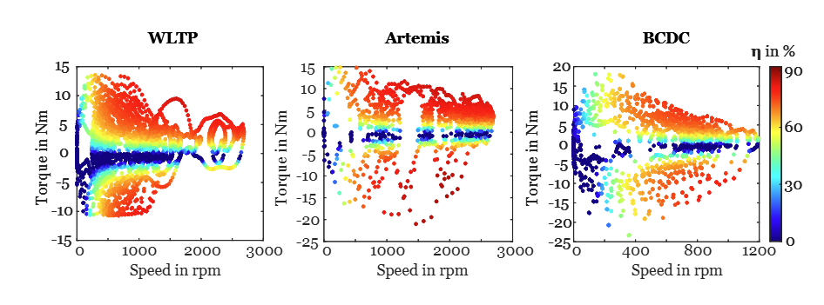
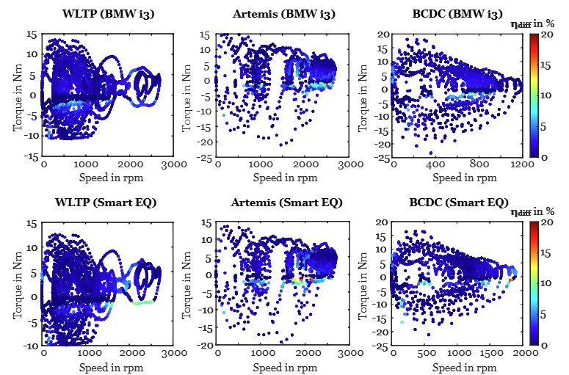
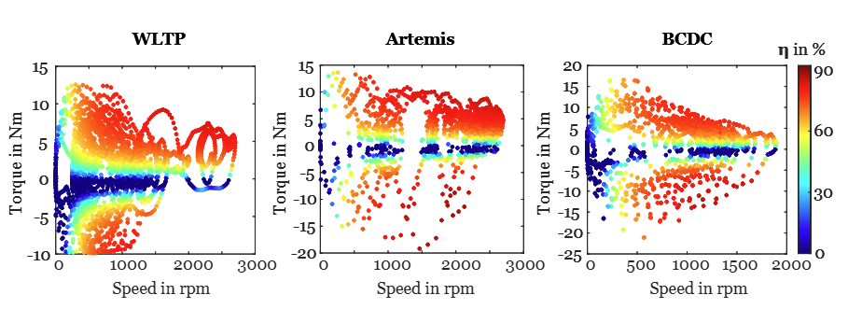
Analytic T-S

Slide 38
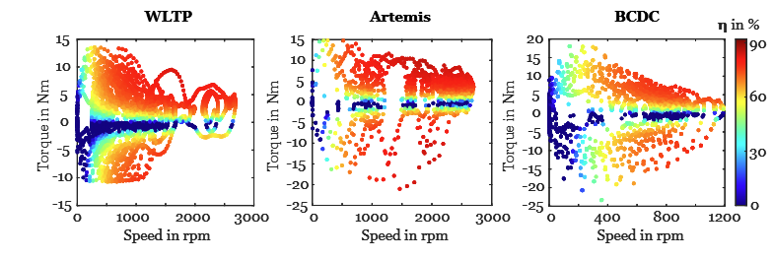
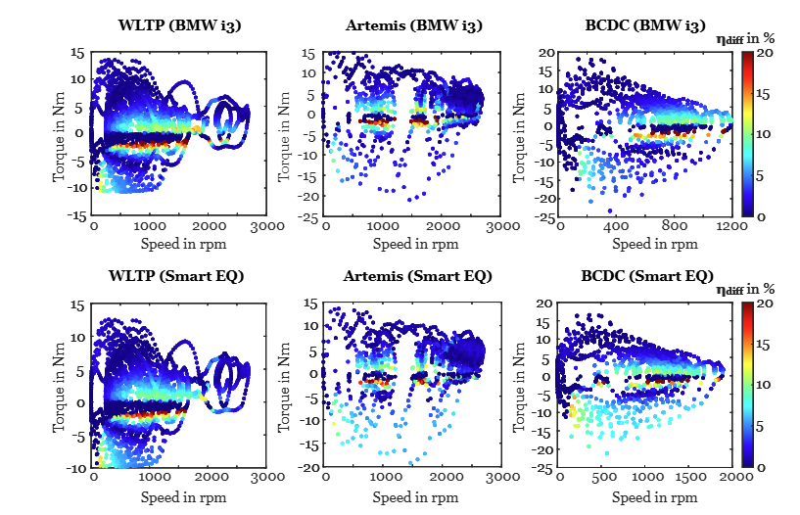
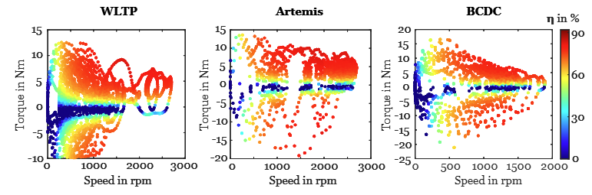
Direct FEA

Slide 39
Analysis of Harmonic Losses

Slide 40
Accuracy-Cost Trade-off

